Slide 1
ECE
M#4
Course 4.1
Fundamental Movement Skills
M#4 Fundamental Movement Skills, Play and
Motor Skill Assessment

Slide 2
Technical sheet
Project: Education for Physical Activity and Sport: Informal and Non-formal Settings
Authors: EduPASS Project Partners
Intellectual Property Statement: The following slides were presented by Dr. Biljana Popeska (University of Luxembourg) during the EduPASS LTT events. They are shared here as a resource to be adapted in respective contexts, where Dr. Biljana Popeska’s/ University of Luxembourg’s intellectual property should be acknowledged if their slides are used.
For further information on the EduPASS Project please follow the link:
Website https://edupass-project.eu/
This work is licensed under the Creative Commons Attribution 4.0 International
License http://creativecommons.org/licenses/by/4.0/

Slide 3
Overview
Overview of Fundamental Movement Skills
Importance of Fundamental Movement Skills for child motor development

Slide 4
WHAT ARE FUNDAMENTAL MOVEMENT SKILLS?
All the movements that children and adults do every day are named FUNDAMENTAL MOVEMENTS. This includes movement such as: walking, running, jogging, hopping, bending, rotating, balancing, turning, skipping etc.
FUNDAMENTAL MOVEMENT SKILLS (FMS) refer to the basic movement patterns that are fundaments for other more specific and complex movements and elements from different sports (Jurimae & Jurimae, 2001).
Fundamental movement skills (FMS) are traditionally associated with the physical development of the human body. They are known as the ‘building blocks’ or foundational skills, foundation movements that are needed to support the development of more complex skills that a child or person will need throughout their life. These are the fine and gross movement skills that are fundamental to human movement.

Slide 5
WHAT ARE FUNDAMENTAL MOVEMENT SKILLS?
WHY ARE THEY IMPORTANT?
They give us the possibility to move from one place to another, to do different activities and sports; to do all everyday activities
FMS are the essence of human movement. Different fundamental movements are combined and are bases of all sports (For example: handball includes running, jumping, pivoting, throwing and catching the ball, striking etc)
FMS AND SPORTS SKILLS – SAME OR DIFFERENT?
FMS are different from sports skills. FMS are needed to develop sports skills.
Well-developed FMS are needed for developing more complex and specialized skills as elements from different sports. In fact, elements from different sports are combinations of different fundamental movement skills.
FUNDAMENTAL MOVEMENT SKILLS

Slide 6
WHAT ARE FUNDAMENTAL MOVEMENT SKILLS?
There is a wide range of fundamental movement skills, but in general, they are divided into three main categories:
locomotor skills
manipulative skills and
Non–locomotor skills
Locomotor skills - skills that allow the body to move from one place to another on different ways, using hands and foot as support.
Manipulative skills - are skills related to the manipulation with objects using hand, foot, or other object and maintaining control of different objects. Manipulative skills include catching and throwing objects and launching objects.
Non–locomotor skills - movements that are performed in place around the vertical axis of the body (spine) and are performed with different body part or the whole body without moving the body in the space

Slide 7
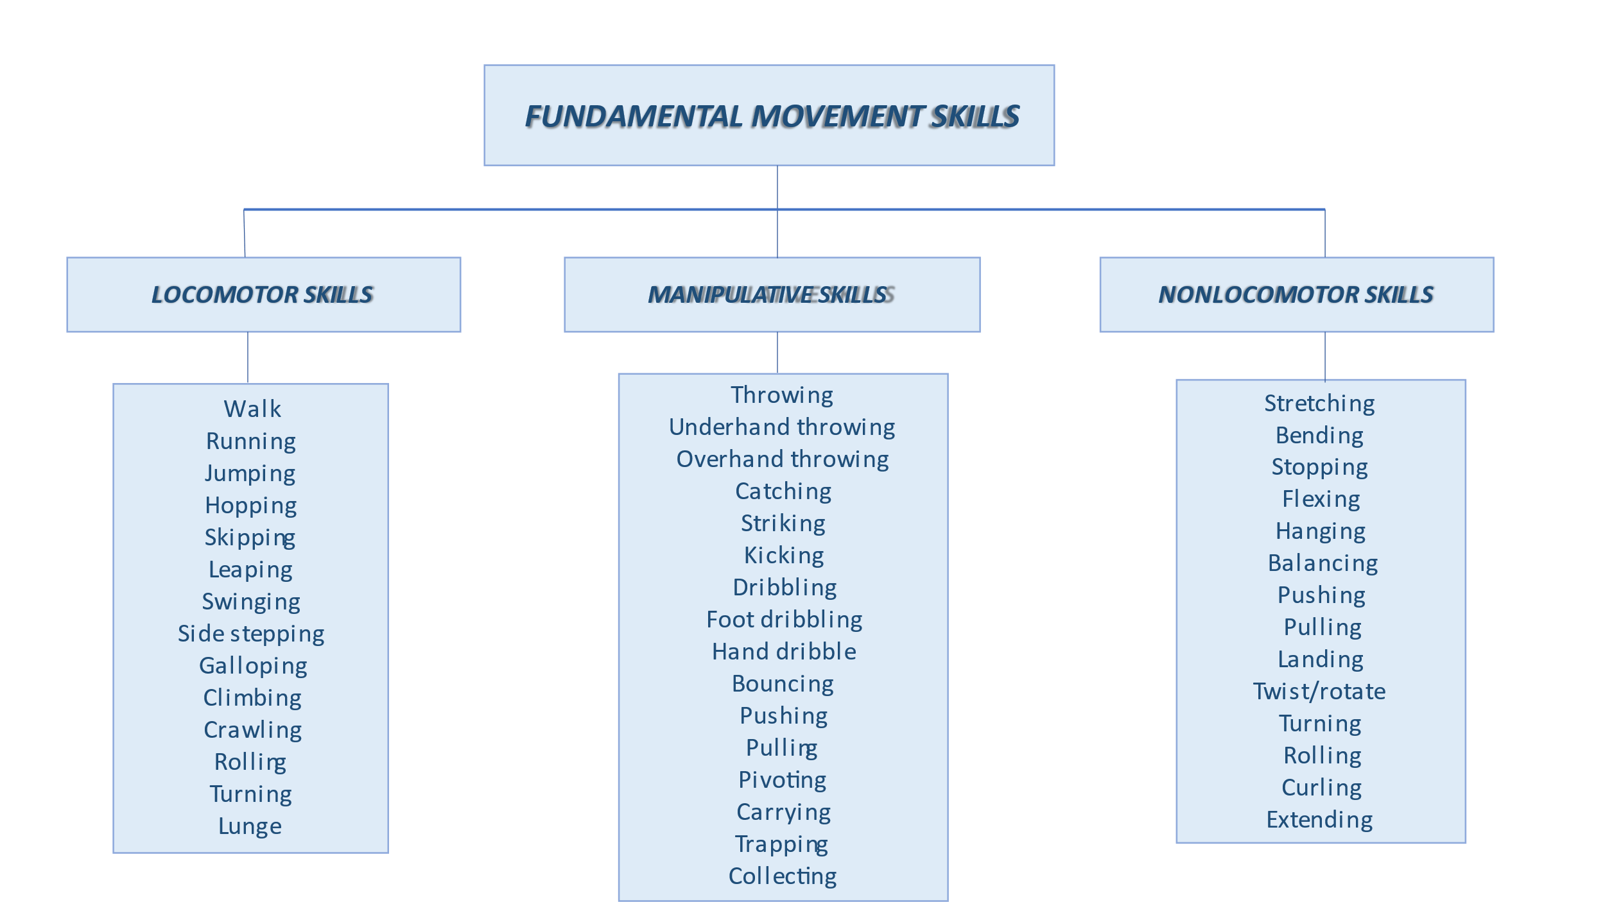
FUNDAMENTAL MOVEMENT SKILLS?

Slide 8
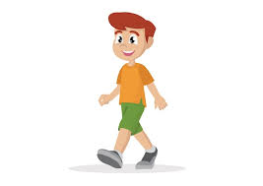
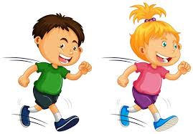
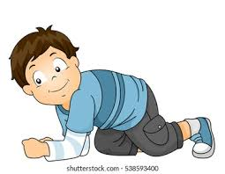
FUNDAMENTAL MOVEMENT SKILLS?
Fundamental skills | Variety manifestations of different FMS
Walking | Position of the foot: walking on toes, heel, external and internal side of the foot Position of the body: walking in an upright position, walking in semi-squat and squat position Length of the step: walking with short steps, long steps Directions: walking front, backward, sidewalks, zig–zag walking, straight line, defined track of walking Walking on different surfaces: walking on flat and uneven terrain, downhill and uphill, walking on sand, snow, ice, walking over small stones, reduced surface (bench, beam, rope) etc. Imitations of different forms of walking: penguin (walking on heel), bird (walking on toes), crab (walking on both foot and hands) etc
Running | Free running, running with high knees Running with different tempo and speed Running in different directions: front, backward, side, zig–zag running, straight line, defined track of running. Running with a fast change of direction Running from different starting positions: standing, sitting, laying, sitting backward Running on different surfaces: flat and uneven terrain, downhill and uphill, running on sand, snow etc
Crawling | Different types of crawling depending on the supporting area – support on the whole body, support on elbows, support on hands and knees, support on knees and foot Use of arms and legs – simultaneously or asymmetric Direction of movement – front, back, zig-zag etc. Crawling combined with climbing and slipping on and through different objects

Slide 9
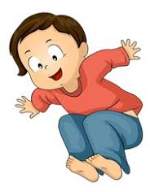
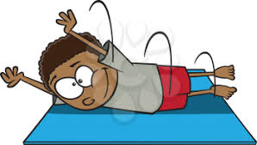
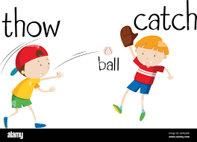
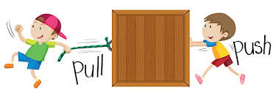
FUNDAMENTAL MOVEMENT SKILLS?
Fundamental skills | Variety manifestations of different FMS
Jumping | Jumping on one leg, both legs, changes one and two legs Jumping front, back, side and combinations Jumping high, deep, jumping in distance, jumping over obstacles Jumping with rope, elastic tape Imitations – jumping like rabbit, kangaroo, frog Jumping over different objects Jumping in send, water, snow etc
Rolling | Flat and declined surface With bend or extended arms With or without objects
Throwing and catching | Throwing and catching with one or both hands Underhand and overhand throwing Throwing and catching at the level above the head, chess level, below chess level Bouncing Dribbling Throwing/hitting in target Throwing different objects
Pushing and pulling | Pushing and pulling different objects – chair, partner, Pilates balls, medicine balls, ropes, sledge etc

Slide 10
Overview
Overview of Fundamental Movement Skills
Importance of Fundamental Movement Skills

Slide 11
IMPORTANCE OF FUNDAMENTAL MOVEMENT SKILLS
Manifestation of FMS
Fundamental movements are manifested in different periods of child development.
Development of FMS
Their manifestation is determined by the level of development of CNS and individual tempo of development. Regarding the tempo of development, a manifestation of FMS happens always in the same order of manifestation (walking will always manifest before running; standing will always manifest before jumping).
Well-developed fundamental skills facilitate the process of learning elements in specific sports and provide the possibility for greater success in sports.
Fundamental movement skills can be improved in different ways.
Movement games, relay games, obstacle courses, and other forms of physical activity that integrate different forms of fundamental movements support the development of fundamental movement skills
Well-established fundamental movement skills provide fundaments for easier acquisition of complex movements that are part of different sports. Therefore, fundamental movement skills are the core of PE programs in preschool and early school period and the baseline for further sports specialization
Until 6 years old, all children have learned all fundamental movements
They should be improved in a period from 7 – 9 years using different activities
By improving motor abilities, we also improve fundamental movements and other way around
In a period from 10 – 12 years and after that 14 – 15 years, fundamental movements are mastered by participating in different sports.
SEE MODULE #1, Course 1.1, and learn more about the phases of motor development and changes in FMS in different age periods

Slide 12
FUNDAMENTAL MOVEMENT SKILLS?
Fundamental skills | Importance for child development
Walking | Children start walking at the age of 12 or 13 months, but stability in walking is achieved until the end of the second year. Around the age of seven, walking becomes completely automatized. At an early age, the movements are uncertain and uncoordinated. The balance is not well established yet. Around the age of 4 or 5, walking becomes more stable and coordinated. In terms of health impact, different types of walking stimulate the cardiovascular and respiratory systems of children and are especially useful if done outside in fresh air.
Running | Children start to run 6 – 7 months after start walking. The improvement of running is related to the development of balance and maintaining the balance. This is closely related to the development of the nervous system and the process of myelinization. Running is very efficient for improving the strength of lower body parts, especially explosive strength, to improve speed, coordination, and agility. It also has health benefits in terms of improving aerobic capacities.
Crawling | Crawling has a positive effect on strengthening the muscles of the arms, shoulders, and back. It is highly recommended for movement in the early childhood period as provides the strength of the upper body and the possibility for symmetrical development of the upper body and strengthening of the core muscles. This is especially important for proper development of spine curves and good body posture. Crawling is usually combined with climbing. Children that crawl, usually climb on different objects around the house or playgrounds. This is especially important to develop body awareness and spatial orientation but also for stimulating the vestibular and proprioceptive systems and building child self - confidence.

Slide 13
FUNDAMENTAL MOVEMENT SKILLS?
Fundamental skills | Importance for child development
Jumping | Jumping has a positive effect on functional capacities and the development of the muscles, especially lower body muscles and core muscles Different types of jumps improve the explosive strength of the lower body and improve coordination, agility, and balance. It develops body awareness and space orientation Jumping supports the development of the vestibular system and proprioceptive system The children start to jump around the age of 2 but the first jumps are very low, heavy, and mainly with both legs together Until the end of pre – school period, children have mastered different types of jumps with and without equipment as well as jumps over different objects.
Rolling | Rolling is a rotational movement around the horizontal or vertical axis. Is important for child development as it supports the development of the muscles of the whole body, especially helps strengthen the core muscles. Different types of rolling improve coordination, space orientation and body awareness
Throwing and catching | Development of catching and throwing is determined by the development of coordination, especially eye-hand coordination It helps build the strength of the muscles of upper body parts and core muscles, but also lower body parts are included. Throwing and catching help the improvement of explosive strength, speed, and preciseness It is also closely related to the ability to focus, concentrate, space orientation (to estimate the distance) awareness of time and distance, etc.

Slide 14
REFERENCES FOR ADDITIONAL READING
Gallahue, D., & Ozmun, J. (2006). Understanding Motor Development: Infants, Children, Adolescents, Adults (6th ed.). New York: McGraw-Hill.
Haywood, K., & Getchell, N. (2004). Life span motor development. Champaign: IL. Human Kinetics.
Haywood, K.M.; Getchell, N. (2020). Life Span Motor Development, 7th ed.; Human Kinetics: Champaign, IL, USA, 2020
Jürimäe, T. & Jürimäe, J. (2001). Growth, physical activity and motor development in prepubertal children. New York: CRC Press
Malina, R. (2004) Motor development during infancy and early childhood: Overview and suggested directions for research. Growth and development, International Journal of Sport and health science. 2, 50 – 66
Malina, R., Bouchard, C. & Bar – Or, O. (2004). Growth, Maturation and Physical Activity (Second Edition). Champaign: Human Kinetic, Illinois.
Patterson, C. Ј. (2008). Infancy & Childhood. New York: McGraw – Hill Higher. USA
Santrock, J. (2008). Life – Span Development (Elevent edition) New York: McGraw – Hill Book Company
Schmidt, R. & Lee, T. (2005). Motor control and learning. (Fourth edition). Champaign: Human Kinetic, Illinois.

Slide 15
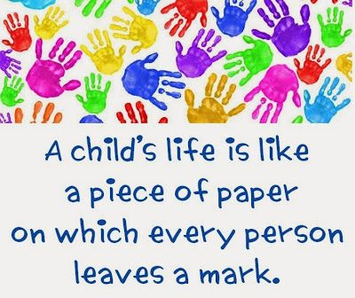
Make sure to leave a good one!
For contact:
Biljana Popeska, University of Luxembourg
e – mail: biljana.popeska@uni.lu

