Slide 1
ECE
M#2
Course 2.1
Basic Motor Skills
M#2 Principles of Educating Children

Slide 2
Technical sheet
Project: Education for Physical Activity and Sport: Informal and Non-formal Settings
Authors: EduPASS Project Partners
Intellectual Property Statement: The following slides were presented by Valgo Sports Consultancy during the EduPASS LTT events. They are shared here as a resource to be adapted in respective contexts, where those “Valgo Sports Consultancy” intellectual property should be acknowledged, if their slides are used.
For further information on the EduPASS Project please follow the link:
Website https://edupass-project.eu/
This work is licensed under the Creative Commons Attribution 4.0 International
License http://creativecommons.org/licenses/by/4.0/

Slide 3
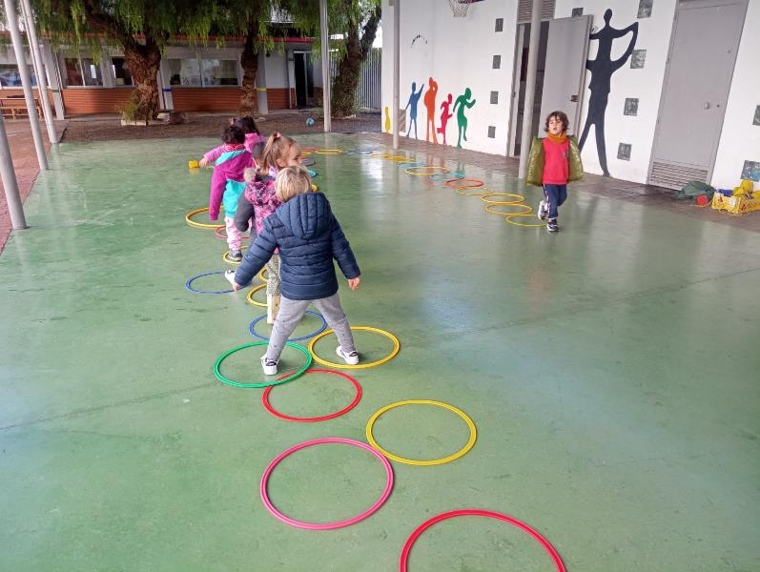
What is Basic Motor Skills in Early Childhood Education (ECE)?
Two main objectives of the course:
Building a solid foundation of motor skills essential for childhood development.
Emphasizes the importance of physical activity and its benefits for long-term well-being.

Slide 4
What is Basic Motor Skills in Early Childhood Education (ECE)?
Basic Motor Skills refer to fundamental movements that lay the foundation for a wide range of physical skills. These skills, developed through intentional activities in early childhood.
Locomotor movements
Such as running, jumping, and sliding, which allow children to move from one place to another with agility and control.
Manipulative movements
Like throwing, catching, and kicking, essential for hand-eye and foot-eye coordination, promoting interaction and control over objects.
Stability movements
Such as balancing and rotating, which help children maintain control over their own bodies and develop spatial and postural awareness.

Slide 5
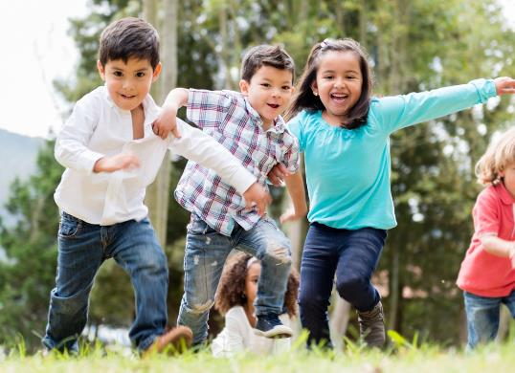
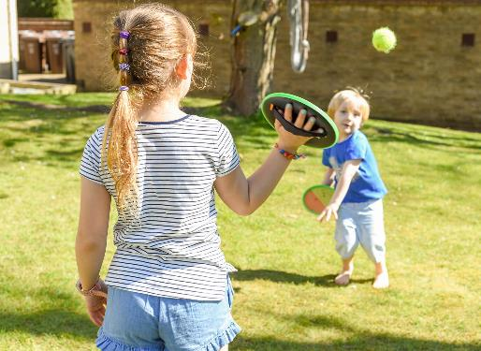
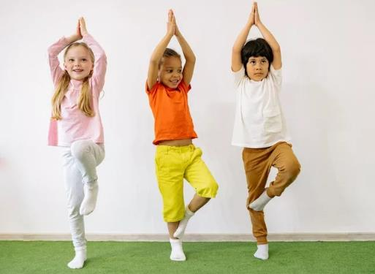
What is Basic Motor Skills in Early Childhood Education (ECE)?
Stability Movements
Locomotor Movements
Manipulative Movements

Slide 6
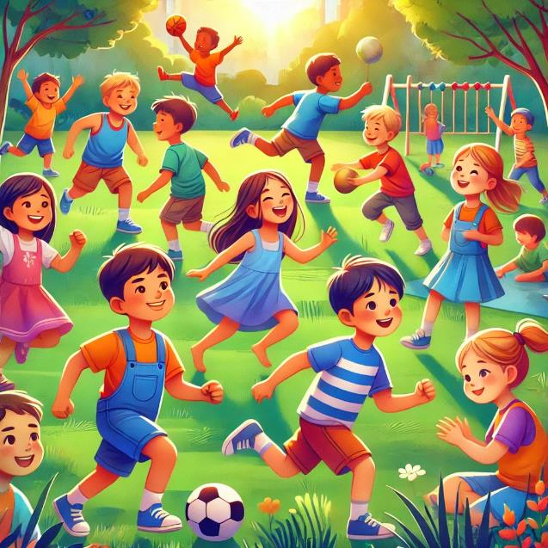
Why is important to develop Basic Motor Skills in ECE ?
Basic Motor Skills (BMS) are essential for children’s physical, social, and emotional development. Encouraging them from an early age improves coordination, strength, and body control, while also promoting social relationships and strengthening confidence and self-esteem. These skills help children develop resilience and a growth mindset. Early focus on BMS fosters lifelong habits of health and well-being.

Slide 7
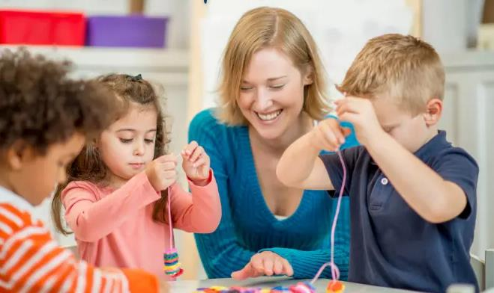
Benefits of developing Basic Motor Skills in ECE
Lifelong Benefits
Emotional Benefits
Social Benefits
Cognitive Benefits
Physical Benefits

Slide 8
Benefits of developing Basic Motor Skills in ECE
Physical activity supports cognitive functions such as focus, memory, and problem-solving
Engages brain development, fostering learning readiness.
Encourages attention to tasks and instructions.
Cognitive growth is directly supported by physical movement, leading to better academic and developmental outcomes.
Cognitive Benefits
Engages children in cooperative activities, fostering teamwork
Builds self-confidence and resilience through challenges
Helps children learn patience, respect, and turn-taking
Social interactions in physical activities are crucial for building positive peer relationships.
Enhances muscular strength and endurance.
Develops agility, balance, and coordination.
Supports physical fitness, setting a foundation for future health.
Physical development through BMS helps children become active, capable, and prepared for sports and daily activities.
Social Benefits
Physical Benefits

Slide 9
Benefits of developing Basic Motor Skills in ECE
Encourages lifelong physical activity habits
Builds a foundation for enjoying sports and fitness
Supports long-term health and well-being
Developing BMS early sets the stage for a healthy, active lifestyle that benefits children throughout their lives.
Increases self-confidence by achieving physical milestones.
Encourages self-regulation and resilience.
Provides a healthy outlet for energy and emotional expression.
Motor skill activities contribute to emotional well-being and help children develop a positive self-image.
Lifelong Benefits
Emotional Benefits

Slide 10
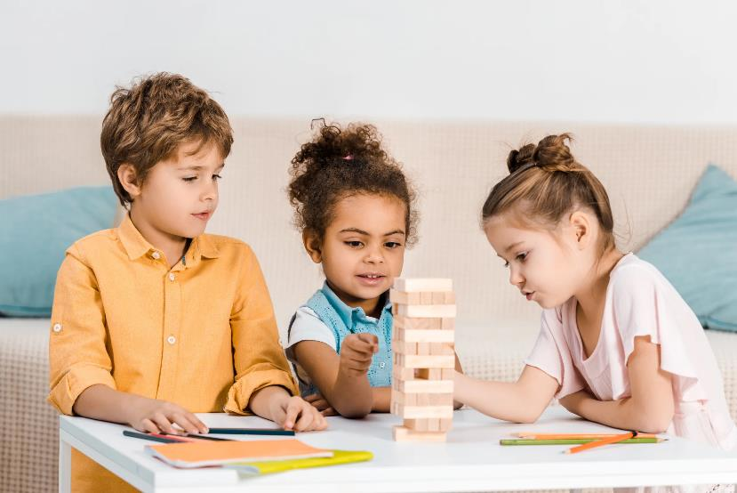
Teaching methods for developing Basic Motor Skills in ECE
Autonomous Learning
Hands-on Learning
Guided Activities

Slide 11
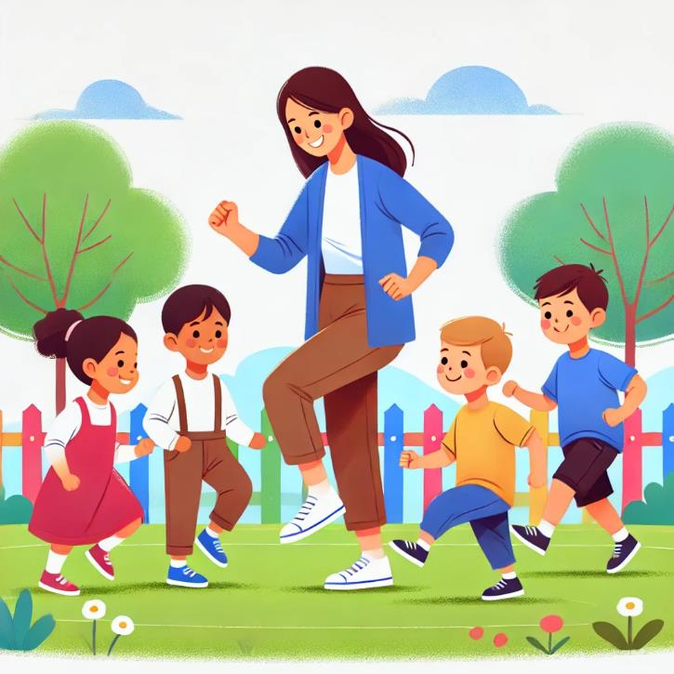
Teaching methods for developing Basic Motor Skills in ECE
GUIDED ACTIVITIES
Guided activities involve the teacher leading and instructing children in motor skill activities, providing structure and ensuring a safe environment. This method is especially helpful for introducing new skills, as the teacher can demonstrate the correct movements and offer immediate feedback.

Slide 12
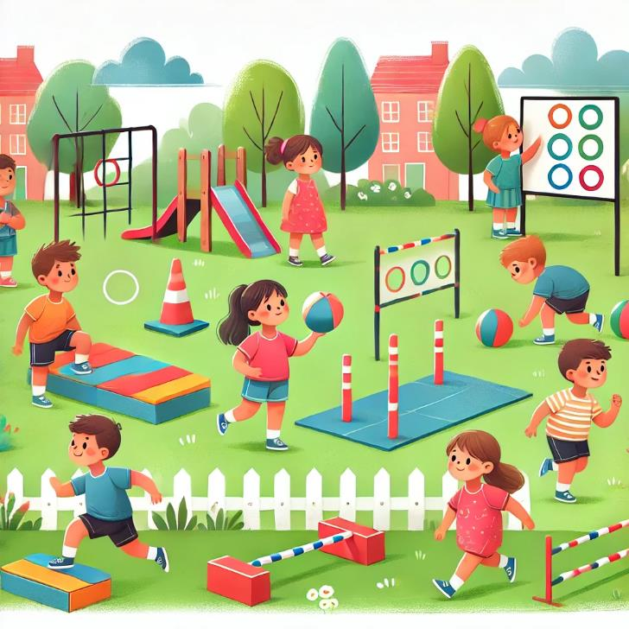
Teaching methods for developing Basic Motor Skills in ECE
HANDS-ON LEARNING
Hands-on learning involves giving children direct experience with physical activities. This method lets them practice BMS actively, allowing for trial and error as they learn. Through hands-on learning, children gain muscle memory and improve their skills by repeating physical tasks.

Slide 13
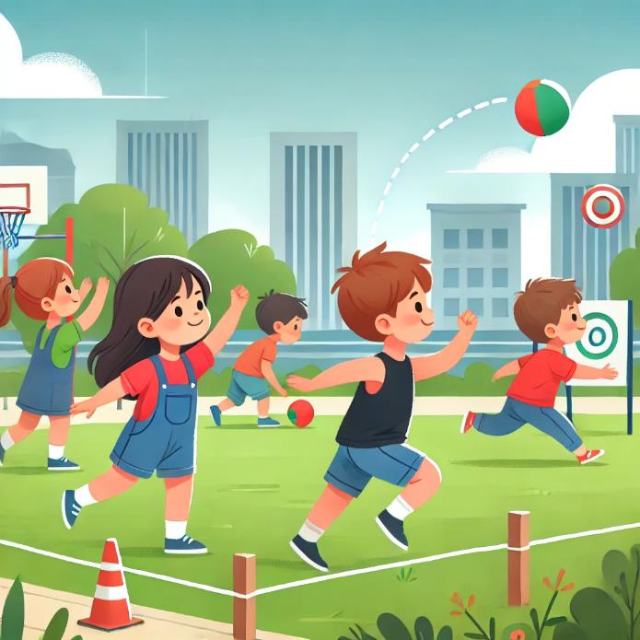
Teaching methods for developing Basic Motor Skills in ECE
AUTONOMOUS LEARNING
Autonomous learning encourages children to practice motor skills independently, fostering self-confidence, responsibility, and self-motivation. This method is particularly valuable because it helps children take ownership of their learning and builds self-discipline, as they explore movements on their own.

Slide 14
Assessment and monitoring progress in Basic Motor Skills.
The Assessment and Monitoring Phase in Basic Motor Skills (BMS) development is essential for understanding children’s motor progress and for tailoring activities to their individual needs. This phase not only measures physical progress but also fosters a growth mindset and builds children’s confidence.

Slide 15
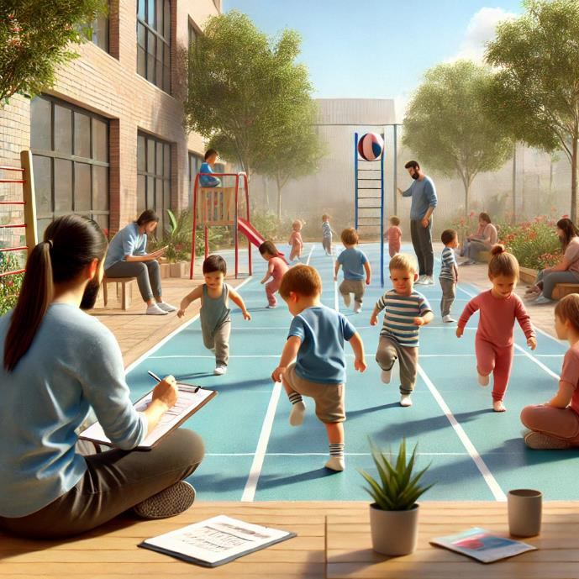
Assessment and monitoring progress in Basic Motor Skills.
Assessment and Monitoring Phase
Direct Observation
Self-Assessment for Children
Constructive Feedback
Personalized Support and Adaptation

Slide 16
Assessment and monitoring progress in Basic Motor Skills.
DIRECT OBSERVATION
SELF – ASSESSMENT FOR CHILDREN
CONSTRUCTIVE FEEDBACK
PERSONALIZED SUPPORT AND ADAPTATION
Direct observation allows educators to assess motor development in real-time by watching how children move, interact in groups, and respond to physical challenges. This helps capture important aspects of coordination, balance, and control.
Simple self-reflection activities enable children to recognize their achievements and challenges, fostering a growth mindset. This promotes self-awareness and encourages goal-setting.
Educators give specific, constructive feedback that reinforces achievements and guides improvement. Instead of generic praise, children receive focused comments on their progress and skills.
Based on assessment, educators adjust activities to match each child’s needs, promoting inclusive learning. Tasks are adapted to be either simplified or more challenging, depending on the child’s skill level.

Slide 17
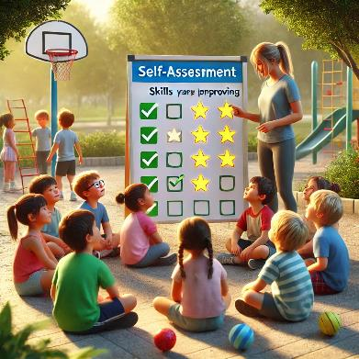
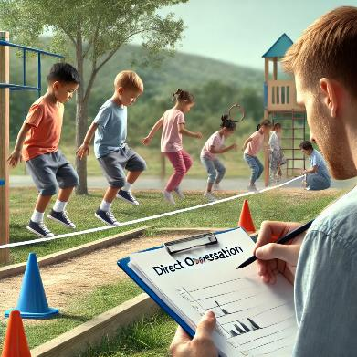
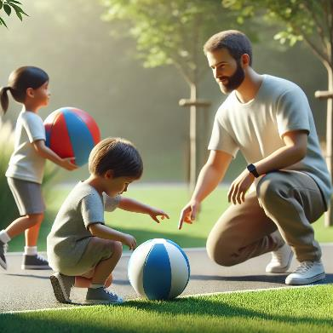
Assessment and monitoring progress in Basic Motor Skills.
CONSTRUCTIVE FEEDBACK
PERSONALIZED SUPPORT AND ADAPTATION
SELF – ASSESSMENT FOR CHILDREN
DIRECT OBSERVATION

