Slide 1
ECE
M#3
Course 3.1
Inclusive Teaching – Theoretical Foundations
M#3 Inclusive Teaching

Slide 2
Technical sheet
Project: Education for Physical Activity and Sport: Informal and Non-formal Settings
Authors: EduPASS Project Partners
Intellectual Property Statement: The following slides were presented by Prof. Andreas Bund (University of Luxembourg) during the EduPASS LTT events. They are shared here as a resource to be adapted in respective contexts, where Prof. Andreas Bund’s/ the University of Luxembourg’s intellectual property should be acknowledged, if the slides are used.
For further information on the EduPASS Project please follow the link:
Website https://edupass-project.eu/
This work is licensed under the Creative Commons Attribution 4.0 International
License http://creativecommons.org/licenses/by/4.0/

Slide 3
Overview
What is inclusion?
Theoretical foundations of inclusive teaching
The DIPPE project

Slide 4
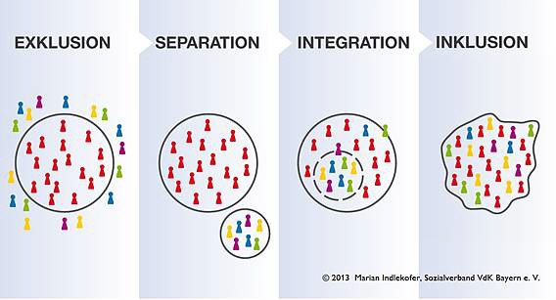
1. What is inclusion?
Integration: Incorporating a person (e.g. student with a disability) into an already existing system (e.g. school); the school does not change substantially, but the integrated student must adapt.
Inclusion: Wants a common system for all people from the start, without anyone being excluded or stigmatized.

Slide 5
1. What is inclusion?
Basis
Initiated by the UN Convention on the Rights of Persons with Disabilities*, the federal and state governments have committed themselves to imple-menting the principle of inclusion of people with disabilities in schools and to further develop the general school system in Germany into an inclusive school landscape (Conference of Ministers of Education, 2015, p. 6).
* UN convention on the Rights of Persons with Disabilities, 13th of December 2013

Slide 6
1. What is inclusion?
Definition
“In this context, inclusion is understood (…) as the right to enable all people, regardless of their social and cultural origins, gender, religion, disability, etc., full and equal participation in all areas of life. Inclusion is therefore expressly not limited to the diversity dimension of disability” (Tiemann & Weber, 2020).
“The diversity of people is understood as a central characteristic of a social structure from which no segregation takes place. It is seen as a quality that is valued and seen as an enrichment of life” (Tiemann and Weber, 2020).

Slide 7
1. What is inclusion?
Inclusion and Primary School
Even elementary school shows selective and separating structures!
Enrollment in a school for children with special educational needs.
Deferral of school enrollment.
Class repeats.
Exclusion and separation in the education system (Klemm, 2015):
Kindergarden: 67% of children with special educational needs are included.
Primary school: 47% of children with special educational needs are included.
Secondary school: 30% of children with special educational needs are included.

Slide 8
Overview
What is inclusion?
Theoretical foundations of inclusive teaching
The DIPPE project

Slide 9
2. Theoretical foundations
Research 1
Two groups of studies:
Studies with a “narrow understanding of inclusion” (→ category disability or “special educational needs” is the focus).
Studies with a “broad understanding of inclusion” (→ all dimensions of differences or heterogeneity are the focus).
Studies on the attitudes of physical education teachers:
Positive attitudes of teachers are crucial for the success of inclusive PE! Working conditions, external resources, training, individual self-efficacy etc. play a role!

Slide 10
2. Theoretical foundations
Research 2
Studies on teaching measures:
Peer tutoring / “reciprocal role assumption”.
“Two-teacher system” (PE teacher + specifically trained teacher).
Need of clarification of roles and tasks in inclusive lessons in advance!
Studies on the student perspective:
Positive: Students with special needs experience PE lessons as successful in terms of social interactions and the development of friendships.
Negative: experiences of exclusion and shame.

Slide 11
2. Theoretical foundations
Didactic approach – General orientation
Keep the poles of „difference“ and „equality“ in balance!
Difference
Activities that enable individual learning progress
(e.g., individual practice at stations with differentiated tasks adapted to the level of learning)
Equality
Activities aimed at equality, cooperation, and communication
(e.g., student A and B have to complete tasks that can only mastered if both students work together)
PE lesson / Teaching activity

Slide 12
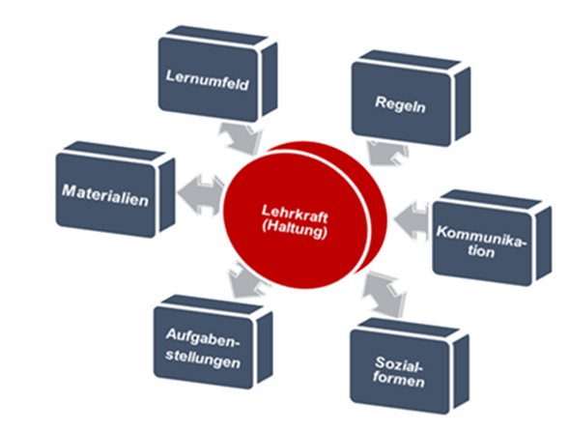
2. Theoretical foundations
Didactic approach – Models for adaptions 1
6+1-Model of Adaptative Physical Education (Tiemann, 2013)
Accessibility
Lighting
Acoustics
Learning
Environment
Rule adjustments in terms
of scoring, playing area,
number of players etc.
Rules
Process
Check continoulsly and
adjust if necessary!
Balls
Boxes
Mats
Equipment
Teacher
(Attitude)
Easy language
Demonstrations
Digital media
Communi-
cation
Tasks variants
Open tasks
Cooperation tasks
Tasks
Organi-
zation
Small groups
Partner work

Slide 13
2. Theoretical foundations
Didactic approach – Models for adaptions 2
TREE-Modell (Australian Sports Commission, 2006)
Teaching Style
Rules
Environment
Equipment

Slide 14
2. Theoretical foundations
Didactic approach – Models for adaptions 3
CHANGE IT-Modell (Australian Sports Commission, o.J.)
C - Coaching Style
H - How to score
A - Playing Area
N - Number of Players
G - Game Rules
E - Equipment
I - Inclusion
T - Time

Slide 15
2. Theoretical foundations
Didactic approach – Types of activities / tasks / games
Open activities / tasks / games
Open activities / tasks in terms of execution, use of equipment,
and organization.
Adapted activities / tasks / games
Activities, tasks and games with rule adjustments.
Adapted, parallel executed activities / tasks / games
Parallel executed activities, tasks and games with individual or group-related rule adjustments or modifications.
Keep the poles of „difference“ and „equality“ in balance!

Slide 16
2. Theoretical foundations
Didaktic approach – Learning situations
Coexisting learning situations
Individual practice, little social interaction
(e.g., individual practice at station)
Subsidiary learning situations
Supporting or pro-social learning situations
(e.g., student A supports student B mastering activities or tasks)
Cooperative learning situations
Complementary and solidarity learning situations
(individual or joint goals, e.g., crossing obstacles)
Keep the poles of „difference“ and „equality“ in balance!

Slide 17
Overview
What is inclusion?
Theoretical foundations of inclusive teaching
The DIPPE project

Slide 18
3. The DIPPE project
Das DIPPE-Projekt – Disentangling Inclusion in Primary Physical Education
Project coordinator Project partners
Associated partners
EPPEN
European Primary Physical Education Network

Slide 19
3. The DIPPE project
The DIPPE-Project – Disentangling Inclusion in Primary Physical Education
Development of a free open educational resource (web platform) consisting of inclusive strategies for physical education.
Easy access to information, resources and tools to help teachers to include all children in physical education and/or physical activity .

Slide 20
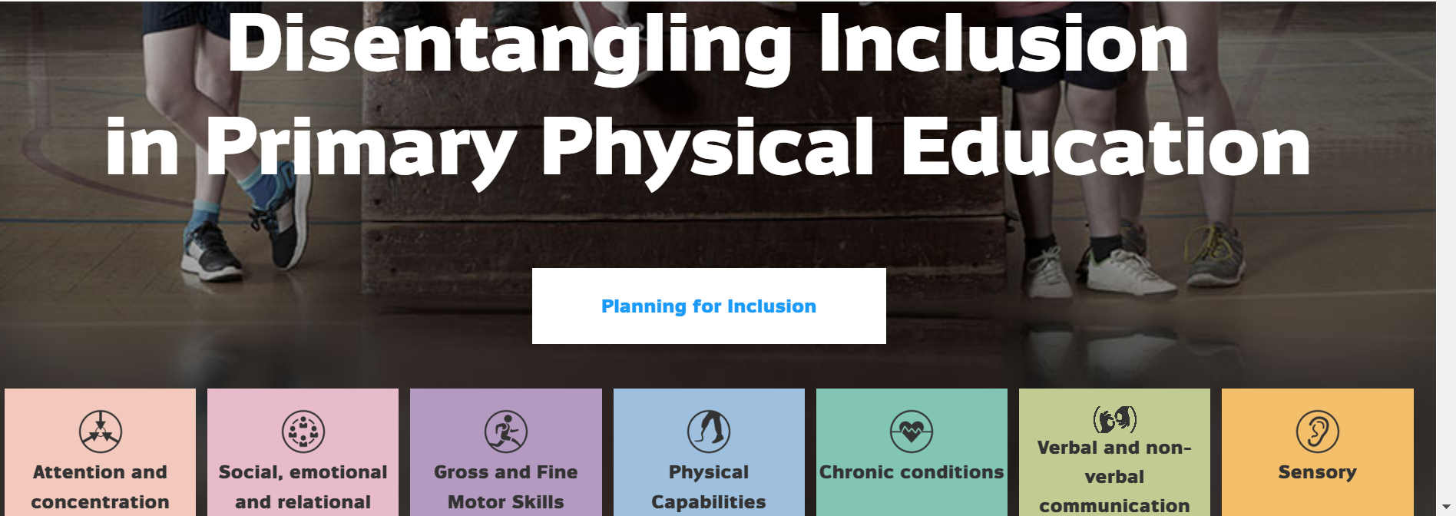
3. The DIPPE project
https://www.dippe.lu/

