Slide 1
ECE
M#3
Course 3.2
Inclusive Teaching in Practice
M#3 Inclusive Teaching

Slide 2

Technical sheet
Project: Education for Physical Activity and Sport:
Informal and Non-formal Settings
Authors: EduPASS Project Partners
Intellectual Property Statement:
The following slides were presented by Lynn Decker and Joe Merkes (Institute national de l’activité physique et des sport, INAPS) during the EduPASS LTT events. They are shared here as a resource to be adapted in respective contexts, where Lynn Decker’s and Joe Merkes’/INAPS’ intellectual property should be acknowledged, if their slides are used.
For further information on the EduPASS Project
please follow the link:
Website https://edupass-project.eu/
This work is licensed under the Creative
Commons Attribution 4.0 International
License http://creativecommons.org/licenses/by/4.0/

Slide 3
Table of contents
What does inclusion mean?
Definition of disability
What exclusion factors are there?
Cooperation on a common object
Summary model 6+1
Conclusion
Feedback round

Slide 4
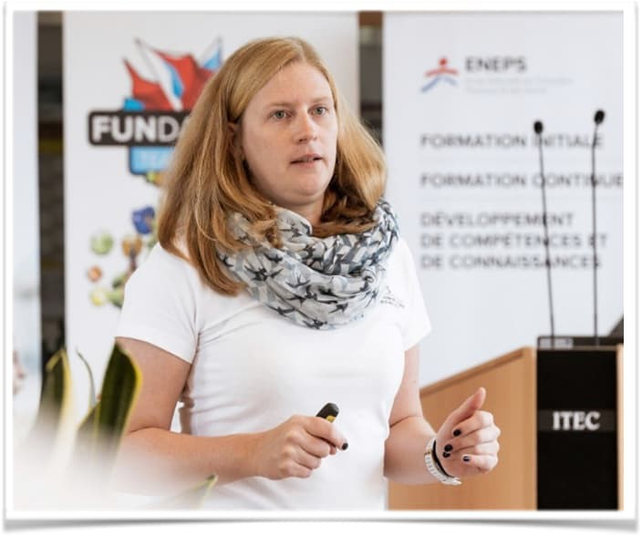
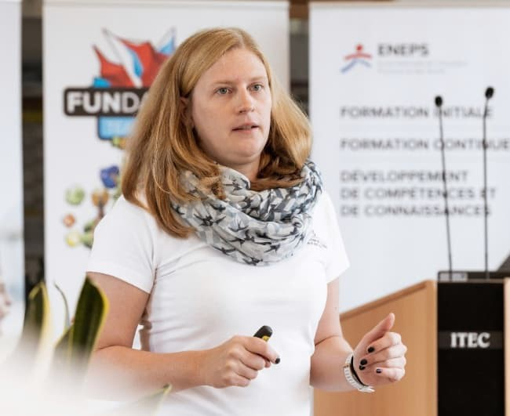
Lecturer
Lynn DECKER
Teacher in Physical Education
Worked with primary classes for 5 years
Working for INAPS since 2020
Sports: Volleyball and scuba diving
Contact:
Lynn.decker@inaps.etat.lu
+352 247 73412

Slide 5
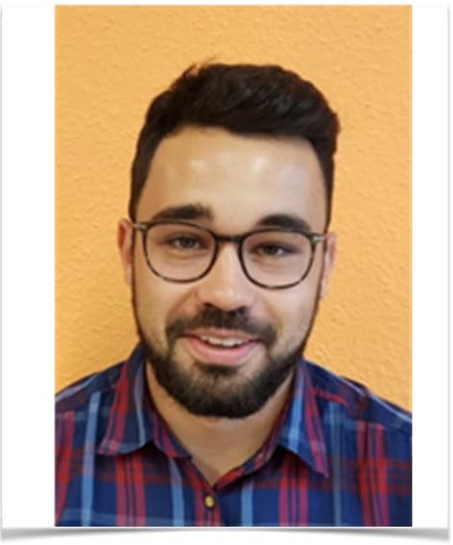
Lecturer
Joe MERKES
Primary school teacher
Master Inclusion and School
Master's thesis: Inclusive school sport
Sport: Football
Contact:
joe_merkes@hotmail.com

Slide 6
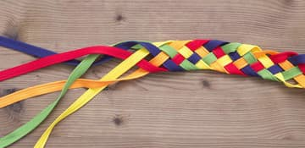
What does inclusion mean?

Slide 7
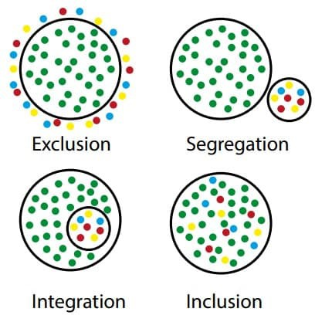
What does inclusion mean?

Slide 8
What does inclusion mean?
"The idea of inclusion affirms the fundamental heterogeneity of all people and understands it as a normal case of human coexistence."
(Giese & Weigelt, 2015)*
"Inclusion emphasises autopoiesis, the primordial autonomy of each individual, and places
its creation and preservation at the centre of institutional and didactic efforts with the aim of achieving the highest possible level of social participation."
(Giese & Weigelt, 2015)*
"Inclusion is goal-differentiated learning without external differentiation, which seeks to avoid external labelling as far as possible without negating the claim to skills."
(Giese & Weigelt, 2015)*
*free translation

Slide 9
Inclusion in, with, and through
Sports / Inclusive sports
creation of opportunities for people with different abilities, backgrounds and needs to participate in sport
promotes equality, participation and social inclusion
  Participation of all people
  Adaptation of sports
  Awareness and training
  Accessibility
  Promoting social inclusion
  Role models
  Events and programmes

Slide 10
Inclusion in, with, and through
Sports / Inclusive sports
intertwined in practice, but emphasis different aspects of inclusion in relation to sport
Inclusion in sport:
Inclusive sport:
creation of an inclusive environment within sport itself
includes adapting sports, regulations and facilities
aim: all people, regardless of their individual characteristics, have the opportunity to participate in sport
sport itself should be inclusive from the outset
designing sports, events and activities so that they are inherently open to people with different abilities without the
need for special adaptations.
Inclusion with sport:
Inclusion through sport:
joint participation of people with different abilities in sport.
sport used as a platform to connect people from different backgrounds and encourage
collaboration
using sport to bring about social change and inclusion beyond the sporting activity itself.
programs designed to promote social inclusion through sport

Slide 11
What exclusion factors are there in society?
Language
Culture
Religion
Ethnicity
Migration and refugee status
Poverty
Education level
Gender and age
Sexual orientation
Physical impairments, restrictions and disorders
"Everyone is different, different in their own way,
but all are equal in their rights and needs.” (Free translation from Anneken, 2013, p. 27).

Slide 12
What is disability?
Medical model
Mental and/or physical impairment
"The main purpose of the medical model is to determine the deviation and then treat it in an appropriate way." (Hirschberg & Köbsell, 2017)
Social model
The focus is set on attitude towards people with disabilities/impairments.
It is no longer regarded merely as suffering or deviation from the norm, but as a social category caused by social conditions.

Slide 13
Relevant impairments in physical activities
Physical impairment
e.g., visual impairment/restriction, hearing impairment/restriction
Socio-emotional developmental disorders (e.g., ADHD, Autism)
Learning development disorders
Intellectual development deficits
Down syndrome (trisomy 21)
Giftedness

Slide 14
How can you make sport inclusive?

Slide 15
Cooperation on a common object
Human = product of his culture and fellow human beings.
Inner differentiation.
Zone of the next development (no under- or overcharged).
Cooperative learning situations
  Complementary learning situation: Partner A and Partner B pursue different goals but cannot achieve them independently of each other.
  Solidary learning situations: a common goal is pursued and can only be achieved together.

Slide 16
6+1 model (Tiemann, 2013)
6: Six fields of potential adaptations:
(1) communication, (2) social form, (3) rules, (4) learning environment,
(5) tasks and (6) materials.
+1: At the center of the model is the leader and his/her attitude.

Slide 17
6+1 model (Tiemann, 2013)
Fields of adaptions
Communication
Visualisation / visual language
Adapted language / simple language
Gestures
Demonstration
Social forms
Small groups or tandems
Peer group mentoring or tutoring
Rules
Individual requirements and goals
Customised group rules
Understandable and realisable for everyone
Learning environment
Switch off sources of interference
Timetable
Retreat
Accessibility (e.g., ramps, lifts, use of rest rooms)

Slide 18
6+1 model (Tiemann, 2013)
Fields of adaptions
Tasks
Various solutions to support individual development (e.g., dribbling a slalom in basketball: The teacher does not give any instructions on how to complete the slalom. Each child masters it according to their personal abilities).
A distinction should be made between closed tasks (e.g., dribbling a slalom in basketball: Students are given different instructions depending on their abilities).
Material
Aids such as headphones or balls with bright colours.
Changing the level of difficulty (e.g., large/small balls, different bounce or flight characteristics while teaching ball games).

Slide 19
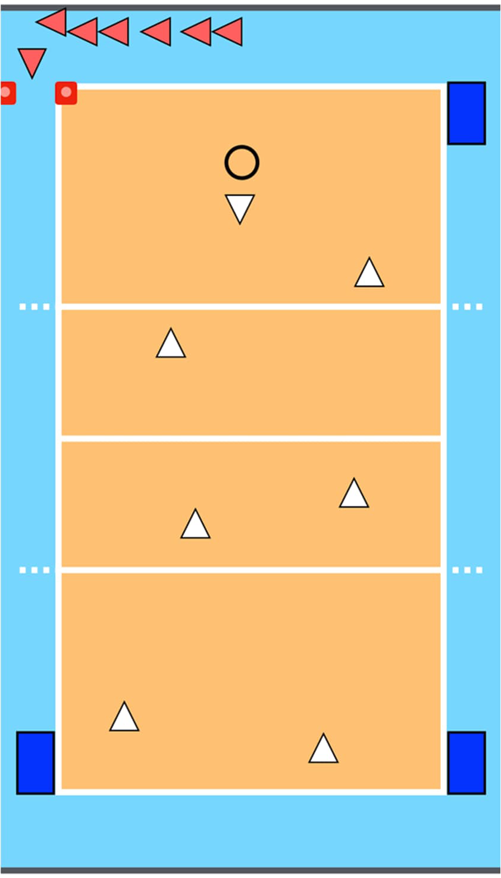
Example „Burning Ball“
(Brennball)
Learning environment
  The playing field can be enlarged or reduced if necessary.
Tasks
  In addition to the mats, the children can also run around pylons. This applies not only to children who are limited in their running, but also to children who are slower.
Materials
  Different balls are available to the children (bright colours). The throwing technique can also be varied.
Rule adjustments
  Watch out for additional stigmatisation. Playing field zones, for example, would make more sense.
Social forms
  The children can also run in tandem or in threes.
Communication
  Simple language, gestures, symbol cards.

Slide 20
Summary of the 6+1 model
Learning environment
Infrastructure must be barrier-free. (background noise, place of retreat, etc.).
Tasks
Should enable different solutions and support individual development processes.
Materials
Difficulty level can be increased or decreased. Atypical materials can be used. (water noodles - catching games).
Rule adjustments
Watch out for additional stigmatisation. Playing field zones, for example, would make more sense.
Social forms
Exercises - partner work, small groups, possible learning support.
Communication
Simple language, gestures, symbol cards. A combination of visualisation, written explanations and communication in simple language can promote comprehension of the exercises.

Slide 21
Conclusion
Situation-dependent - Not transferable to all and everyone.
Inclusion stands and falls with the attitude of the (accompanying) leader.
Rethinking norms / acceptance of variety and diversity.
Try it out! If it doesn't work, everything stays as it was.
Self-reflection.
Lack of communication/information flow.
What can I do so that you can take part?

Slide 22
Group task (10 minutes)
5 participants
Choose one or some impairments
Choose a game or an exercice
Change the game or the exercice using the 6+1 model

Slide 23
Bibliography
Aguayo-Krauthausen, R., & Kulik, M. (2023). Those who want inclusion will find a way. Those who don't want it will find excuses. Rowohlt Polaris.
Pack, R. P. (2013). Didactic concepts for school sport(Vol. 21). Meyer & Meyer.
Wocken, H. (1998). Shared learning situations. An outline of the theory.
https://www.bayreuth.de/rathaus-buergerservice/leben-in- bayreuth/menschen-mit-behinderung/fachstelle-inklusion/aktionsplan- inklusion/
http://legilux.public.lu/eli/etat/leg/loi/2011/07/28/n3/jo
https://www.tmasgff.de/fileadmin/user_upload/Soziales/Dateien/Mensch en_mit_Behinderungen/Die_UN-Behindertenrechtskonvention.pdf

