Slide 1
ECE
M#4
Course 4.3
Motor Skill Assessment
M#4 Fundamental Movement Skills, Play and
Motor Skill Assessment

Slide 2
Technical sheet
Project: Education for Physical Activity and Sport: Informal and Non-formal Settings
Authors: EduPASS Project Partners
Intellectual Property Statement: The following slides were presented by Prof. Andreas Bund (University of Luxembourg) during the EduPASS LTT events. They are shared here as a resource to be adapted in respective contexts, where Prof. Andreas Bund’s / University of Luxembourg’s intellectual property should be acknowledged, if their slides are used.
For further information on the EduPASS Project please follow the link:
Website https://edupass-project.eu/
This work is licensed under the Creative Commons Attribution 4.0 International
License http://creativecommons.org/licenses/by/4.0/

Slide 3
Overview
Definition and types of motor assessment
Assessment of motor skills (Example: MOBAK)
Assessment of motor abilities (Example: DMT)
Quality criteria of motor assessment

Slide 4
1. Definition and types
There are two types of motor tests
Skill-oriented motor tests aiming to assess (fundamental) motor skills
and/or motor competencies such as running, throwing, and balancing.
An example is the test „Motorische Basiskompetenzen“ (MOBAK).
Ability-oriented motor tests aiming to assess motor abilities such as
strength, endurance, and coordination. An example is the „German
Motor Test“ (DMT).
Skill-oriented motor tests are particularly used in english-speaking countries.
Ability-oriented motor tests are particularly used in german-speaking countries.

Slide 5
Overview
Definition and types of motor assessment
Assessment of motor skills (Example: MOBAK)
Assessment of motor abilities (Example: DMT)
Quality criteria of motor assessment

Slide 6
2. Assessment of motor skills
The aim of skill-oriented motor tests is to measure (fundamental or basic)
motor skills or motor competencies!
Example: The MOBAK test
(in German „Motorische Basiskompetenzen“, in English „Basic Motor Competencies“)
MOBAK is a curriculum-based test that measures wether children have the basic
motor skills appropriate for their age. „Basic motor skills“ are those skills that make
it possible for children to actively participate in the most common/important sports
like soccer, athletics, swimming, gymnastics etc.
Please see here for comprehensive information:
https://mobak.info/en/mobak/

Slide 7
2. Assessment of motor skills
The MOBAK test includes 8 tasks in the categories „object-movement“ and
„self-movement“ and is available for the following grades / age groups:
Mobak-KG (Kindergarten) / Age 4-6
Website: https://mobak.info/en/mobak/#1533027832975-9a3d366d-61bd
Test manual: https://mobak.info/wp-content/uploads/2020/07/MOBAK-KG_englisch.pdf
Mobak-1-2 (Grade 1-2) / Age 6-8
Website: https://mobak.info/en/mobak/#1510315880104-6968de13-f681
Mobak-3-4 (Grade 3-4) / Age 8-10
Website: https://mobak.info/en/mobak/#1510392976778-8c0ced82-1e40
Mobak-5-6 (Grade 3-4) / Age 10-12
Website: https://mobak.info/en/mobak/#1510328386180-48a80652-56ed

Slide 8
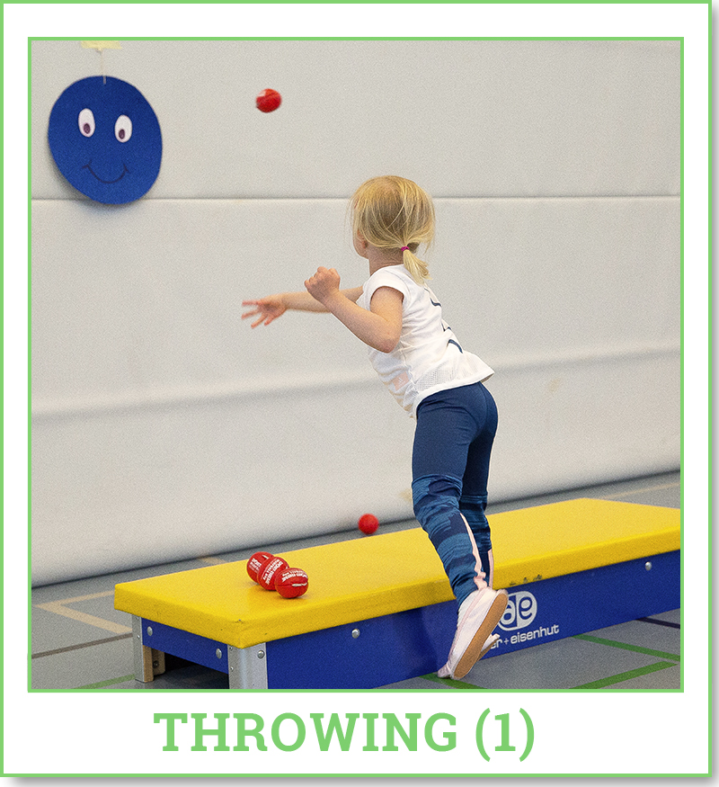
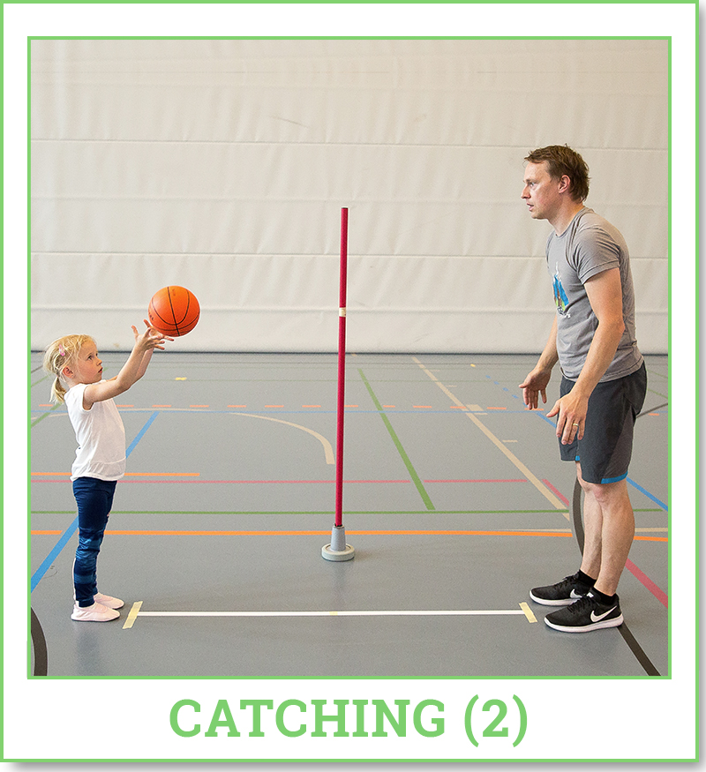
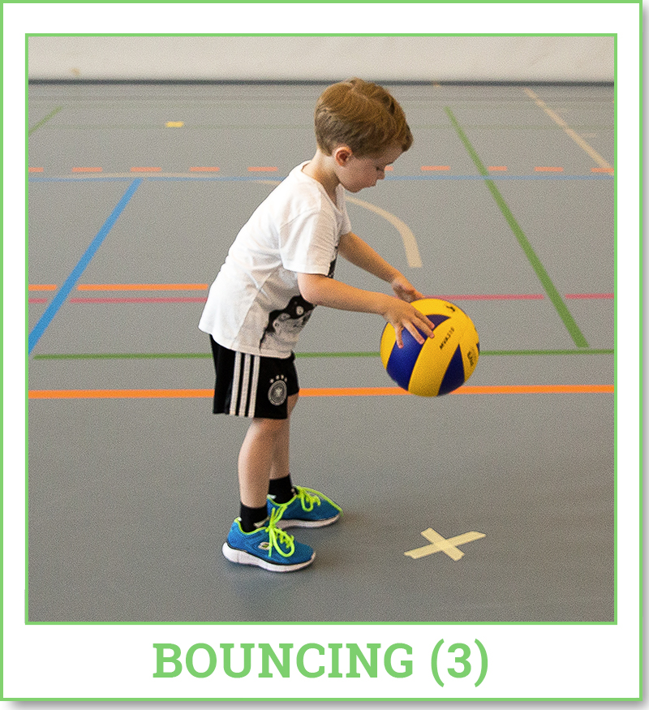
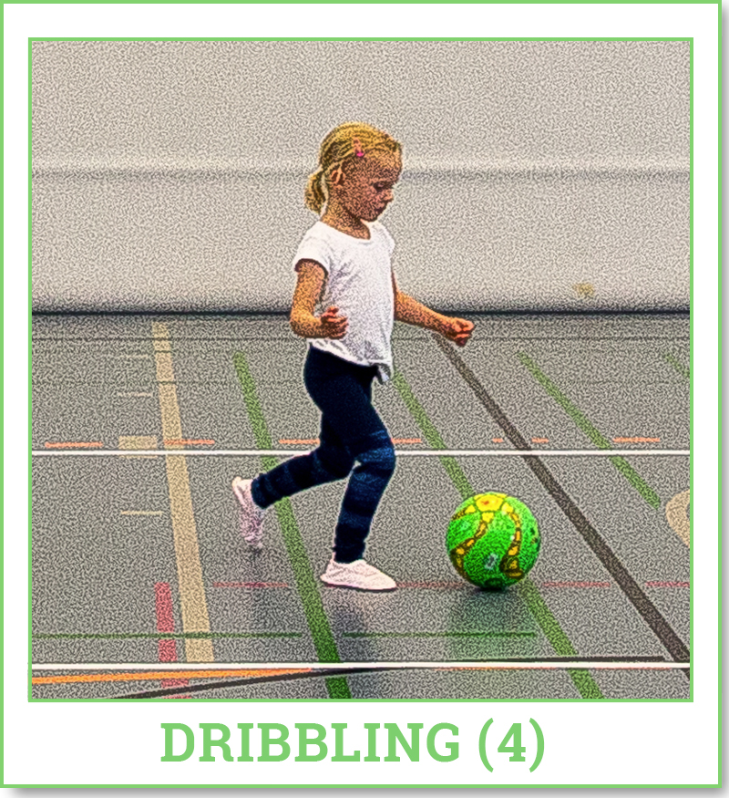
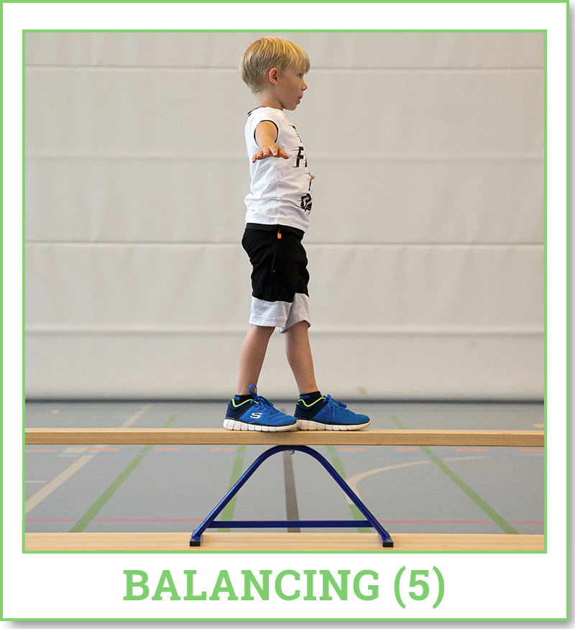
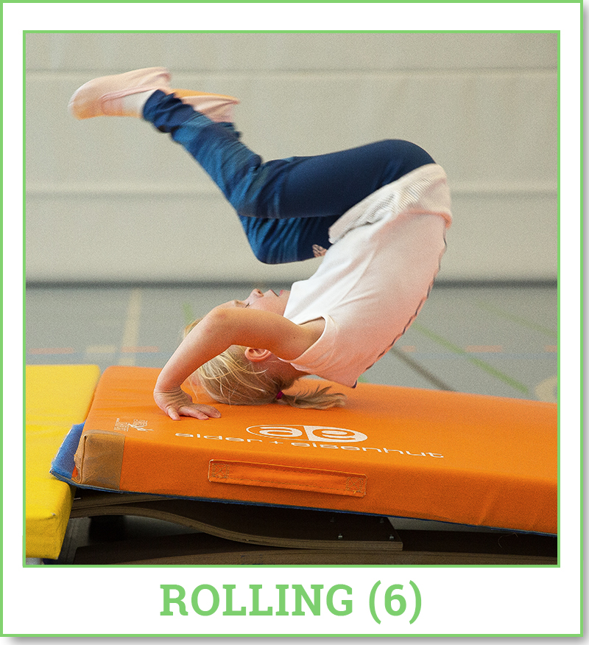
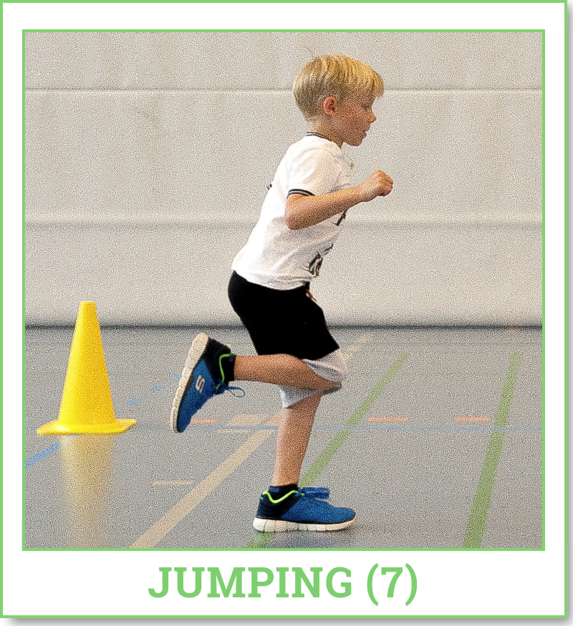
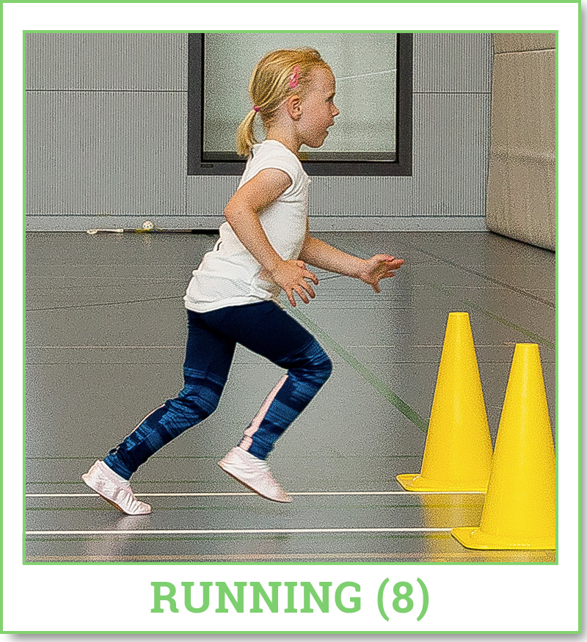
2. Assessment of motor skills
Tasks of the MOBAK-KG (Kindergarten) / Age 4-6
Object-movement
Self-movement

Slide 9
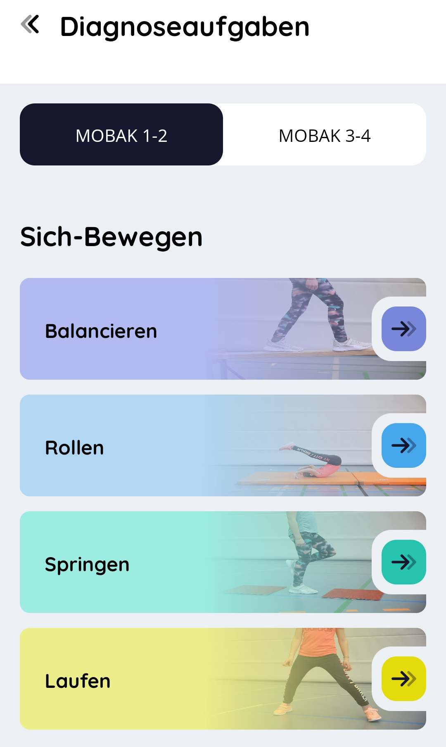
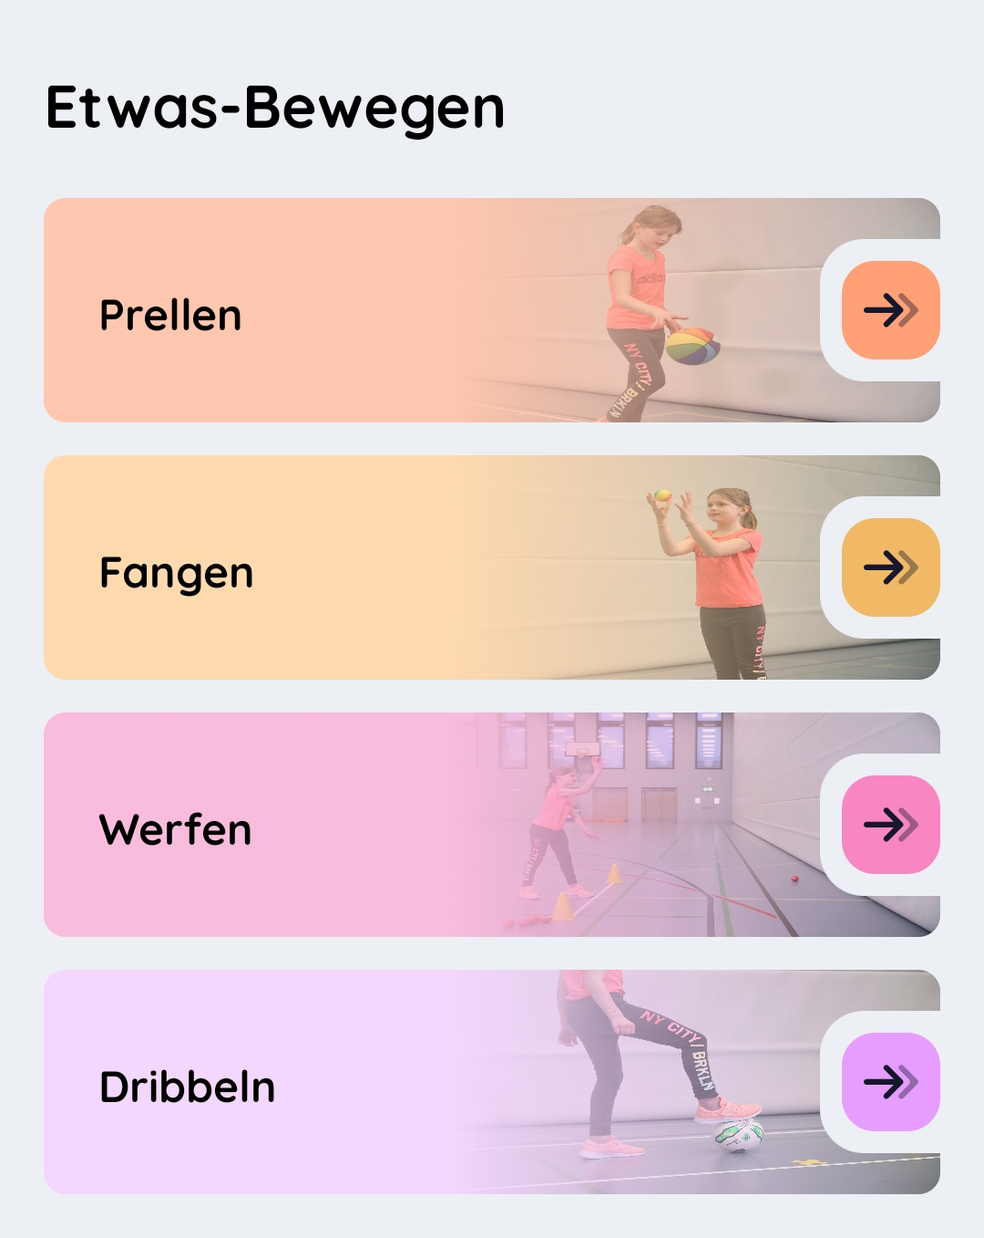
2. Assessment of motor skills
The MOBAK test can also be carried out using a smartphone app! In the app, all tasks are described in words and pictures and the test results can be evaluated and saved. Based on the results, practice tasks are also suggested. The app is available for Apple and Android and in various languages.
This app was developed within the project „Basic Mo-tor Competencies in Europe – Digital promotion“ (BMC EU-Digi Pro), co-funded by the EU.

Slide 10
Overview
Definition and types of motor assessment
Assessment of motor skills (Example: MOBAK)
Assessment of motor abilities (Example: DMT)
Quality criteria of motor assessment

Slide 11
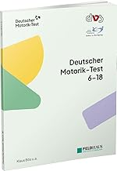
3. Assessment of motor abilities
The aim of ability-oriented motor tests is to measure motor abilities!
Example: The DMT
(in German „Deutscher Motorik-Test“, in English „German Motor Test“)
The DMT measures the motor abilities of strength, endurance,
speed, flexibility and coordination with 8 tasks.
Please see for…
- comprehensive information: https://www.deutschermotoriktest.de/
- downloads for teacher: https://www.deutschermotoriktest.de/testen/fuer-lehrerinnen/
- downloads for coaches: https://www.deutschermotoriktest.de/testen/fuer-trainerinnen/

Slide 12
3. Assessment of motor abilities
For a Powerpoint presentation
on the DMT please see here.
YSC · Module 01 · Course 1.2
https://edupass-project.eu/wp-content/uploads/2024/11/EduPASS_YSC_Module1_DailyPA_Course1.2.pptx

Slide 13
Overview
Definition and types of motor assessment
Assessment of motor skills (Example: MOBAK)
Assessment of motor abilities (Example: DMT)
Quality criteria of motor assessment

Slide 14
4. Quality criteria
Motor tests must fullfill certain quality criteria
Objectivity
Fullfillment of these quality criteria is crucial to the accuracy of the
test results!
Reliability
Validity

Slide 15
4. Quality criteria
Objectivity
A motor test is objective if the test results are independent from
(= not influenced by) the test leader and the test situation!
Question: How can objectivity be achieved?
Answer: Standardization of the entire test procedure!
→ Execution → Analysis → Interpretation
Standardization through: Test manual, training of testleiter, material box etc.

Slide 16
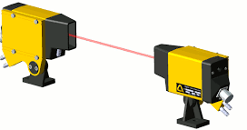
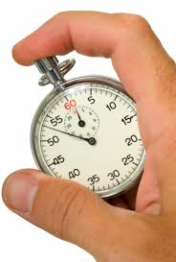
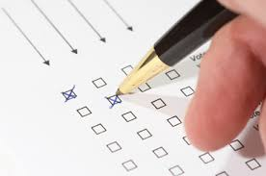
4. Quality criteria
Reliability
A motor test is reliable if the test results are accurate and repeatable!
Question: How can reliability be achieved?
Answer: Depends on two questions!
→ What should be measured?
→ How can it be measured?
Reliability +

Slide 17
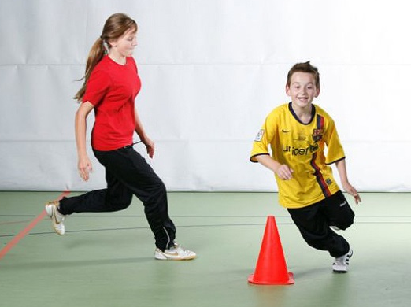
4. Quality criteria
Validity
A motor test is valid if it only measured what is supposed to be measured!
Question: How can validity can be achieved?
Answer: (First of all) Expertise!
Group work (5-10 min.)
How valid is the task „6 min.-run“
of the DMT to assess the aerobic
endurance? Do this task possibly
measure other factors than the
aerobic endurance?

Slide 18
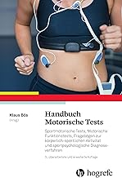
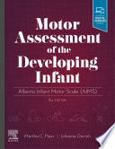
Literature
For german-speaking user For english-speaking user
Bös, K. (Hrsg.) (2017). Handbuch Motorische Tests. Göttingen: Hogrefe.
M. Piper & J. Darrah (2021). Motor Assessment of the Developing Infant.
Amsterdam: Elsevier.

