Slide 1
ECE
M#6
Course 6.2
Reflecting Practice in Early Childhood Education
M#6 Plan, Reflect and Learn

Slide 2
Technical sheet
Project: Education for Physical Activity and Sport: Informal and Non-formal Settings
Author: Francis Ries
Intellectual Property Statement: The following slides were adapted from “Reflective Practice in PE Teaching”, Part of the subject “Teaching of PE II”, within the Faculty of Educational Sciences, University of Seville, by Prof. Dr. Francis Ries. They are shared here as a resource to be adapted in respective contexts, where those organisation’s (University of Seville) and individual’s (Francis Ries) intellectual property should be acknowledged, if their slides are used.
For further information on the EduPASS Project please follow the link:
Website https://edupass-project.eu/
This work is licensed under the Creative Commons Attribution 4.0 International
License http://creativecommons.org/licenses/by/4.0/

Slide 3
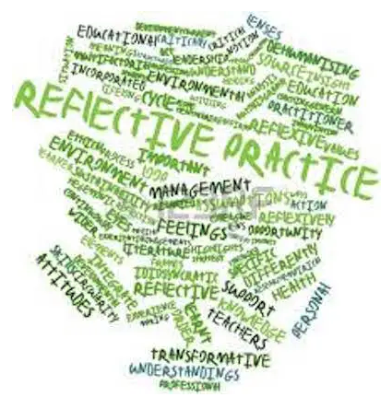
ECE
M#6
Course 6.2

Slide 4
What is Reflective Practice (RP) in Early Childhood Education (ECE) ?
Promotion of self-reflection
Emotional awareness
Critical thinking
Problem-solving to identify areas of improving
Make conclusions
Meet professional goals in ECE
Does RP really matters in ECE?
Self-reflection and emotional awareness are important skills for ECE professionals.
Emotionally ‘dysregulated’ children are unable to access their own executive functions !
ECE educators also feel that because we are the ‘adults’, we know better, and have learned
to deal with or even ignore our emotions!
This is why RP matters!

Slide 5
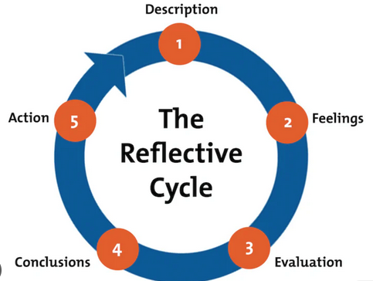
Gibbs G (1988). Learning by Doing: A guide to teaching and learning methods. Further Education Unit. Oxford Polytechnic: Oxford.

Slide 6
Importance of RP in ECE
It provides Continuous Professional Development, support, feedback and a safe space to discuss experiences in the classroom and the related feelings.
Children are ‘emotional’ detectives !
They pick up the verbal and non-verbal responses and reactions of the ECE educators.
If ECE edcuators, are not aware of their own emotions, the skills to understand and manage them,
or how to practice self-reflection, they will not be able to support children’s development of these same skills.

Slide 7
The Benefits of RP
1. Enhances self-awareness:
Self-reflection prepares the way for emotional awareness and self-awareness
Reflect on:
Children’s needs
Different communication preferences of families,
Aware of our tone of voice, facial expressions, body language, feelings, and reactions
ensures that we are able to take a step back, manage your feelings in the heat of the moment,
adjust our approach, and respond appropriately.
RP encourages ECE educators to develop a better understanding of their own beliefs and values.
They become better equipped to respond to the diverse needs of children.

Slide 8
The Benefits of RP
2. Improves Teaching Practices
While reflecting on their own teaching, ECE educators may identify strengths and flaws that
help improve their teaching practices.
We need to be able to take a step back and realice “what is working and what isn’t?”
How we engage with our students / children in PE class.
How we support their emotions and behaviours.
How we plan curriculum activities.
How we communicate with families
How we collaborate with other PE / ECE colleagues,
RP allows us to refine our approach to better support children’s individual and developmental needs.

Slide 9
The Benefits of RP
3. Improves communication and relationships
It helps ECE educators to use empathy and perspective-taking with others – reflecting not just on how we feel, but how others might feel as well to actively improve communication.
It helps improve relationships with children and families.
Tuning into the emotional responses of others helps us act with compassion and empathy during challenging conversations, creating respectful partnerships rather than confrontations.

Slide 10
The Benefits of RP
Epstein, A. (2003)
4. Enhances Continuous Professional Growth
It allows all ECE / PE educators to truly tap into their best selves personally and professionally,
hence strengthing the entire ECE community.
Through proactive problem-solving, ECE educators expand their knowledge and skills, and find
strategies to help them meet their goals.
RP ensures that all ECE / PE educators get the opportunity to explore how their work, role, actions,
and words impact others – and how they, in turn, are impacted by their work.

Slide 11
Why should we integrate RP into our ECE training programs?
RP should be incorporated into ECE training programs, especially those focused on
mental health, physical health and well-being, and social-emotional health.
When training programs place self-reflection, self-awareness, communication, problem-solving,
and professional growth at the center, educators are set up for support and success.
Incorporating mentors or tutors for ECE / PE educators will give valuable support for educators.
Experienced mentors / tutors can guide and support teachers through the reflective process,
offering feedback, encouragement, and guidance for professional growth.

Slide 12
RP Hints
Always remember that whatever feelings we have are real and valid.
Tune into what we are actually feeling and acknowledge it. What can we do next?
Document our thoughts, feelings, and reflections - they matter!
Writing something down helps validate that something happened that affected us,
whether we are ready to process it or not.
Find the “helpers” in our community.
There are always people around who can help you process. We are constantly learning from others
and growing because of their support. We always say that children develop within the context of responsive
relationships, but they also continue to thrive when they are consistently present. Who is our “helper”?

Slide 13
The Role of RP in Child-Centered ECE
Goes Beyond Just Positive Behavior Guidance
RP also helps:
Finding effective ways to manage children’s behaviours.
Supporting their understanding of emotions, what caused them, and related behaviours.
ECE educators can explore the underlying factors and identify proactive strategies to support
children’s social-emotional development.
Supporting children in explaining why a behaviour isn’t okay before providing an example of something
that they can do instead.
“Child-centered teaching methods enhance early childhood PE”
Zachopoulou, E., Liukkonen, J., Pickup, I., Tsangaridou, N. (2010). Early Steps Physical Education Curriculum. Theory and Practice for Children Under 8

Slide 14
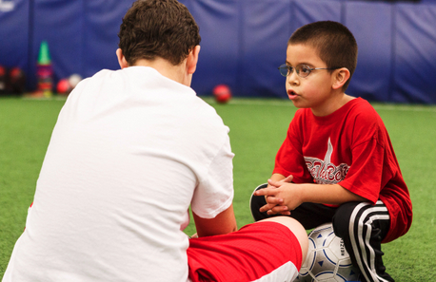
The Role of RP in Child-Centered ECE
2. Individualizes Instruction
RP helps ECE / PE educators:
Adapting the teaching approach to meet the individual needs and interests of their students / children.
Educators become more self-aware and more attuned to their pupils. This allows educators to observe
the responses of children and reflect on their needs, helping with making informed decisions about
adjusting teaching, materials, and learning experiences to optimize learning outcomes for all children.

Slide 15
The Role of RP in Child-Centered ECE
3. Promotes Problem-Solving and Executive Function Skills
A ‘dysregulated’ brain cannot learn!
When children are dealing with an unmanaged emotion, it reduces the brain’s ability
to listen, think, focus, learn new information – key executive function skills necessary for learning.
Through regular implementation of RP and Emotional, Cognitive, and Social Early Learning
language, tools, and techniques, children between the ages of 0-8 learn to manage their emotions
so they can learn, succeed, and thrive emotionally, cognitively, and socially.

Slide 16
The Role of RP in Child-Centered ECE
4. Supporting Social-Emotional Development
RP helps educators to develop critical emotional competencies themselves first so they can foster
these same skills in children – the skills of emotional intelligence.
By self-reflecting, ECE educators learn how to practice effective emotional identification, understanding, expression,
and regulation in order to model for and guide children in these strategies.
Reflecting on one’s own interactions, responses, and reactions to challenging classroom experiences
also helps educators adjust their approach to model empathy, prosocial behaviours, inclusion, self-regulation,
communication, and relationship skills that children internalize and make their own.
This promotes children’s healthy social-emotional development, mental health, well-being, and learning.

Slide 17
“ We proposed that the why(s), what(s) and how(s) should be the objects of student reflection in (ECE) / PE”
Bjørke, L., & Quennerstedt, M. (2023). Reflecting on student reflections in physical education practice: moving beyond a theory-and-practice divide. Physical Education and Sport Pedagogy, 1–14.
https://doi.org/10.1080/17408989.2023.2281913

