Slide 1
YSC
M#2
Course 2.1
ICOACHKIDS Pledge –
10 Principles of Coaching Children
M#2 Principles of Coaching Children

Slide 2


Technical sheet
Project: Education for Physical Activity and Sport:
Informal and Non-formal Settings
Authors: EduPASS Project Partners
Intellectual Property Statement:
The following slides were presented by Sport Ireland Coaching during the EduPASS LTT events. They are shared here as a resource to be adapted in respective contexts, where those Sport Ireland Coaching ’ intellectual property should be acknowledged, if their slides are used.
For further information on the EduPASS Project
please follow the link:
Website https://edupass-project.eu/
This work is licensed under the Creative
Commons Attribution 4.0 International
License http://creativecommons.org/licenses/by/4.0/

Slide 3
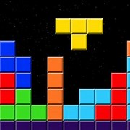
The impact of sport on children depends on putting the right pieces in the right place at the right time… for the right child!

Slide 4








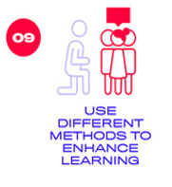
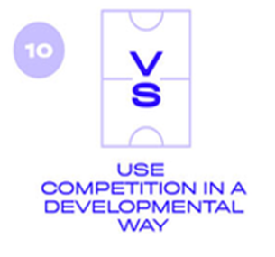
ICOACHKIDS Pledge
The ICOACHKIDS Pledge contains 10 golden principles that will help coaches guarantee
that sport is a positive experience for all involved, especially for each and every child.
Watch this video for more information https://www.youtube.com/watch?v=t8UikQNO2R8

Slide 5

What motives each child that you coach?
Who is each child and what are their needs?
Engage with each child
Actively listen

Slide 6
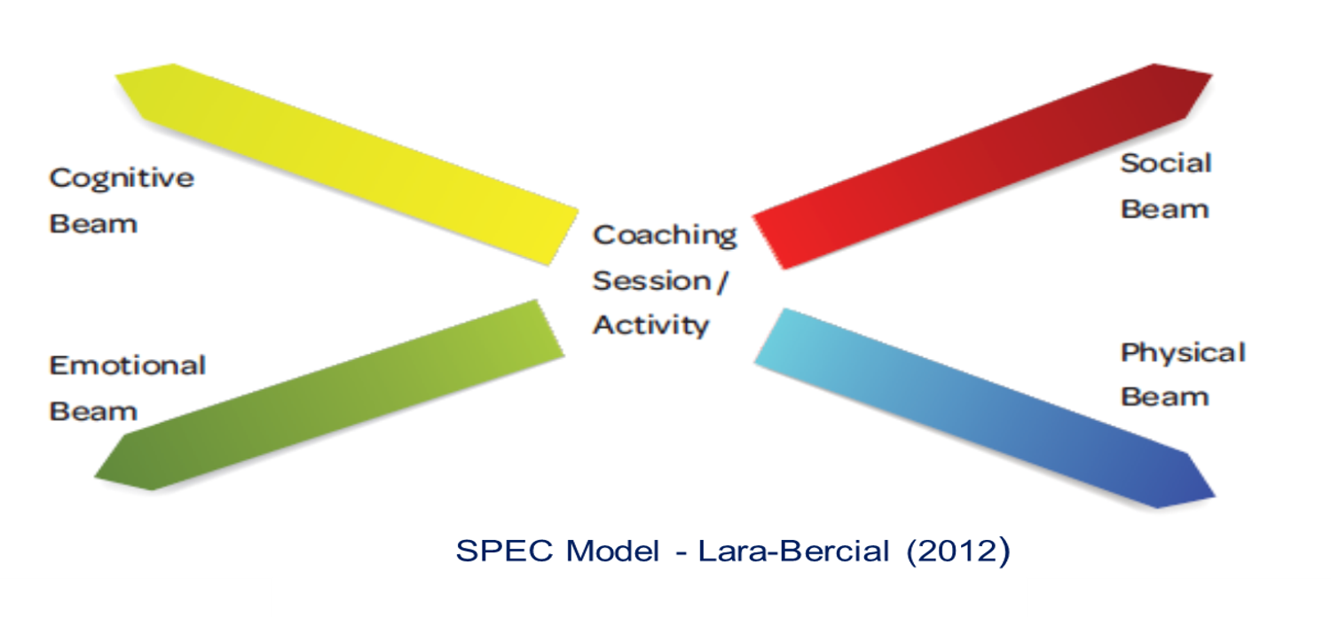

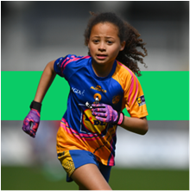
Be informed by the development of each child on each beam

Slide 7
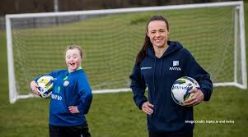
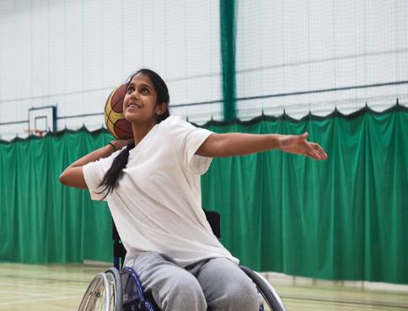
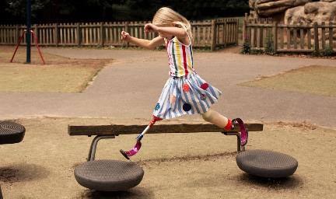
Challenge yourself to adapt your coaching for each child
Remove barriers to participation
Pay attention to each child
Try to ensure that your coaching facilitates learning for children of all shapes, sizes, genders, ethnicities, beliefs, abilities and motivations
Coaching is not one size fits all.

Slide 8
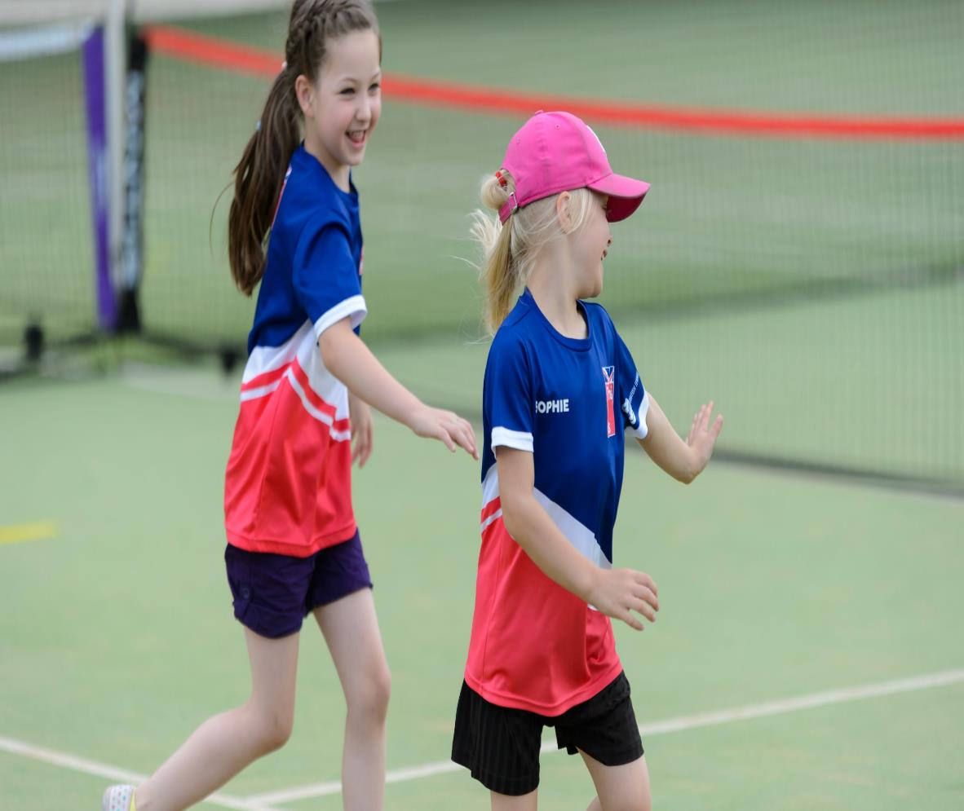
Children only learn in environments where they feel safe
Don’t let learning get in the way of fun. Focus on creating fun environments first

Slide 9


The child who loves and values being active will keep being active
Learning will stem from this continuing to be active
Notes:
As we already know only a small % of children want to be elite athletes and of those even a tiny % will make it. BUT they all have the potential to become healthy active adults. Creating that fantastic legacy is one of the jobs of the coach and sports clubs.

Slide 10
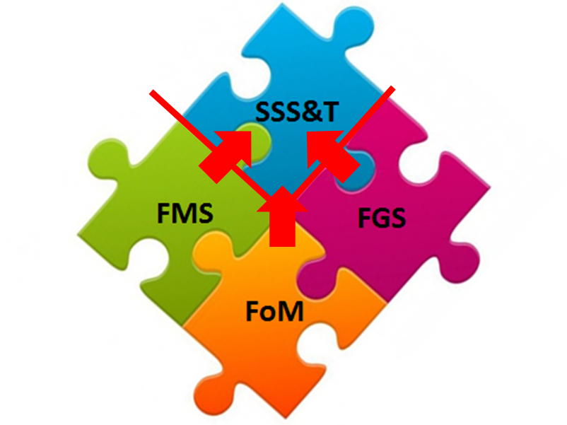
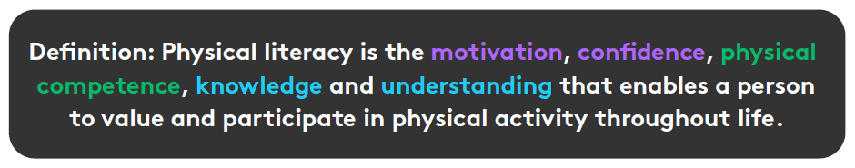
Multi-Skills Jigsaw
Fundamentals of Movements
Fundamental Movements skills
Fundamental Game Skills
Sports Specific Skills and Tactics
Notes:
Build skills early:
Encourage, expect, and support children from a young age to master the fundamental skills they need to succeed in sport. Skills give sport meaning for girls, make competition fairer and success more attainable, building and sustaining self-belief.
Develop physical literacy – how you - THINK – FEEL – DO – sport and physical activity!

Slide 11
Foundational Skills - Life Skills: The Cs Model & Sport
Contribution
Competence
Confidence
Connection
Character
Caring
Creativity
Being able to do things
Being able to find own solutions to problems
Self-Worth and Belief
Positive connections with people and environment
Caring for others and being cared for
Respect for rules and a Sense of Right & Wrong
Adapted from sportscoachUK (2011)
Notes:
Being HOLISTIC means helping children grow in many all parts of their lives. The Cs Model is a useful tool to do this.

Slide 12
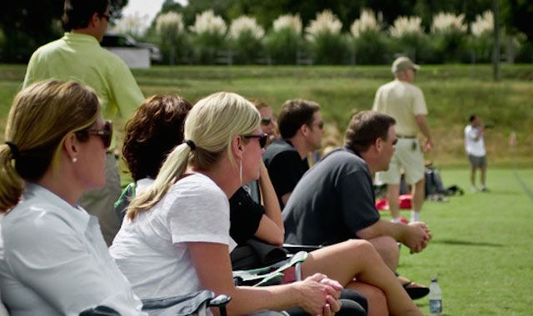

Notes:
Think of parents as, not the enemy, but the biggest resource at the coach’s deposal. Engage with parents positively. Both coaches and parents want the best for young people, so align this want.
Coaches can do this by:
Talk with parents and find out what they have to offer and how they may be able to help.
Opening and maintaining regular lines of communication with parents e.g. texts, emails, meetings.
Helping parents, especially overzealous parents, to understand how they can help their child make the most out of sport.

Slide 13
Parent Meeting Agenda - Template
Introductions
Philosophy/Goals
Children’s Expectations
Parent Expectations
Coaches Expectations
Define Success
Practices- Time/Venue/Requirements

Slide 14
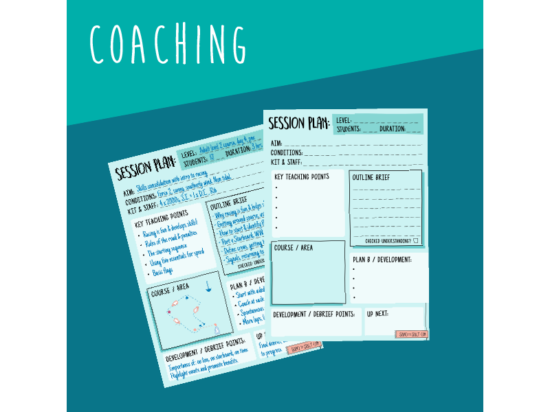
Notes:
Remember, you are taking young people on a long learning journey. Don’t coach just for ‘Saturday’, but coach for long term holistic goals.
This is possible with the implementation of a good coaching plan that is developmentally appropriate – i.e. the plan should consider the young person’s age and stage of development, their needs and wants, and the best way to help them progress.

Slide 15

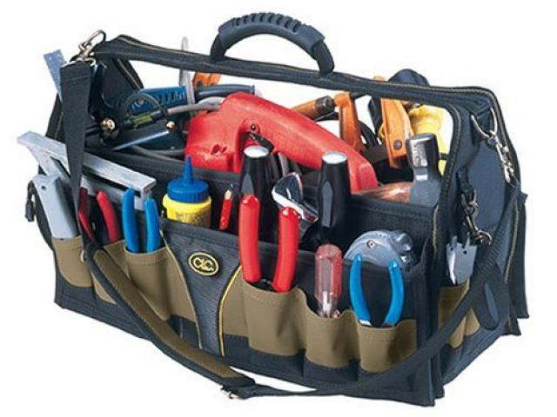
Coaches Tool Kit

Slide 16
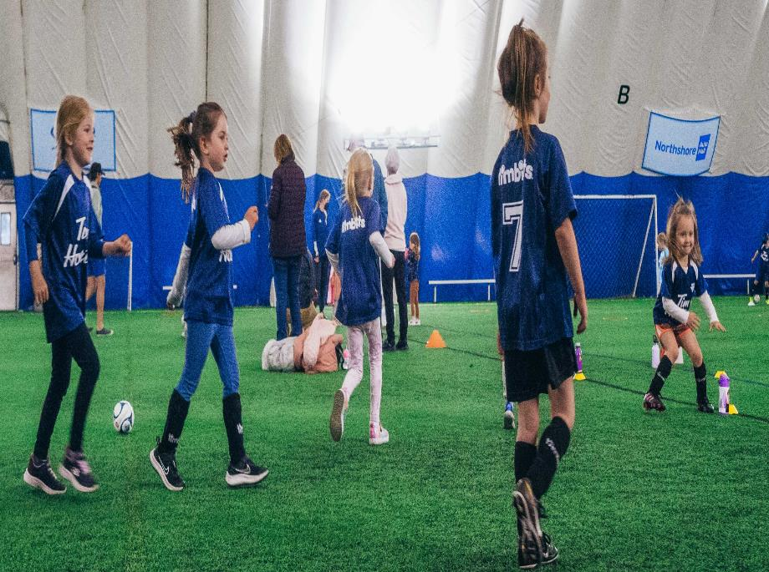
Notes:
Key takeaways for coaches:
Competition is neither good nor bad by itself. It’s impact on the experience of young people and the outcomes that they get in relation to competition in sport, depends on how it is organised, presented and managed.
Key things for coaches to keep in mind:
Avoid replicating the adult-version of the game
Be wary of how the competition in its different forms incentivises different behaviours, for examples:
– Selection decisions
– Position and game time decisions
– Parent behaviours

Slide 17
Personal Observations- Reflections
Which of the 10 Golden Principles do you consider the most important?
Why?
Look at the worksheet and reflect on your status on each of the 10 principles.
Now, set yourself a SMART personal develop goals.

Slide 18
THANK YOU!

