Slide 1
YSC
M#3
Course 3.2
Effective
Relationships
M#3 Inclusive Coaching / Safeguarding

Slide 2
Technical sheet
Project: Education for Physical Activity and Sport: Informal and Non-formal Settings
Authors: EduPASS Project Partners
Intellectual Property Statement: The following slides were presented by Sport Ireland Coaching during the EduPASS LTT events. They are shared here as a resource to be adapted in respective contexts, where those organisations `Sport Ireland Coaching` intellectual property should be acknowledged, if their slides are used.
For further information on the EduPASS Project please follow the link:
Website https://edupass-project.eu/
This work is licensed under the Creative Commons Attribution 4.0 International
License http://creativecommons.org/licenses/by/4.0/

Slide 3
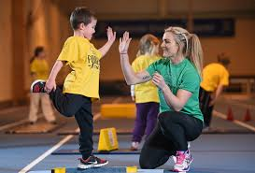
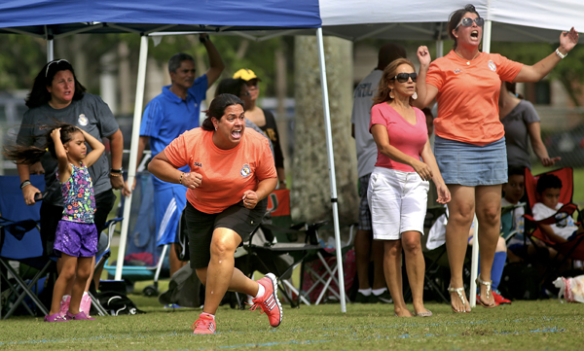
Positive relationships lead to …
Increased satisfaction
Increased motivation
More positive moods
A greater sense of support
A reduction in anxiety
Children, Parents,/Guardians, and other who can impact the Caring environment
sportireland.ie

Slide 4
Building effective relationships
As a coach you are the key to Creating a caring Climate
Relationships matter
Coaching is about working with children. Knowing what they feel, and think is important.
Build Relationships before Building Skills
Show you care by actively listening – taking action (Child’s voice)
Observe- enjoy, interaction with others etc.
“Nobody cares how much you know until the know how much you care” Noel O Reilly
sportireland.ie

Slide 5
Team Talk!
Break into groups of 4, discuss
how much do you relate to children?
How do you gain trust, respect, understanding?
How do you respond, provide support?
5 mins
sportireland.ie

Slide 6
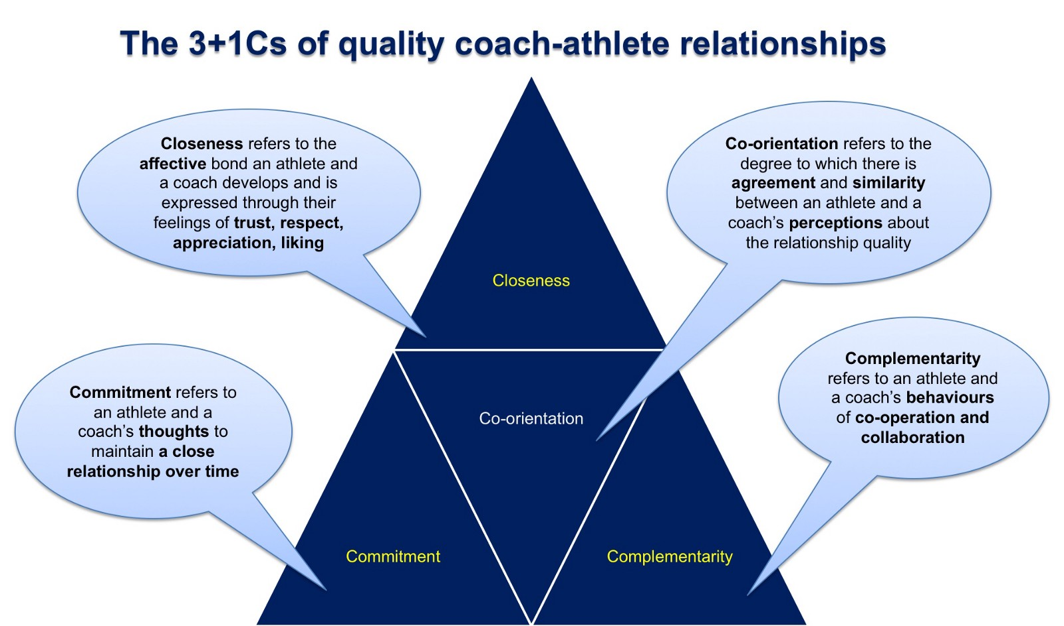
Jowett, S (2017)
sportireland.ie
Notes:
Slide 20: Using the feedback from the group activity, the Tutor will introduce the 3+1 Cs module of coach-athlete relationships.

Slide 7
Group Discussion: Coach-Athlete Relationship in Childrens Sport
How would you show or express Closeness?
Trust, Respect, Appreciate, Like your athlete…
How would you show or express Commitment?
You are by the athlete side for the long-term…
How would you show or express Complementarity?
You can lead, direct, instruct your athlete and at the same time you are responsive, receptive and approachable…
5 minutes
sportireland.ie
Notes:
Slide 21: Group Discussion: The coach athlete relationship in girl’s sport. Using the feedback from the group activity, participants are asked to consider the 3+1 Cs of the coach-athlete relationship, and the practical implications these would have for coaching girls. The Tutor guides the learners in reflecting on how their practice may change armed with this knowledge.

Slide 8
Key motivational theories and what they mean to your coaching
In this section we will explore:
Three basic psychological needs that underpin intrinsic motivation.
Two approaches to goal orientation.
sportireland.ie

Slide 9
Three basic psychological needs that underpin intrinsic motivation (from Self-Determination Theory, Deci & Ryan, 2008)
Competence Coaches can create feelings of competence by providing opportunities for success with a given task, activity or game. This might mean ensuring the challenge point is just right for each participant.
Autonomy Autonomy can be supported by allowing children choice over their own actions. Three main things that coaches should consider are giving children choice, ownership, and empowerment.
Belonging Belonging can be supported by offering a sense of being connected with others and to something bigger than oneself. Help children to connect and build positive relationships through creating opportunities to engage in group work and take part in social activities.
sportireland.ie

Slide 10
Team Talk
In groups, discuss the following questions:
How do you develop a feeling of competence in children?
How do you provide for a feeling of autonomy in children?
How do you develop a sense of belonging in children?
5 minutes
sportireland.ie

Slide 11
Two approaches to goal orientation
Mastery orientation
Performance orientation
(from Achievement Goal Theory by J. Nicholls)
Nicholls, J. G. (1984). Achievement motivation: Conceptions of ability, subjective experience, task choice, and performance. Psychological Review, 91(3), 328–346. https://doi.org/10.1037/0033-295X.91.3.328
sportireland.ie

Slide 12
Mastery Orientation
Performance Orientation
This is when people focus on effort and personal improvement without comparing themselves to others (Self-referenced or Ipsative).
Research shows that children who have a Mastery Orientation will persist more, have better coping strategies if they do not immediately succeed and will generally have a more positive attitude to learning.
This is when people focus on comparing themselves to others and are only satisfied when they outperform others.
Performance orientated children will generally select easier tasks, be concerned with the thoughts of others in the group and give up easily if they fail at a task.
sportireland.ie

Slide 13
Every Child …
The thing is, every child will have a motivational preference:
that is a leaning towards a Mastery or Performance Orientation, or even to both at the same time.
Importantly though, research shows that the climate coaches create can push children to adopt one orientation or the other.
sportireland.ie

Slide 14
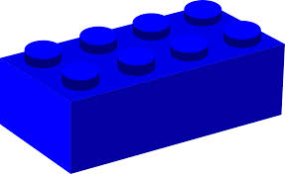
You Might Want to Consider these Building Blocks Towards A Motivated And Confident Child In Sport?
Autonomy and Choice
Sense of Belonging
Challenge and Competition
Appropriate reward and recognition
Groupings
Coach-athlete relationships
Child’s Voice
sportireland.ie
Notes:
Slide 42: Building Blocks Towards A Motivated And Confident Girl In Sport
The Tutor leads a discussion on how the concept outlined in the workshop become the building blocks for effective coaching girls in sport.

Slide 15
Now Consider Unique And Individual Differences In Your Context….
High Achievers
Poor FMS
Challenge and Competition
Sense of Belonging
Autonomy and Choice
Other Individual Differences?
Low motivation
Low confidence
Appropriate reward and recognition
Coach-athlete relationships
Groupings
sportireland.ie
Notes:
Slide 43: Differentiation: The Tutor then indicates that the challenge in effective coaching is to cater to and include each of the girls’ you coach, starting where they are at (the individuals needs and wants) – high achievers, low motivation, poor FMS, low confidence, other individual differences. Coaches can identify how they would cater to the examples provided in the stars.
The Tutor could consider the following questions:
How much do you reinforce the importance of persistence and effort (rather than outcome and performance)?
How do you positively reinforce girls of different ability in your groups?
How much do the girls you coach enjoy the experience of being involved in sport even if they are not winning?
How often do you make direct comparisons on young athlete’s abilities?
How do you involve the girls in your groups in decisions about training and competition?
How well do you cater for individual needs in your groups?

Slide 16
Summary
Different coaching and teaching strategies can serve different purposes at different stages of learning and development, complement each other, and help us to achieve the desired results.
Learning is a complex process with many moving parts. Do not underestimate how difficult it can be for kids.
Consider the factors that underpin successful learning (Ripples on a Pond)
There are lots of innovative ways to facilitate learning. Just make sure that the challenges you set are developmentally appropriate for the child.
Learning takes time, so we have to be patient with progress.
sportireland.ie

Slide 17
Parents in sport
Roles of parents:
Introducing children to sport
Encouraging their initial participation
Supporting them through the ups and downs
Funding participation
Transporting them to training and competitions
Ensuring they have the necessarily equipment and clothes
Emotional support and understanding
Role Model
sportireland.ie

Slide 18
Parents in sport
Parents are NOT THE ENEMY!
Parents are the biggest resource at the disposal of both the child and the coach.
As a coach, you can play an extremely important role in helping parents to develop strategies to cope with different challenges, and consequently, be involved in their children’s sporting lives in the best possible ways.
Involve them positively, but… “one size fits all approach” to engaging parents is unlikely to be successful.
http://www.sportparent.eu/en/
sportireland.ie

Slide 19
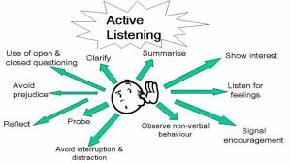
Building relationships with parents
Proactively focus on communication Listen – Problem solve together – Meetings/Drop-Ins
Acknowledge and value parents’ contribution Thank them – Social events – Help them get involved – Listen to their concerns
Commit time to learning about and informing your parents Take time to learn about them – Propose strategies – Ask them what they need from you – Help them get to know you
sportireland.ie

