Slide 1
YSC
M#3
Course 3.3
Coaching Girls
in Sport
M#3 Inclusive Coaching / Safeguarding

Slide 2



Technical sheet
Project: Education for Physical Activity and Sport:
Informal and Non-formal Settings
Authors: EduPASS Project Partners
Intellectual Property Statement:
The following slides were presented by Sport Ireland Coaching and ICoachKids during the EduPASS LTT events. They are shared here as a resource to be adapted in respective contexts, where those organisations `Sport Ireland Coaching and ICoachKids` intellectual property should be acknowledged, if their slides are used.
For further information on the EduPASS Project
please follow the link:
Website https://edupass-project.eu/
This work is licensed under the Creative
Commons Attribution 4.0 International
License http://creativecommons.org/licenses/by/4.0/

Slide 3
More targeted intervention needed for post primary girls!
Primary school Post primary school
Frequency (%) Males Females Males Females 2010 2018 2010 2018 2010 2018 2010 2018
4 or more days a week | 28 | 35 | 23 | 24 | 30 | 30 | 17 | 19
2-3 days a week | 37 | 38 | 40 | 37 | 33 | 32 | 28 | 26
1 day a week | 17 | 13 | 21 | 16 | 7 | 4 | 12 | 7
Less often | 6 | 8 | 5 | 16 | 2 | 4 | 3 | 3
Never | 12 | 7 | 11 | 8 | 28 | 31 | 40 | 45
Of significant concern is that 45% of post primary girls reported never participating in community sport.
Primary boys playing more frequently
Levels of non- participation in primary schools have dropped for both boys and girls
Ireland data only - Children’s Sport Participation and Physical Activity (CSPPA 2018)
sportireland.ie

Slide 4
Reasons Girls Engage in Sport
Friendships
Team spirit
Keeping fit and healthy
To compete and improve
Social aspects
Fun
Positive coaching
Reasons Girls Drop Out of Sport
Loss of interest
Lack of fun and playing opportunities
Failure to learn new skills
Too much pressure
Coach was a poor teacher
Too much time involved
Coach played favourites
Over emphasis on winning
sportireland.ie

Slide 5
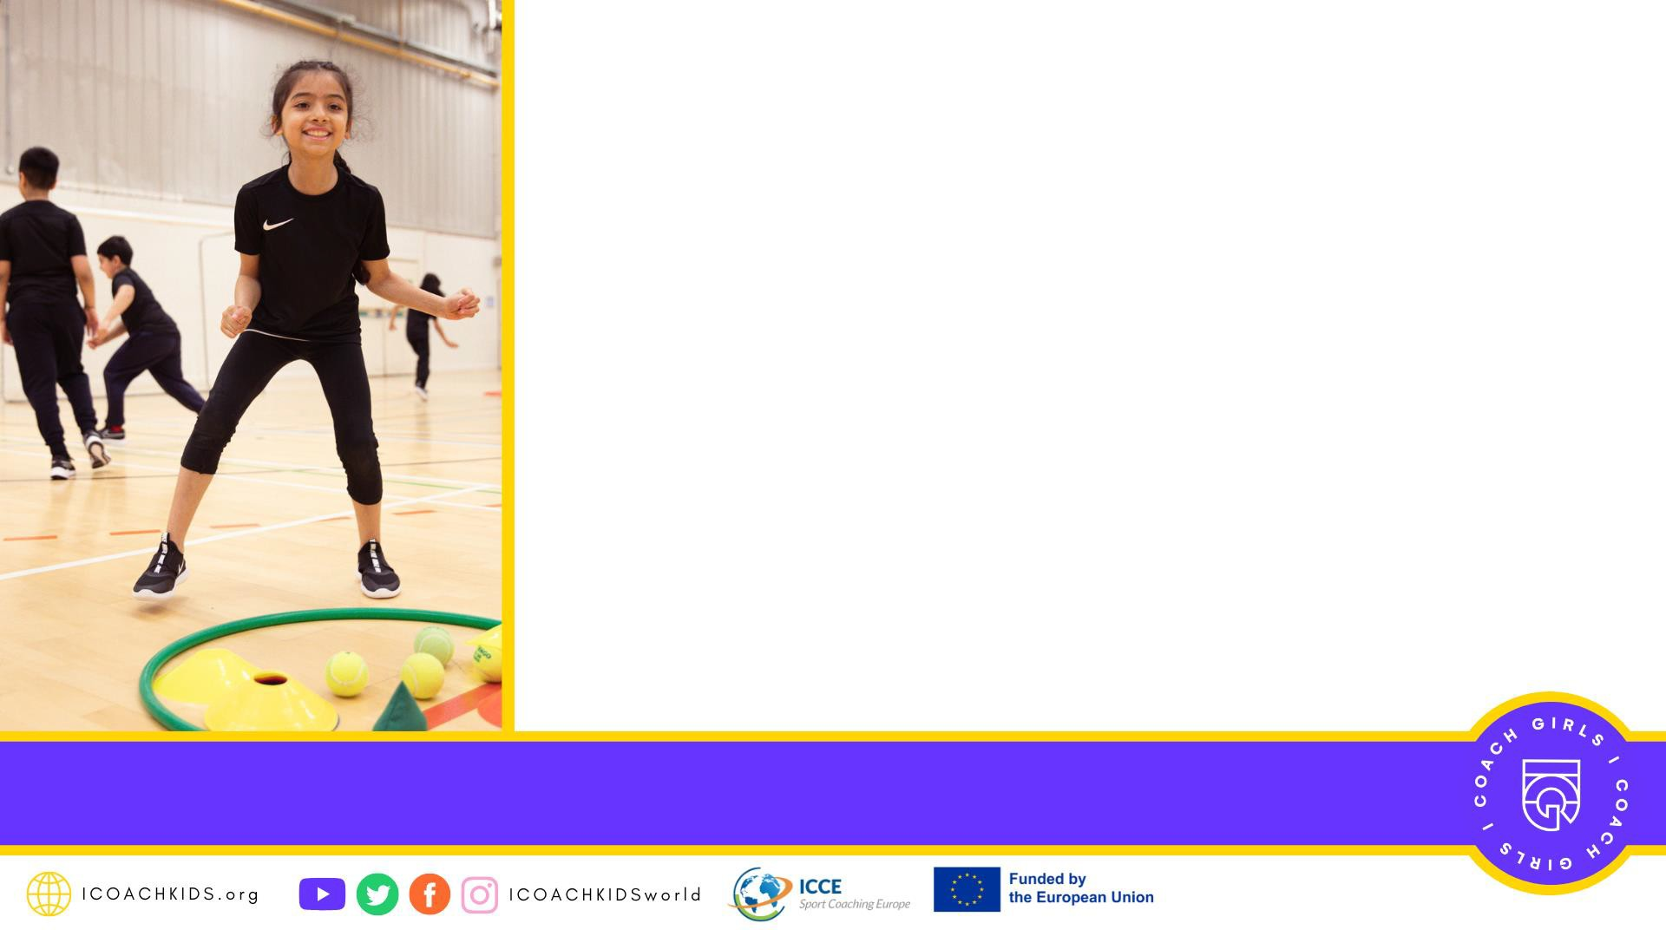
Issues
Lack of role models
Sport being seen as masculine
Body image
Lack of parental support
Sport centred around boys
Lack of early opportunities

Slide 6

Developing Coaching Practices and Building an Environment That Appeals to Girls
Coaching practices that appeal to girls have been found to:
Create an environment of teamwork
Foster autonomy
Build confidence through positive coaching
Embrace and maximise a sense of belonging
sportireland.ie

Slide 7

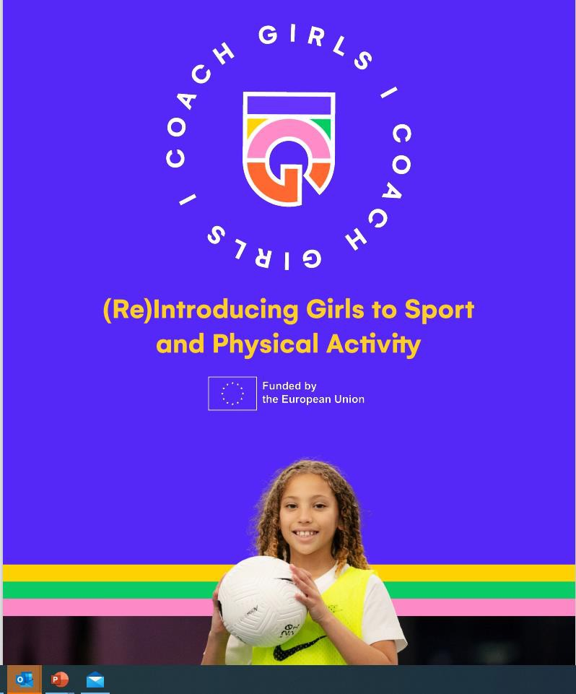
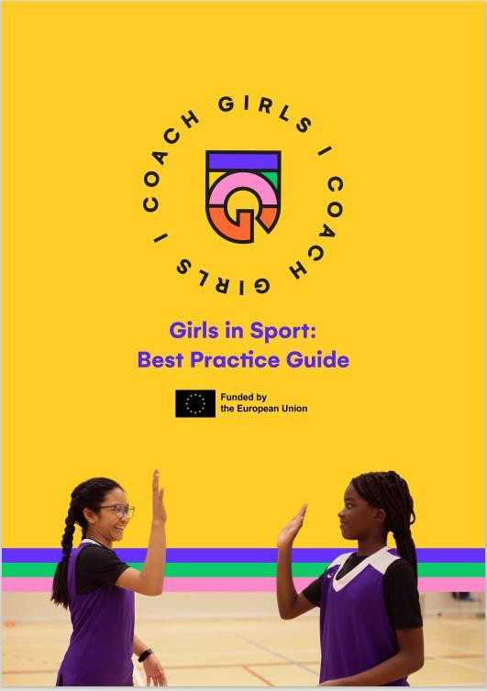

10 elements for success
In brief, the 10 Girls in Sport elements are:
DEVELOPMENT-ORIENTED
Focus on competence
Provide non-competitive activities
MOTIVATIONAL
Provide high support
Offer a variety of activities and variations
Use role-models
CARING
Promote friendships and social connections
Help coaches to understand girls’ needs
SOCIALLY SAFE
Create a positive, inclusive and welcoming environment
Provide girls only opportunities
Be aware of issues related to body image and act accordingly

Slide 8
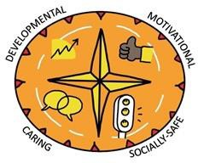
Developmental Oriented Climate
Helping young athletes reach their full potential, by offering age-appropriate activities.
Focus on competence
  Emphasise development instead of winning
  Develop fundamental movement skills
2. Provide non-
competitive activities
The Youth Sport Compass
Emphasise development, fun and involvement
Create a welcoming, non- competitive atmosphere

Slide 9
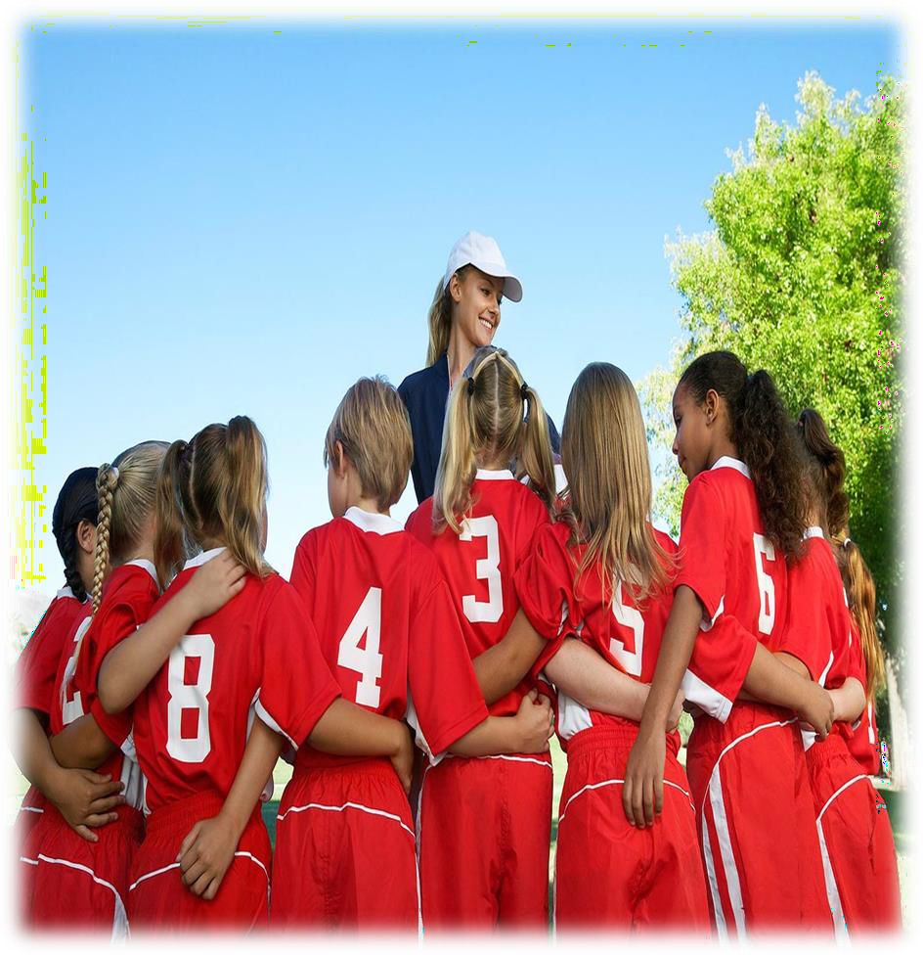
Builds Confidence Through Positive Coaching
Coach the person before the sport
Ensure participants understand that making mistakes is part of the development process - Mistakes are learning opportunities
Focus on process rather than outcome/results –
highlight and reward effort
Make each girl feel valued – do not compare to others but to own previous efforts
Use appropriate language (avoid expressions such as
“lads” or “guys”)
Be FAIR – girls don’t easily reconcile injustice & notice
favouritism readily.
Avoid sarcasm and criticism – girls are more likely to internalise
sportireland.ie

Slide 10
Motivational Climate
Ensuring children become and remain motivated, understanding the importance of positive feedback.
The Youth Sport Compass
3. Provide high support
4. Offer a variety of activities and variations
5. Use role-models
Provide positive reinforcement
Consult girls about their needs and preferences
Use female coaches to act as role models
Use imagery of women in sport
Provide multiple options
Consult girls

Slide 11
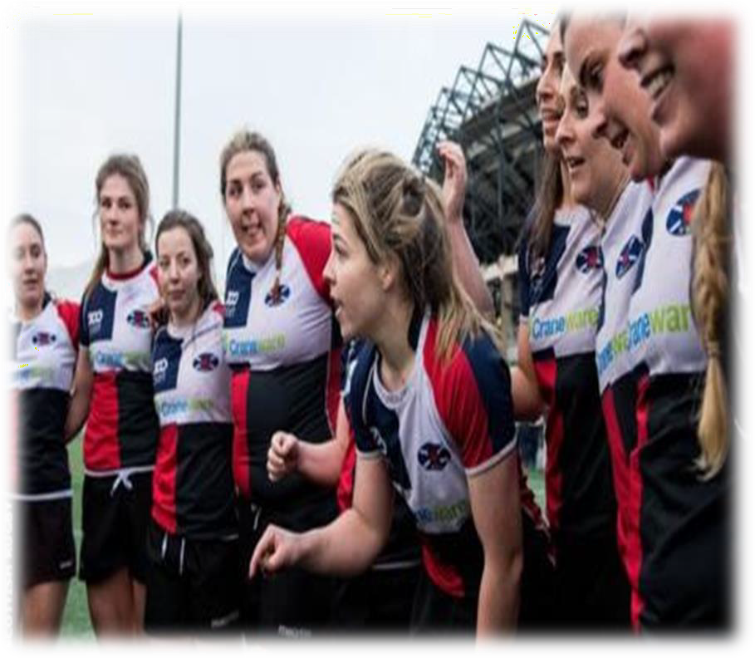
Foster Autonomy Within your Coaching
Girls enjoy having input into their development
Create a safe environment where contribution is celebrated
Be open and create opportunities for girls to
contribute ideas
Focus on decision making components within your coaching
Create opportunities for girls to be leaders – ensure any girl who wants to gets a try
Invite feedback from the participants about the
session and ideas for improvement
sportireland.ie

Slide 12
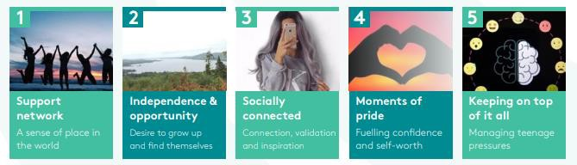
Sport Ireland Research
What really matters in girls lives (aged 14-15 years) through 5 key anchors:
sportireland.ie

Slide 13
Meeting the Psycho-Social Needs of Girls in Sport
Intrapersonal Factors (Within the girl) | Confidence to try new things Priority of sport and physical activity Motivation Body image and appearance
Interpersonal Factors (How the girl connects with others) | Social support from peers and family Relationships with coaches Role models
Environmental Factors (How external environment impacts the girl) | Social climate (Social Environment) Access to opportunities
sportireland.ie

Slide 14
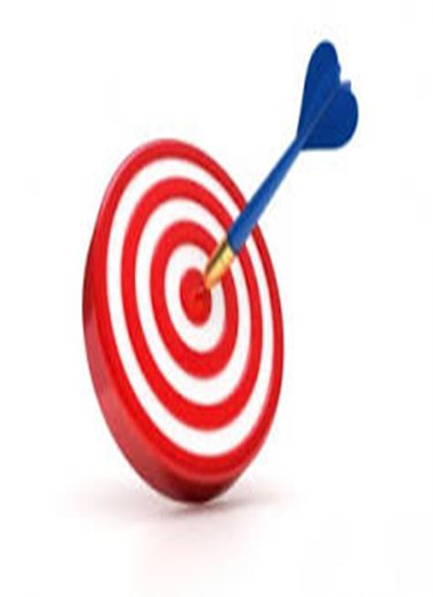

TARGET: Creating a Positive Motivational Climate
Tasks: Focus on learning and task involvement – varied and differentiated
Authority: allow girls to participate in decision making Reward: Reward improvement, effort and social involvement
Time to Reflect 5.1
Grouping: create cooperative learning involvements in groups, mixed ability, cooperative
Evaluation: focus these on personal improvement and emphasis self-referenced improvement
Timing: Flexible time for task completion
Is TARGET useful for
training sessions?
sportireland.ie

Slide 15
Caring Climate
cial
Creating a safe environment, where children feel respected and secure in all so
interactions.
The Youth Sport Compass
6. Promote friendships and
7. Help coaches to
understand girls’ needs
social connections
Create time for socializing
Acknowledge that girls have different needs
before, during and after
sessions
Encourage co-operative play
Interact with girls about their needs and wants

Slide 16
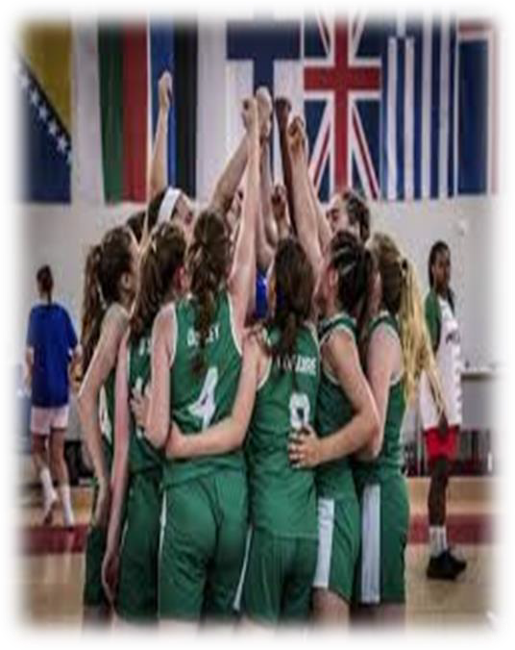
Create a Collective Environment of Teamwork
Consider what a good teammate is and encourage each participant to be a good teammate (ask them)
Find ways for teammates to cheer each other on (at what?)
Embrace and celebrate contribution:
  Ensure all contribution is acknowledged (what examples)
  Seek ways for all participants to contribute
Encourage and celebrate teamwork
Develop opportunities for teammates to cheer on each other
Keep an eye for cliques forming – what could you do?
sportireland.ie

Slide 17
Socially Safe Climate
Ensuring children have sufficient support and care, understanding and seeing each child as a unique individual.
The Youth Sport Compass
8. Create a positive, inclusive and welcoming environment
9. Offer girls only activities
10. Be aware of issues relating to body image
Ensure the initial experience is overwhelmingly positive and friendly
Prevent teasing and bullying
Acknowledge that girls have specific needs
Understand that mixed spaces can be a barrier.
Involve girls in decision about sportwear (clothing and other material)
Provide girls’ facilities (e.g., changing room, sanitary towels).

Slide 18
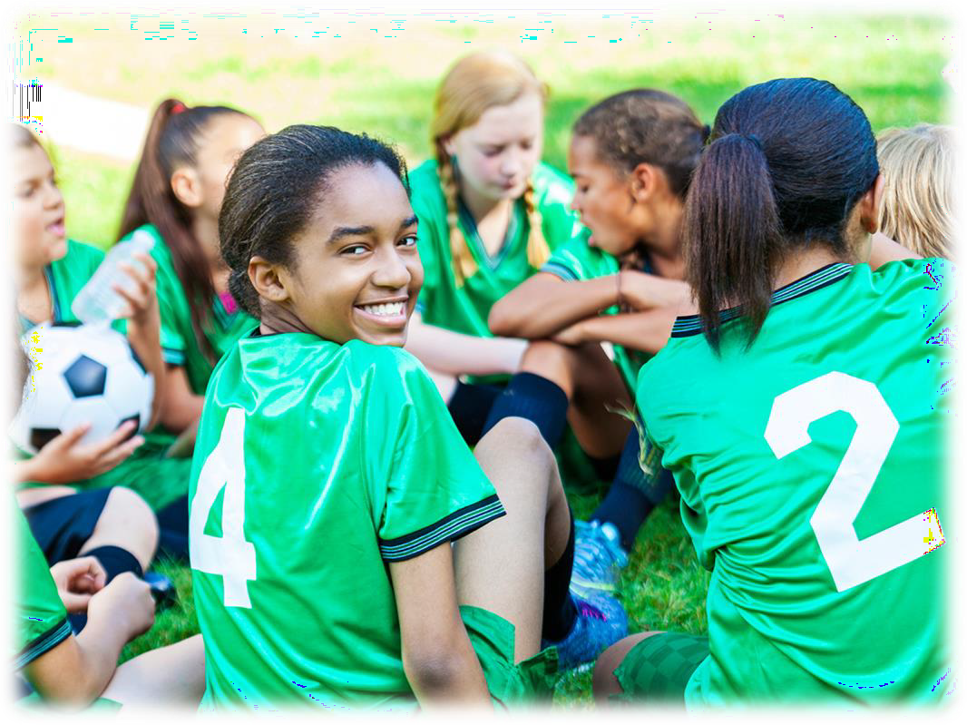
Connect And Encourage Connections to Maximize a Sense of Belonging
Most girls are socialised to be social
Girls respond to feeling connected
Create designated social times – e.g., encourage
the girls to arrive early to connect with their friends
Create opportunities for players to feedback to
each other (positively) e.g. ask them to say something that impressed them about the girls
on their team / group
Encourage girls to celebrate each other
Coaches should connect with each individual –
observe individual needs and preferences
sportireland.ie

Slide 19
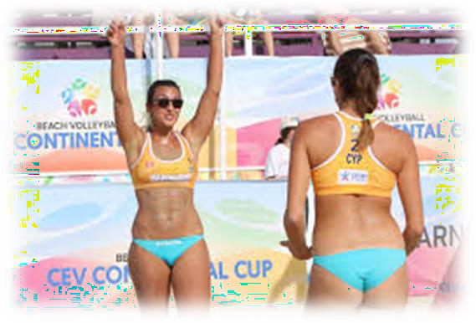
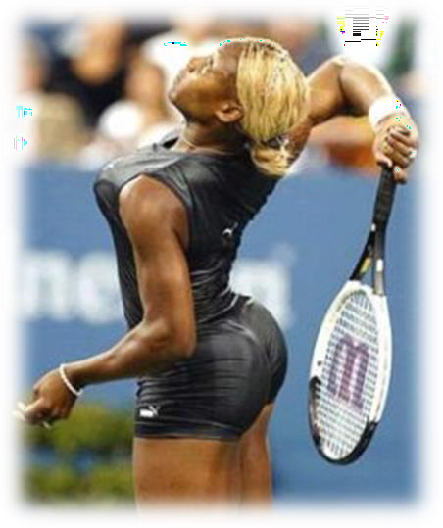
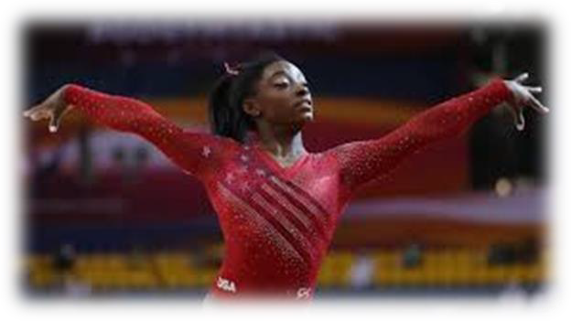
What is Body Image?
Body image refers to the thoughts, feelings, and perceptions you have about your body appearance and shape.
Individuals who feel better about their bodies (i.e., have positive body image) are more likely to engage in physical activity than those who have negative body image.
Individuals who are self-conscious and anxious about their appearance tend to prefer to exercise alone and have lower levels of enjoyment.
sportireland.ie

Slide 20
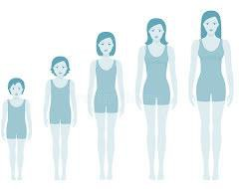
Effects of Puberty
While increases in body size, hormones, and muscle strength can improve athletic performance, there may be a temporary decline in balance skills and body control during the adolescent growth spurt.
Quick increases in height and weight effect the body's centre of gravity and a
teen (12-17) may seem a bit "clumsy."
An increase in fat mass resulting in wider hips and formation of breasts -
psychological impact.
Emotional changes such as mood swings, anxiety and changes in relationships
with others.
sportireland.ie

Slide 21
Practical solutions
Provide high support Offer a variety of activities
Focus on competence
Provide non-competitive activities
Use role-models
Create a positive, inclusive and welcoming environment
Promote friendships and social connections
Help coaches understanding
girls’ needs
Provide girls only opportunities
Be aware of issues relating to body image

Slide 22
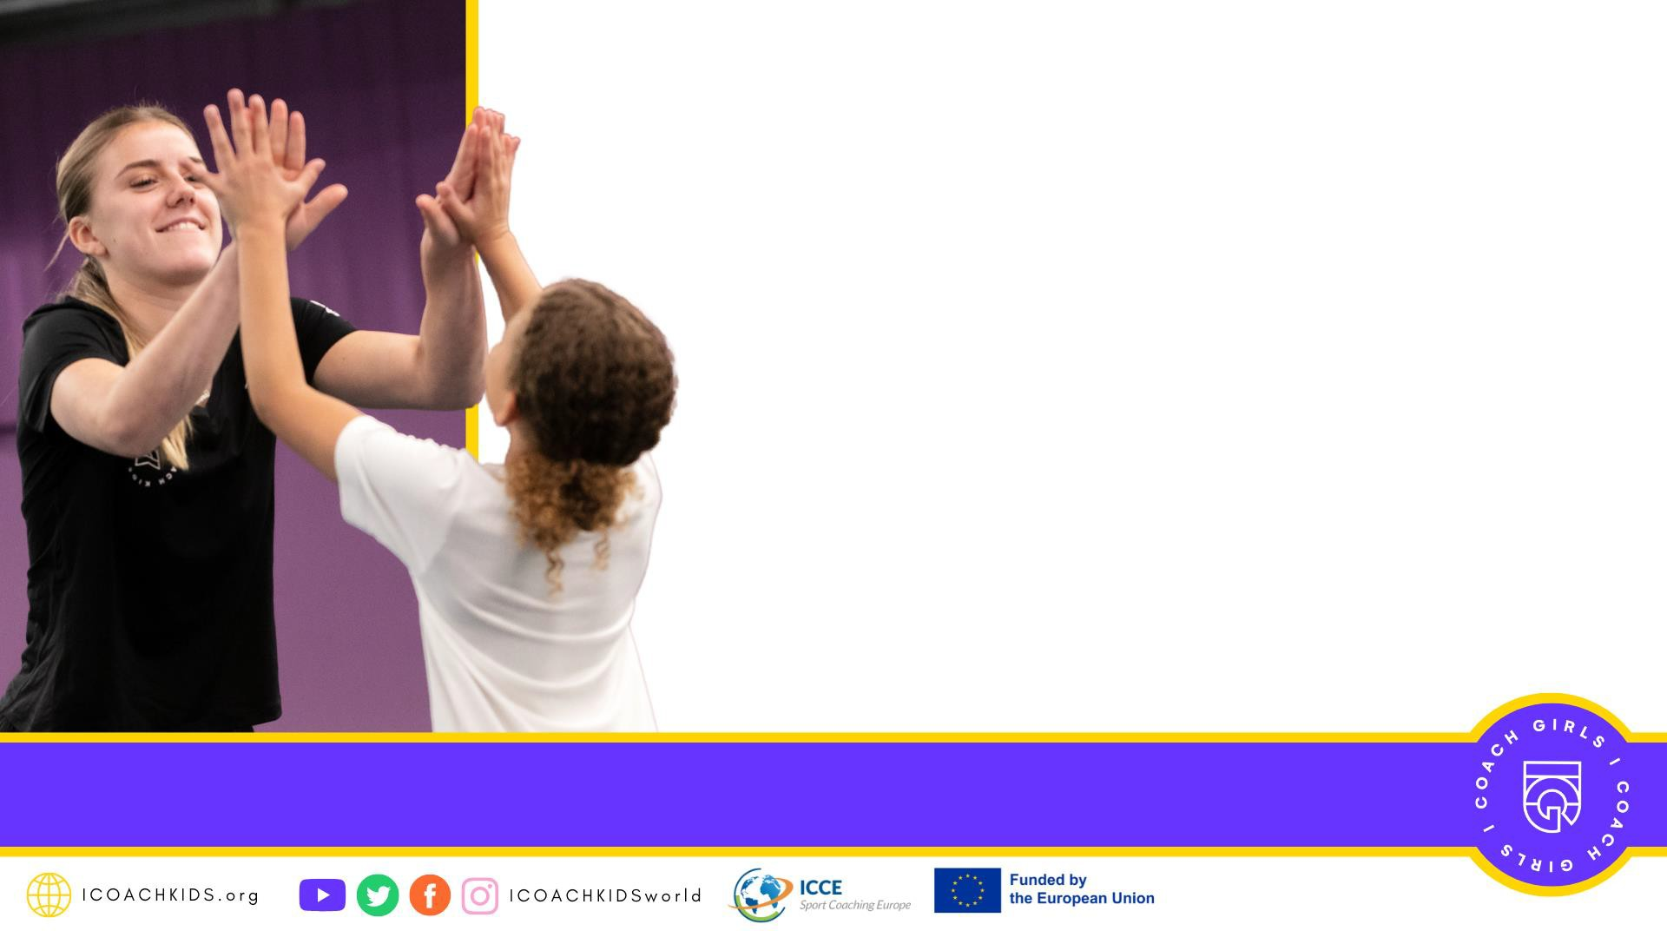
Post Workshop Reading/Task
10 elements – ICOACHGIRLS guide 1
Case Study Projects–ICOACHGIRLS guide 2
ICOACHKIDS Pledge – ICK website
Youth Sport Compass – ICOACHGIRLS guides
ICK Pledge https://www.youtube.com/watch?v=t8UikQNO2R8
Youth Sport Compass https://www.youtube.com/watch?v=83McfP3FUOk

