Slide 1
YSC
M#4
Course 4.2
Understanding Balance, Coordination and Agility and Speed
M#4 Fundamental Movement Skills and Play

Slide 2
Technical sheet
Project: Education for Physical Activity and Sport: Informal and Non-formal Settings
Authors: EduPASS Project Partners
Intellectual Property Statement: The following slides were presented by Sport Ireland Coaching during the EduPASS LTT events. They are shared here as a resource to be adapted in respective contexts, where those Sport Ireland Coaching ’ intellectual property should be acknowledged, if their slides are used.
For further information on the EduPASS Project please follow the link:
Website https://edupass-project.eu/
This work is licensed under the Creative Commons Attribution 4.0 International
License http://creativecommons.org/licenses/by/4.0/

Slide 3
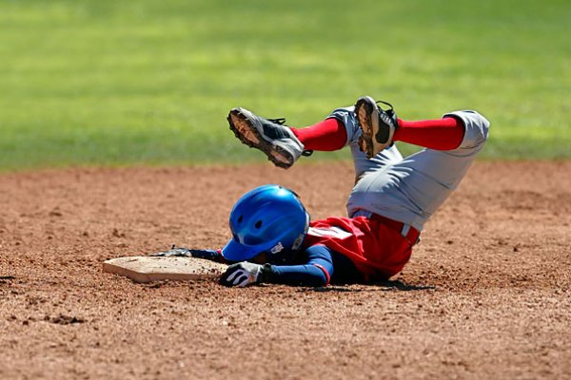
The Holy Grail – Safe & Efficient Movement
https://www.youtube.com/watch?v=BJYCp8I9qUs
Notes:
Perhaps review the Multi-Skills Jigsaw from the writing on the wall

Slide 4
The Holy Grail – Safe & Efficient Movement
In small groups, come up with a definition of safe and efficient movement and its key components
Notes:
Perhaps review the Multi-Skills Jigsaw from the writing on the wall

Slide 5
The Holy Grail – Safe & Efficient Movement
Safe movement is movement where the joints and muscles of the body are able to withstand the forces produced by the movement.
Efficient movement is movement where the joints and muscles of the body produce an action or force with the lowest level of energy expenditure possible.
Appropriate angles and ranges of movement, and the ability to create and dissipate force are paramount to this.
BALANCE – COORDINATION – AGILITY & SPEED

Slide 6
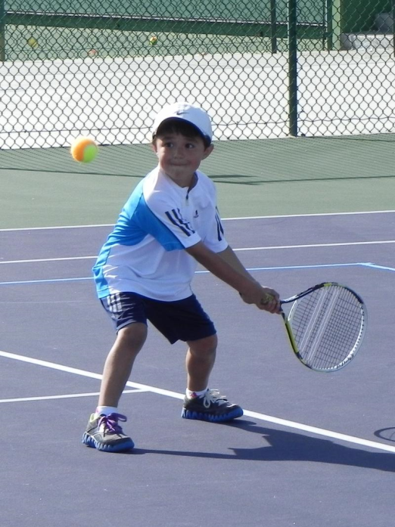
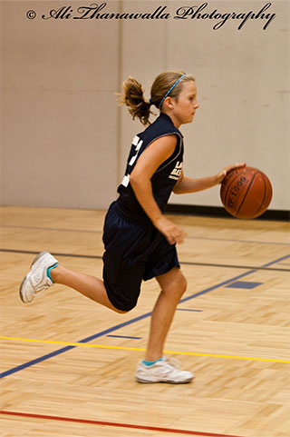
The Holy Grail – Safe & Efficient Movement
Balance, Coordination, Agility and Speed are the fundamental building blocks which allow movement to be safe and efficient.

Slide 7
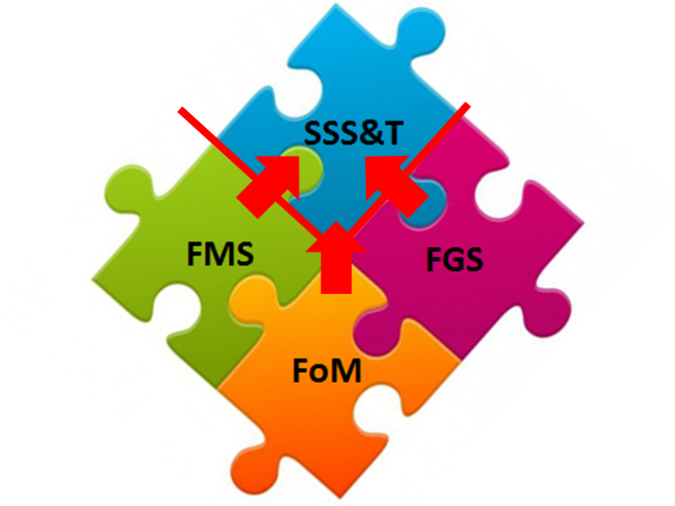
The Multi-Skills Jigsaw
Fundamental Games Skills
Fundamental Movement Skills
Fundamentals of Movement

Slide 8
The Multi-Skills Jigsaw & Benefits
All-round development
Facilitation of skill acquisition later in life
Facilitation of transitions to other sports or within sport
Injury prevention
Prevention of burn-out
Specific sports can be used as a vehicle for multi-skills development
Multi-Skills Jigsaw
Lara-Bercial, Hetherington and Hendrie (2015)

Slide 9
Fundamentals of Movement
Balance
Coordination
Agility
Speed

Slide 10
Balance
Centre of Gravity
A state in which the body remains reasonably steady and stable
It’s the foundation to safe, efficient and effective movement
Static & Dynamic
Counter-balance
Base of Support
Core Strength

Slide 11
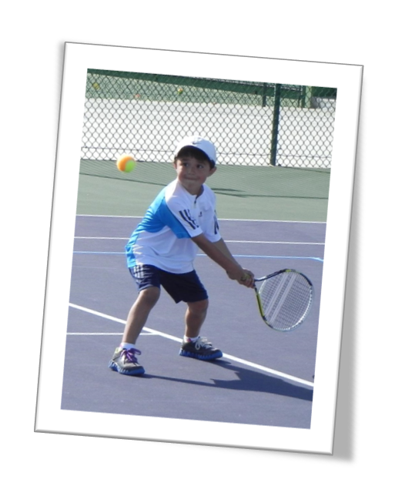
Coordination
Mental Organisation
The skilful and balanced movement of the body and its parts at the same time
Internal and External
To produce an action…
Or to produce force
Kinematic Chain
From the Centre Out
From the Head Down

Slide 12
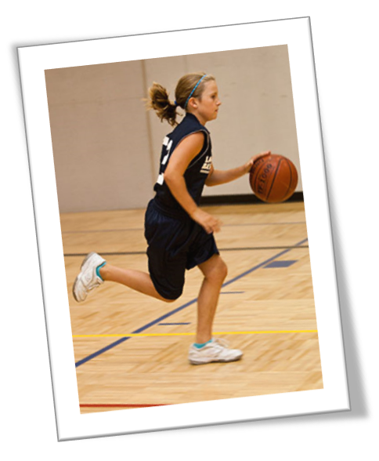
Agility & Speed
Start-Stop
Efficiently
Control of the body and its parts in a dynamic environment
Ability to move quickly and efficiently, start, stop and change direction and speed whilst maintaining stability
Change Speed
Change Planes
Change Direction

Slide 13
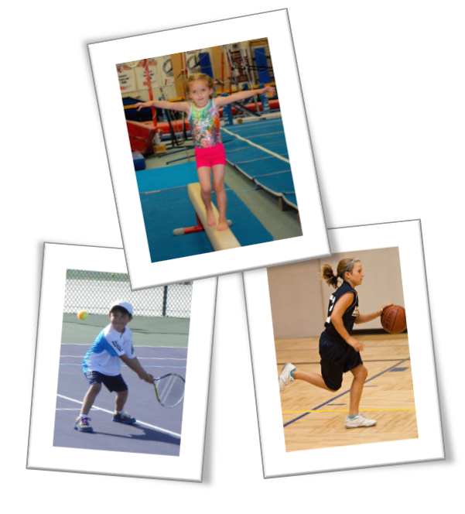
Observation & Analysis Skills - What?
Balance:
Base of support
Height of CoG
Counter balance
Core strength
Coordination
Mental organisation
Mistimed Kinetic Chain
From centre out
From head down
Agility and Speed
Start-Stop efficiently
Changing speed
Change direction
Change plane/level

Slide 14
Observation & Analysis Skills - How?
Vantage Point
Focus on one individual
Whole v Part Focus
More than once
Have an agenda
Use of Video

Slide 15
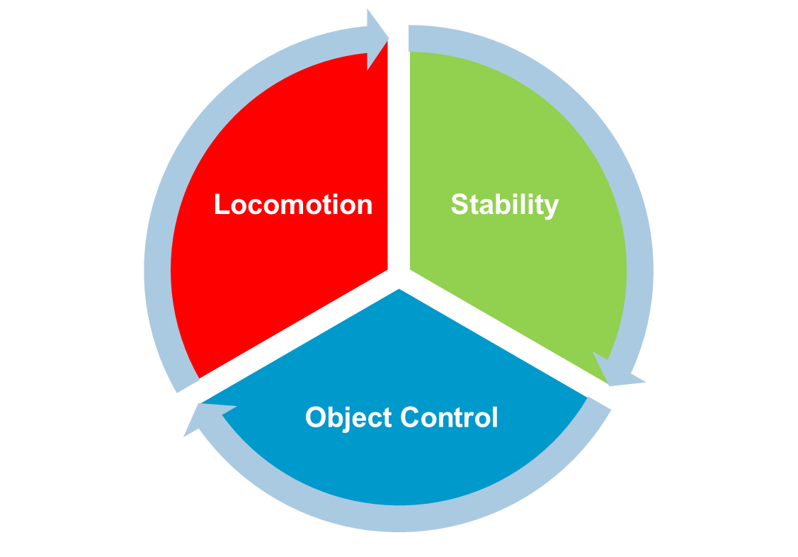
Fundamental Movement Skills (BCAs combo!)
FMS are combinations of different FOM (Balance, Coordination, Agility and Speed) patterns. Take account of how these may apply in different environments and sports
Walking
Running
Jumping
Skipping
Dodging
Leaping
Sliding
Swimming
Etc.
Landing
Twisting
Turning
Starting position
Stopping position
Floating
Etc
Catch, Throw, Pass, Kick, Strike with implement, Dribble, Bounce, Surfboard, Etc.

Slide 16
Activity Analysis - Let’s Play!
1. Set up and play an activity
2. Then review using the worksheet
3. Reflect on what BCAs you observed in the activities
4. Discuss how you would affirm efficient movement
5. Discuss how you would address inefficient movement
Notes:
Building your athletes own GPS system… Stop them depending on yours…

Slide 17
Game Design - Let’s Play!
1. Now think about a particular FOM that you could coach
2. Using the ideas we have covered try to develop or pick a game that would support the learning of that FOM
3. Use the Blank Game Card to record your ideas
4. Volunteer to coach the game
5. Discuss the game with your peers and it’s effectiveness in developing the FOM
Notes:
Building your athletes own GPS system… Stop them depending on yours…

Slide 18
THANK YOU!

