Slide 1
YSC
M#5
Course 5.1
Fundamentals to Coaching Practice
M#5 Hands-on Coaching

Slide 2
Technical sheet
Project: Education for Physical Activity and Sport: Informal and Non-formal Settings
Authors: EduPASS Project Partners
Intellectual Property Statement: The following slides were presented by Sport Ireland Coaching during the EduPASS LTT events. They are shared here as a resource to be adapted in respective contexts, where those organisations’ (Sport Ireland Coaching) intellectual property should be acknowledged, if their slides are used.
For further information on the EduPASS Project please follow the link:
Website https://edupass-project.eu/
This work is licensed under the Creative Commons Attribution 4.0 International
License http://creativecommons.org/licenses/by/4.0/

Slide 3
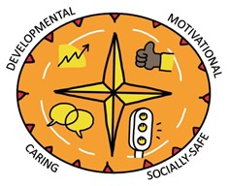
Youth Sport Compass
DEVELOPMENT-ORIENTED
Helping young athletes reach their full potential, by offering age-appropriate activities.
MOTIVATIONAL
Ensuring children become and remain motivated, understanding the importance of positive feedback.
The youth sport compass is a great tool to help us think about how to support children in appropriate ways. By considering our practice across the four corners, we can ensure we create a positive environment where children can thrive.
Watch this video for more:
https://www.youtube.com/watch?v=83McfP3FUOk
SOCIALLY SAFE
Creating a safe environment, where children feel respected and secure in all social interactions.
CARING
Ensuring children have sufficient support and care, understanding and seeing each child as a unique individual.

Slide 4
Introduction
Coaching children is not always easy. But it is very rewarding. Active children are more likely to become active adults, and who knows… maybe the coaches of the future.
Creating a child-centred motivational climate can be a challenging task. Promoting communication, honesty and openness in your coaching relationships and environments is essential.
It is important to emphasise that YOU, the coach, can have an impact on what goes on in your training sessions and the type of environments that you create. Create safe spaces for children to develop a LOVE FOR SPORT.

Slide 5
Key point …..
A very small proportion of kids will become elite athletes, yet all of them have the potential to become healthy and active adults.
Creating that legacy is a part of a coach’s job.
And remember:
Children are not mini-adults: make sport fit the child, not the child fit the sport

Slide 6
Ripples on a Pond
Imagine dropping a stone into water. The ripple effect it causes is just like the things that learning needs to grow and develop.
Ripple 1: Wants and Needs
Ripple 2: Doing
Ripple 3: Making Sense
Ripple 4: Feedback

Slide 7
Ripples on a Pond
Ripple 1: Wants and Needs
Wants:
Learning happens when someone wants to learn something.
But not all children have this want all of the time.
Therefore, a coach should create the want in their participants.
This can only be done if the coach understands a child’s motivations.

Slide 8
Ripples on a Pond
Ripple 1: Wants and Needs
Needs:
When the child is aware of the needs for new knowledge or skills to succeed.
For example, if you want to get to this, you need that.
More simple than creating a want.
But coach must help the child see and feel the need.

Slide 9
Ripples on a Pond
Ripple 2: Doing
This is where children practice the skills according to their wants and needs.
Coaches need to consider whether their activities give their participants the opportunities to practice these skills.
Children love to play, so create opportunities for them to practice while they do so!

Slide 10
Ripples on a Pond
Ripple 3: Making Sense
If kids get to practice, they have more opportunities to make sense and increase their understanding of a skill.
Coaches should consider how they use the tools from the Coaches Toolkit to help kids make greater sense:
Explanations
Demonstrations
Set-up and Stand Back
Questioning and Listening
Feedback*

Slide 11
Ripples on a Pond
Ripple 4: Feedback
Children can receive feedback from:
Coaches
Peers
Parents
Themselves
Coaches should consider how they deliver feedback to keep the kids to:
Come back for more sessions
Develop a love for sport
Meet their wants and needs

Slide 12
Team Talk
In groups, discuss the following:
How do you identify kids wants?
How do you identify kids needs?
5 minutes

Slide 13
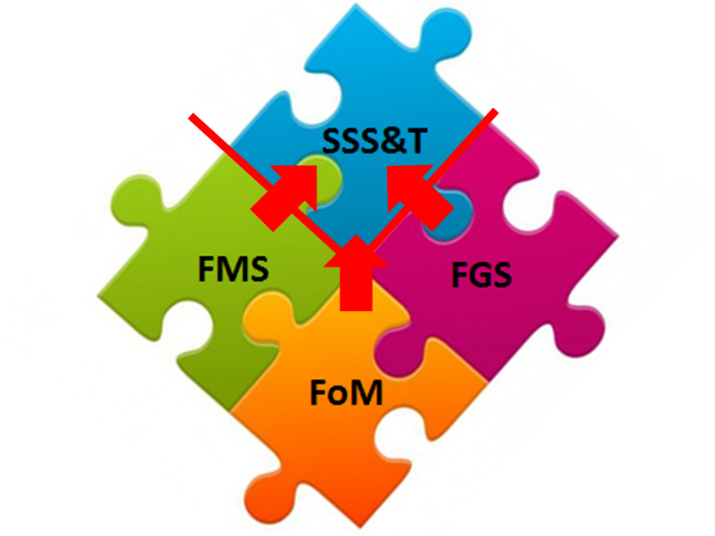
Multi-Skills Jigsaw
Fundamentals of Movements
Fundamental Movement Skills
Fundamental Game Skills
Sports Specific Skills and Tactics
Notes:
Build girls’ skills early so there’s a level playing field:
Encourage, expect, and support girls from a young age to master the fundamental skills they need to succeed in sport. Skills give sport meaning for girls, make competition fairer and success more attainable, building and sustaining self-belief.
Irish children demonstrated low levels of FMS mastery (25.2% - 56.7%), with boys significantly outperforming girls in object control skills

Slide 14
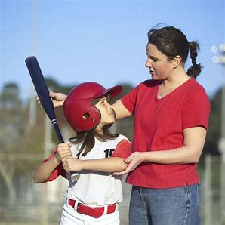
The Coach’s Toolkit
As well as Planning and Organisation -
1. Explanations
2. Demonstrations
3. Setting Up and Standing Back (Observation, Analysis, Have a Go, Intervention)
4. Questioning and Listening
5. Feedback
_______________________
6. Reflection (During a session)

Slide 15
Developing Your Coaching – Experiential Learning
1. Have an open mind: Each Coaching Tool is a SKILL & can be learned!
2. Plan how you will use the Coaching Tool:
Then Deliver - Reflect - Repeat the process.
3. Ask the children about your use of the Coaching Tool.
4. Have a co-coach observe you & provide feedback.
5. Observe other coaches applying the Coaching Tool.

Slide 16
Coach Reflection ‘On Practice’
Defined as - Thinking back on your experience of what happened in the session for the children.
Then deciding what went well and what challenged you.
___________________________________________
Reflect On Practice – After a coaching session:
The Voice of the Children – How did you hear them?
The Youth Sport Compass Climates – What was applied and what worked?
The Coach’s Toolkit – Which Tools did I use and How well did I apply it?
For ICG Play Centres – 15 minutes (post-clean up)
For EduPASS – 10 minutes

Slide 17
Mentoring
Definition - Mentoring is a relationship in which advice, information, guidance, support, or opportunity are offered for further development.
BENEFITS
For the Mentee: Increased learning, motivation, belief, skills, self-satisfaction, not alone
For the Mentor: Sense of commitment, new ideas, continuous learning, leadership skills, satisfaction
For the Club / Community Group: Loyalty and commitment, Enthusiasm, Attraction of new coaches, Development and retention, Reduced turnover, Increased productivity.

