Slide 1
ECE
M#5
Course 5.2
Practical strategies in the classroom
M#5 Hands-on Teaching

Slide 2
ECE
M#5
Course 5.2
Technical sheet
Project: Education for Physical Activity and Sport: Informal and Non-formal Settings
Author: Jerónimo García-Fernández
Intellectual Property Statement:
The following slides were adapted to ECE from “Reflective Practice in PE Teaching” (Prof. Dr. Francis Ries), Part of the subject: “Teaching of PE II”, faculty of Educational Sciences, University of Seville. They are shared here as a resource to be adapted in respective contexts, where the intellectual property of Jerónimo García-Fernández, Francis Ries / University of Seville should be acknowledged, if their slides are used.
For further information on the EduPASS Project please follow the link:
Website https://edupass-project.eu/
This work is licensed under the Creative Commons Attribution 4.0 International
License http://creativecommons.org/licenses/by/4.0/

Slide 3
ECE
M#5
Course 5.2
Design and execute developmentally appropriate activities, utilizing innovative teaching tools. Demonstrate empathy, respect, and a commitment to continuous learning and reflective practice.
Teaching Unit 1: Designing inclusive educational activities. Teaching Unit 2: Managing group dynamics and conflict resolution. Teaching Unit 3: Real-time assessment and feedback.

Slide 4
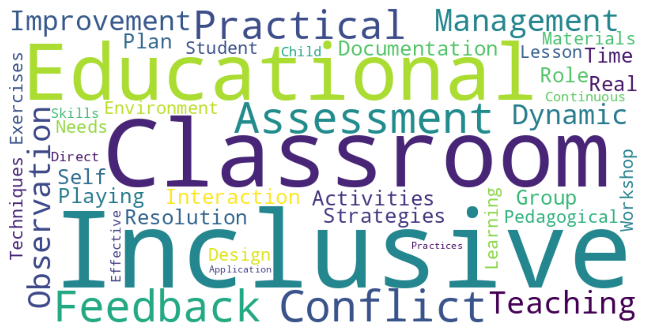
ECE
M#5
Course 5.2
What is important in this course 5.2?

Slide 5
ECE
M#5
Course 5.2
Teaching Unit 1: Designing Inclusive Educational Activities
This section focuses on creating activities that cater to diverse needs in the classroom. You will learn the basics of inclusive education and explore how to design activities that allow all students to participate fully and effectively.

Slide 6
ECE
M#5
Course 5.2
Inclusive education emphasizes equal learning opportunities for all students.
Key concepts include:
Recognizing diverse needs in the classroom.
Adapting activities to different skill levels and learning styles.
Insuring accessibility and active participation for every student.

Slide 7
ECE
M#5
Course 5.2
Creating inclusive materials involves:
Choosing materials that are accessible and engaging.
Customizing resources for varying abilities and learning preferences.
Testing materials for effectiveness in diverse learning environments.
Group activity: Design a sample inclusive material and test it with peers.

Slide 8
ECE
M#5
Course 5.2
A well-designed activity plan includes:
Clear objectives and goals.
Resources and materials needed.
Methods for adapting to various needs.
Assessment criteria to measure success.
Individual activity: Create an educational activity plan focusing on inclusivity and share it for group feedback.

Slide 9
ECE
M#5
Course 5.2
Teaching Unit 2: Managing Group Dynamics and Conflict Resolution
This unit covers techniques for managing group interactions and resolving conflicts. You will gain skills to foster a positive group environment and handle challenges that arise in classroom settings.

Slide 10
ECE
M#5
Course 5.2
Effective group management requires:
Understanding different personalities and how they affect group dynamics.
Setting clear rules and expectations for behavior.
Creating a safe space for open communication.
Group discussion: Share experiences of group dynamics in your classroom.

Slide 11
ECE
M#5
Course 5.2
Key conflict resolution techniques include:
Active listening and empathy.
Clear and assertive communication.
Steps to de-escalate tense situations.
Practice role-playing: Work in pairs to simulate common classroom conflicts and resolve them effectively.

Slide 12
ECE
M#5
Course 5.2
Role-playing activities help you practice managing conflicts.
In pairs:
Take turns acting as teacher and student in a challenging scenario.
Use techniques discussed to resolve the issue constructively.
Reflect on what worked and what could be improved.

Slide 13
ECE
M#5
Course 5.2
Observation and documentation are essential for understanding classroom interactions:
Use observation techniques to notice patterns in behavior.
Document incidents to help identify causes of conflict.
Exercise: Watch a short video or observe a simulated class, and note key interactions.

Slide 14
ECE
M#5
Course 5.2
Regular self-assessment helps refine your management skills:
Reflect on what strategies work best in your classroom.
Adjust your approach based on past experiences.
Activity: Complete a self-assessment on your conflict management and group dynamics strategies, and set goals for improvement.

Slide 15
ECE
M#5
Course 5.2
Teaching Unit 3: Real-Time Assessment and Feedback
Providing real-time feedback can significantly enhance learning outcomes:
Observe student engagement and understanding.
Give immediate, constructive feedback.
Adapt your teaching to meet students’ needs in the moment.
Group discussion: What are the challenges of real-time feedback in the classroom?"

Slide 16
ECE
M#5
Course 5.2
Documenting interactions provides insights into student progress:
Observe behaviors, participation, and social interactions.
Record observations to track development over time.
Group activity: Practice observing a simulated classroom scene, documenting behaviors, and discussing effective feedback methods.

Slide 17
ECE
M#5
Course 5.2
Practical strategies in the classroom
M#5 Hands-on Teaching
Adapted to ECE from: “Reflective Practice in PE Teaching” (Prof. Dr. Francis Ries ), Part of the subject: “Teaching of PE II”, Faculty of Educational Sciences, University of Seville

