Slide 1
YSC
M#1
Course 1.1
Needs and Benefits of Daily Physical Activities
M#1 Daily Physical Activity and Sport
& Motor Skills Assessment

Slide 2
Technical sheet
Project: Education for Physical Activity and Sport: Informal and Non-formal Settings
Authors: EduPASS Project Partners
Intellectual Property Statement: The following slides were presented by Dr. Biljana Popeska (University of Luxembourg) during the EduPASS LTT events. They are shared here as a resource to be adapted in respective contexts, where Dr. Biljana Popeska’s/University of Luxembourg’s intellectual property should be acknowledged, if their slides are used.
For further information on the EduPASS Project please follow the link:
Website https://edupass-project.eu/
This work is licensed under the Creative Commons Attribution 4.0 International
License http://creativecommons.org/licenses/by/4.0/

Slide 3
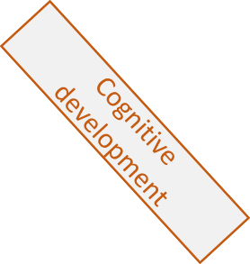
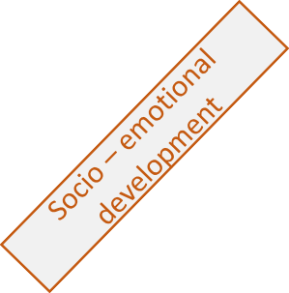
Holistic development of children
Motor development
Changes in fundamental movement skills, motor abilities, motor behavior, changes in movement behavior and factors that initiate those changes
Cognitive development
Changes in thinking, memorizing, attention, concentration, focus, perceptions, speech, fantasies, attention
Socio–emotional development
Changes in emotions, self- perception, and self – concept, interaction with others, communication, social relations
EduPASS LTT Luxembourg, January 22nd-26th 2024

Slide 4
Why is Physical Activity important
https://www.youtube.com/watch?v=U6nnRte5M70

Slide 5
Benefits from daily physical activity for children?
PHYSICAL AND MOTOR DEVELOPEMT
PA is important for proper physical and motor development
Improvement of physical fitness
Development of proper movement habits
Maintaining good posture
COGNITIVE DEVELOPMENT
PA improves all cognitive functions in children
Improves the ability to maintain attention and focus for longer period
Improves cognitive flexibilityy
Helps maintain attention, concentration and focus for longer period
Improves problem solving and orientation on task
SOCIO – EMOTIONAL DEVELOPMENT
Better self – perception
Positive self – image
Better social skills
Regulated emotional reactions
Positive mood
PHYSICAL AND MENTAL HEALTH
Maintain normal weight and proper growth
Supports maintaining good body posture
Improves immune system and overall health
Helps maintaining good sleep
Improves children mental health

Slide 6
Findings and facts from studies, UNESCO and WHO reports for physical activity in children
UNESCO
Physically active children have 15% more chances to continue in higher education
Physically active children has less chances to use tobacco, drugs, alcohol and less
The children of physically active moms has twice bigger chances to be physically active
WHO
Approximately 500 million people will develop hearth diseases, obesity, diabetes and other diseases due to physical inactivity in period between 2020 and 2030
Less than 50 % of the countries has national politics for PA from which, less than 40% are functional
Only 75% of the countries monitor PA of adolescents, while only 30% monitor PA levels in children younger than 5 years.
FINDINGS FROM STUDIES
PA children are less obese and have better sleep
PA children have better academic achievements and better behavior
PA children have better results on tests for memory
PA breaks in between other activities improve children`s attention, focus on tasks, and improved behavior

Slide 7
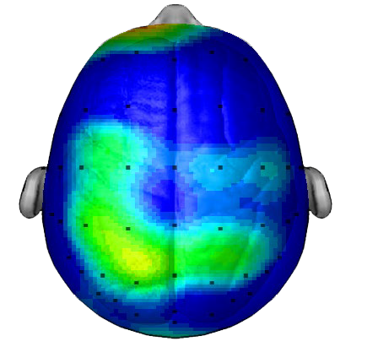
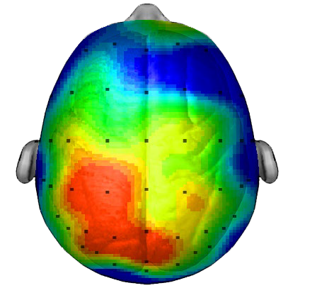
BRAIN ACTIVITY AFTER 20 MIN MOVEMENT
BRAIN ACTIVITY AFTER 1 HOUR SITTING
Research/scan compliments of Dr. Chuck Hillman University of Illinois

Slide 8
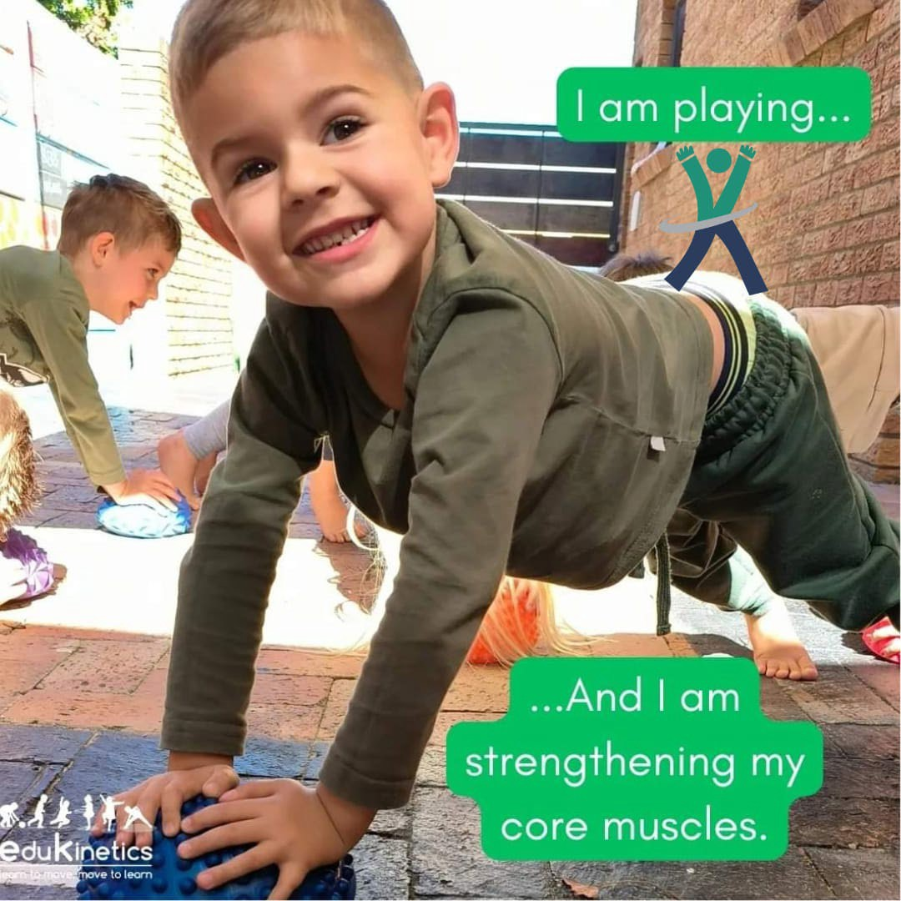
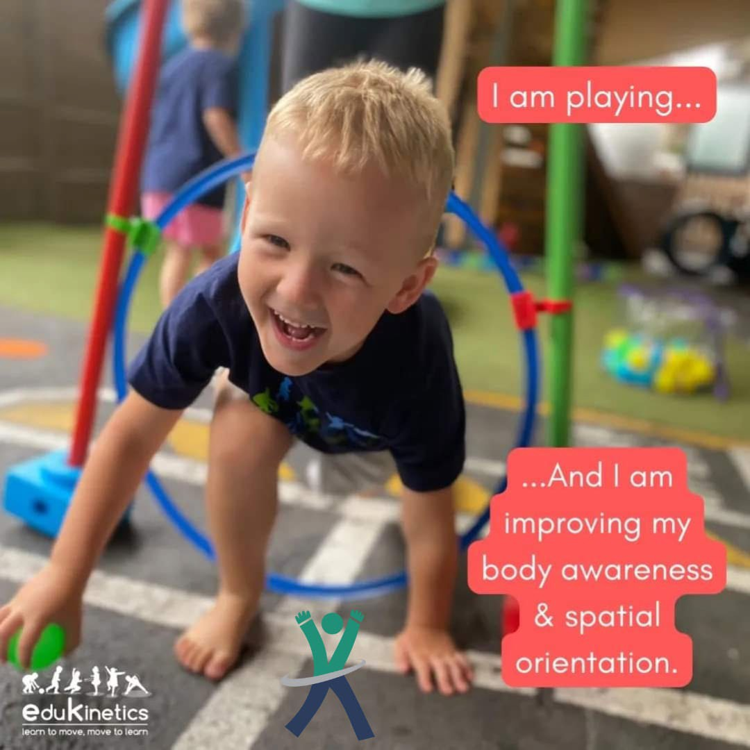
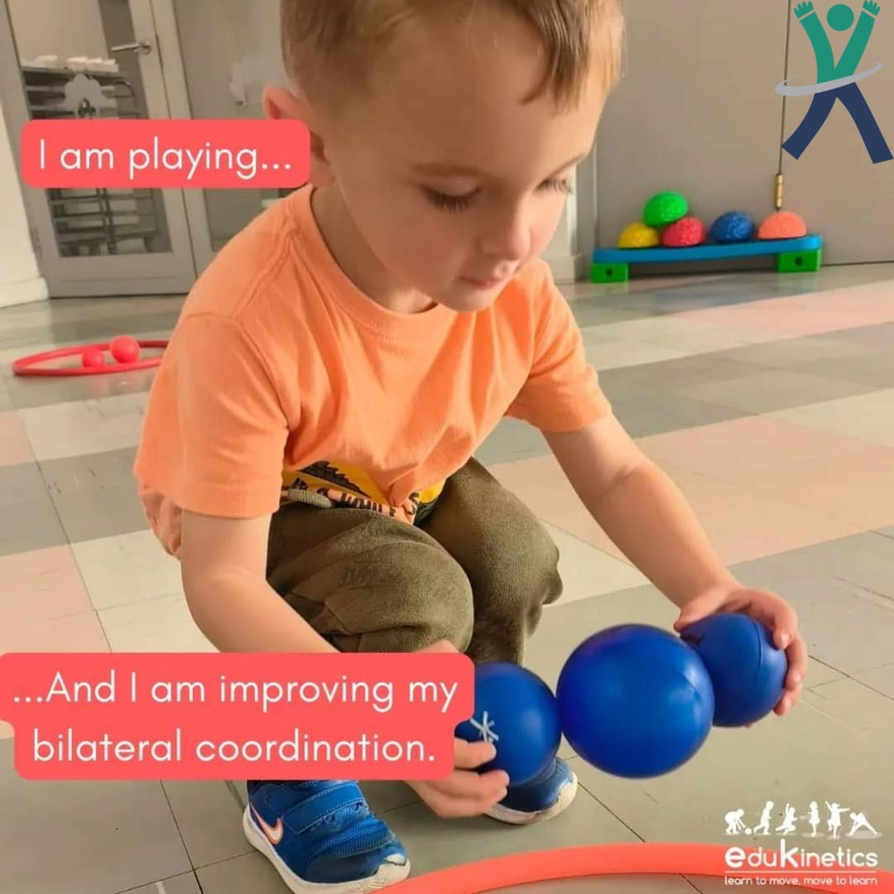
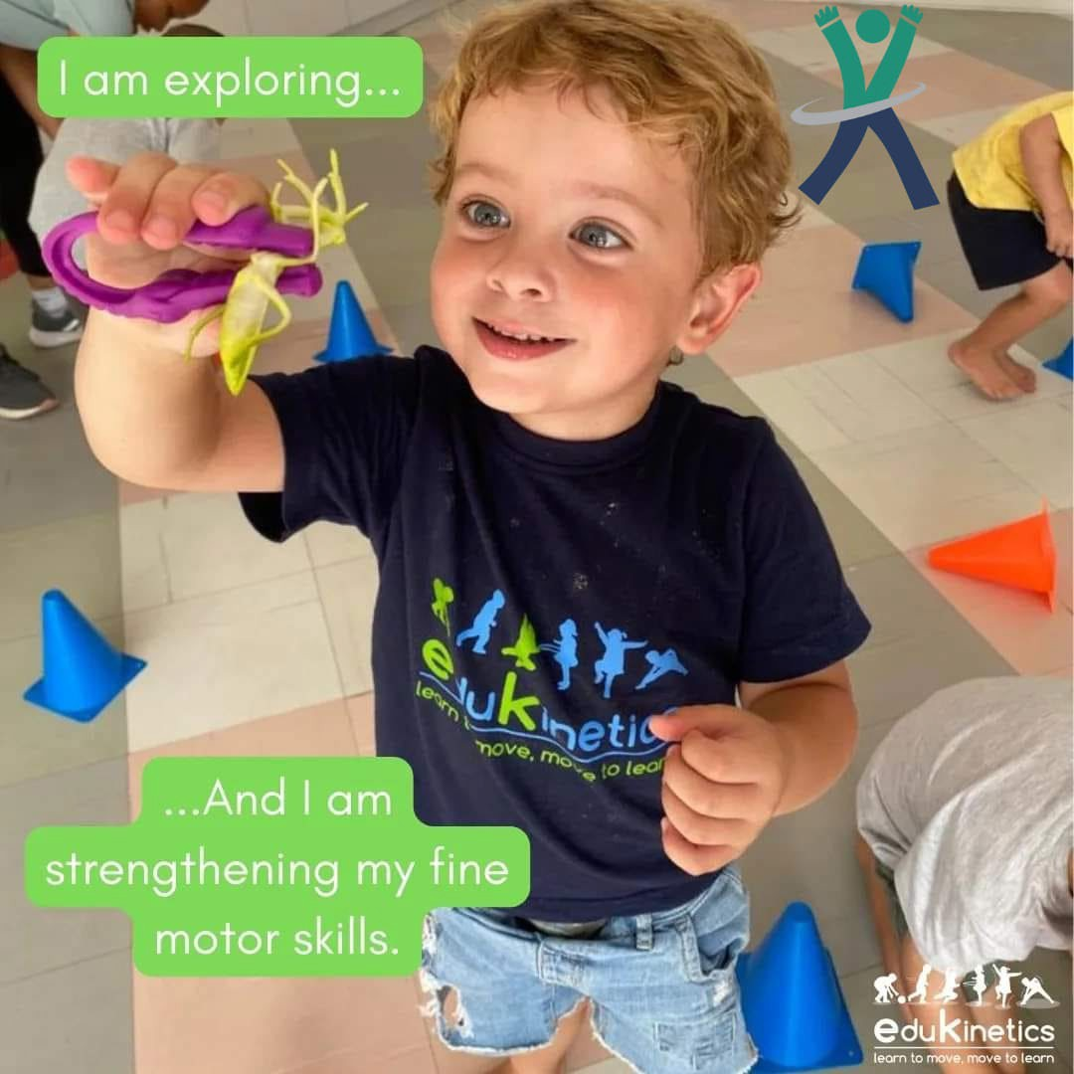
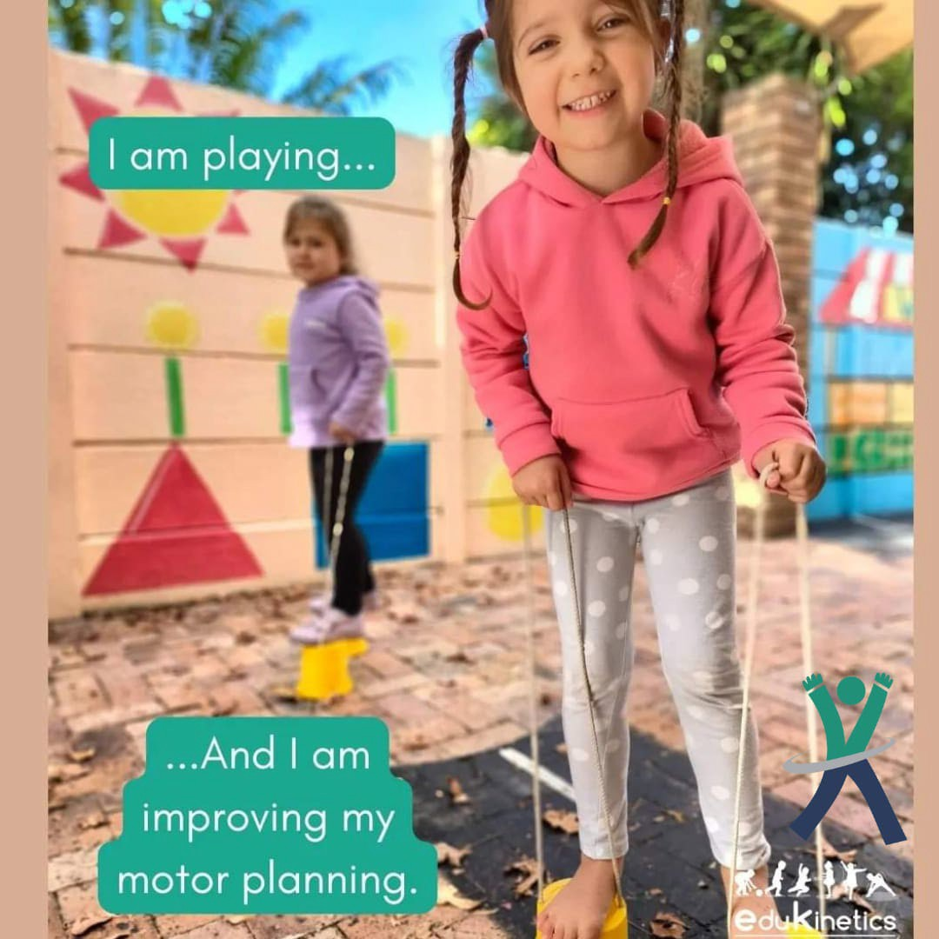
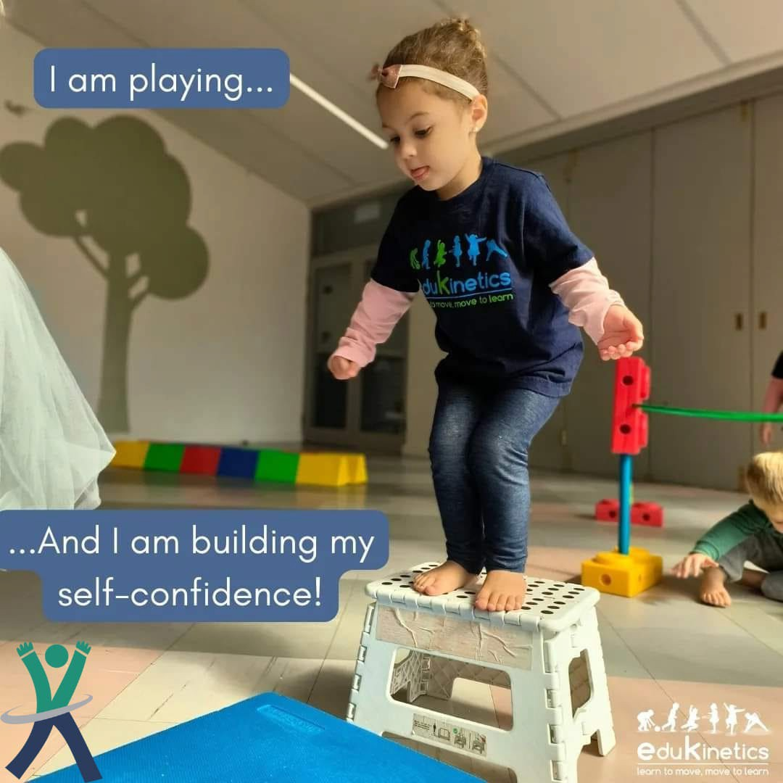
EduPASS LTT – Luxembourg, January 22nd-26th 2024

Slide 9
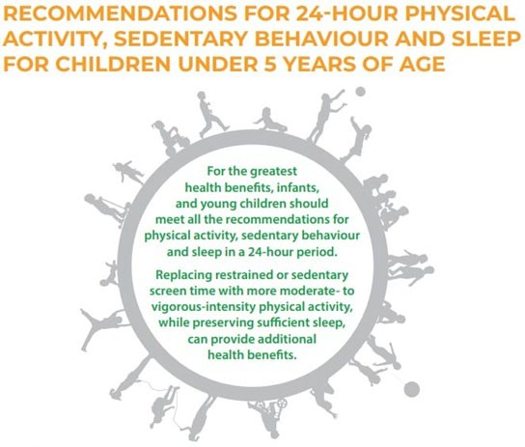
RECOMMENDATIONS FOR PHYSICAL ACTIVITY FOR CHILDREN
Physical activity level
Screen time
Sleep time
EduPASS LTT- Luxembourg, January 22nd-26th 2024

Slide 10
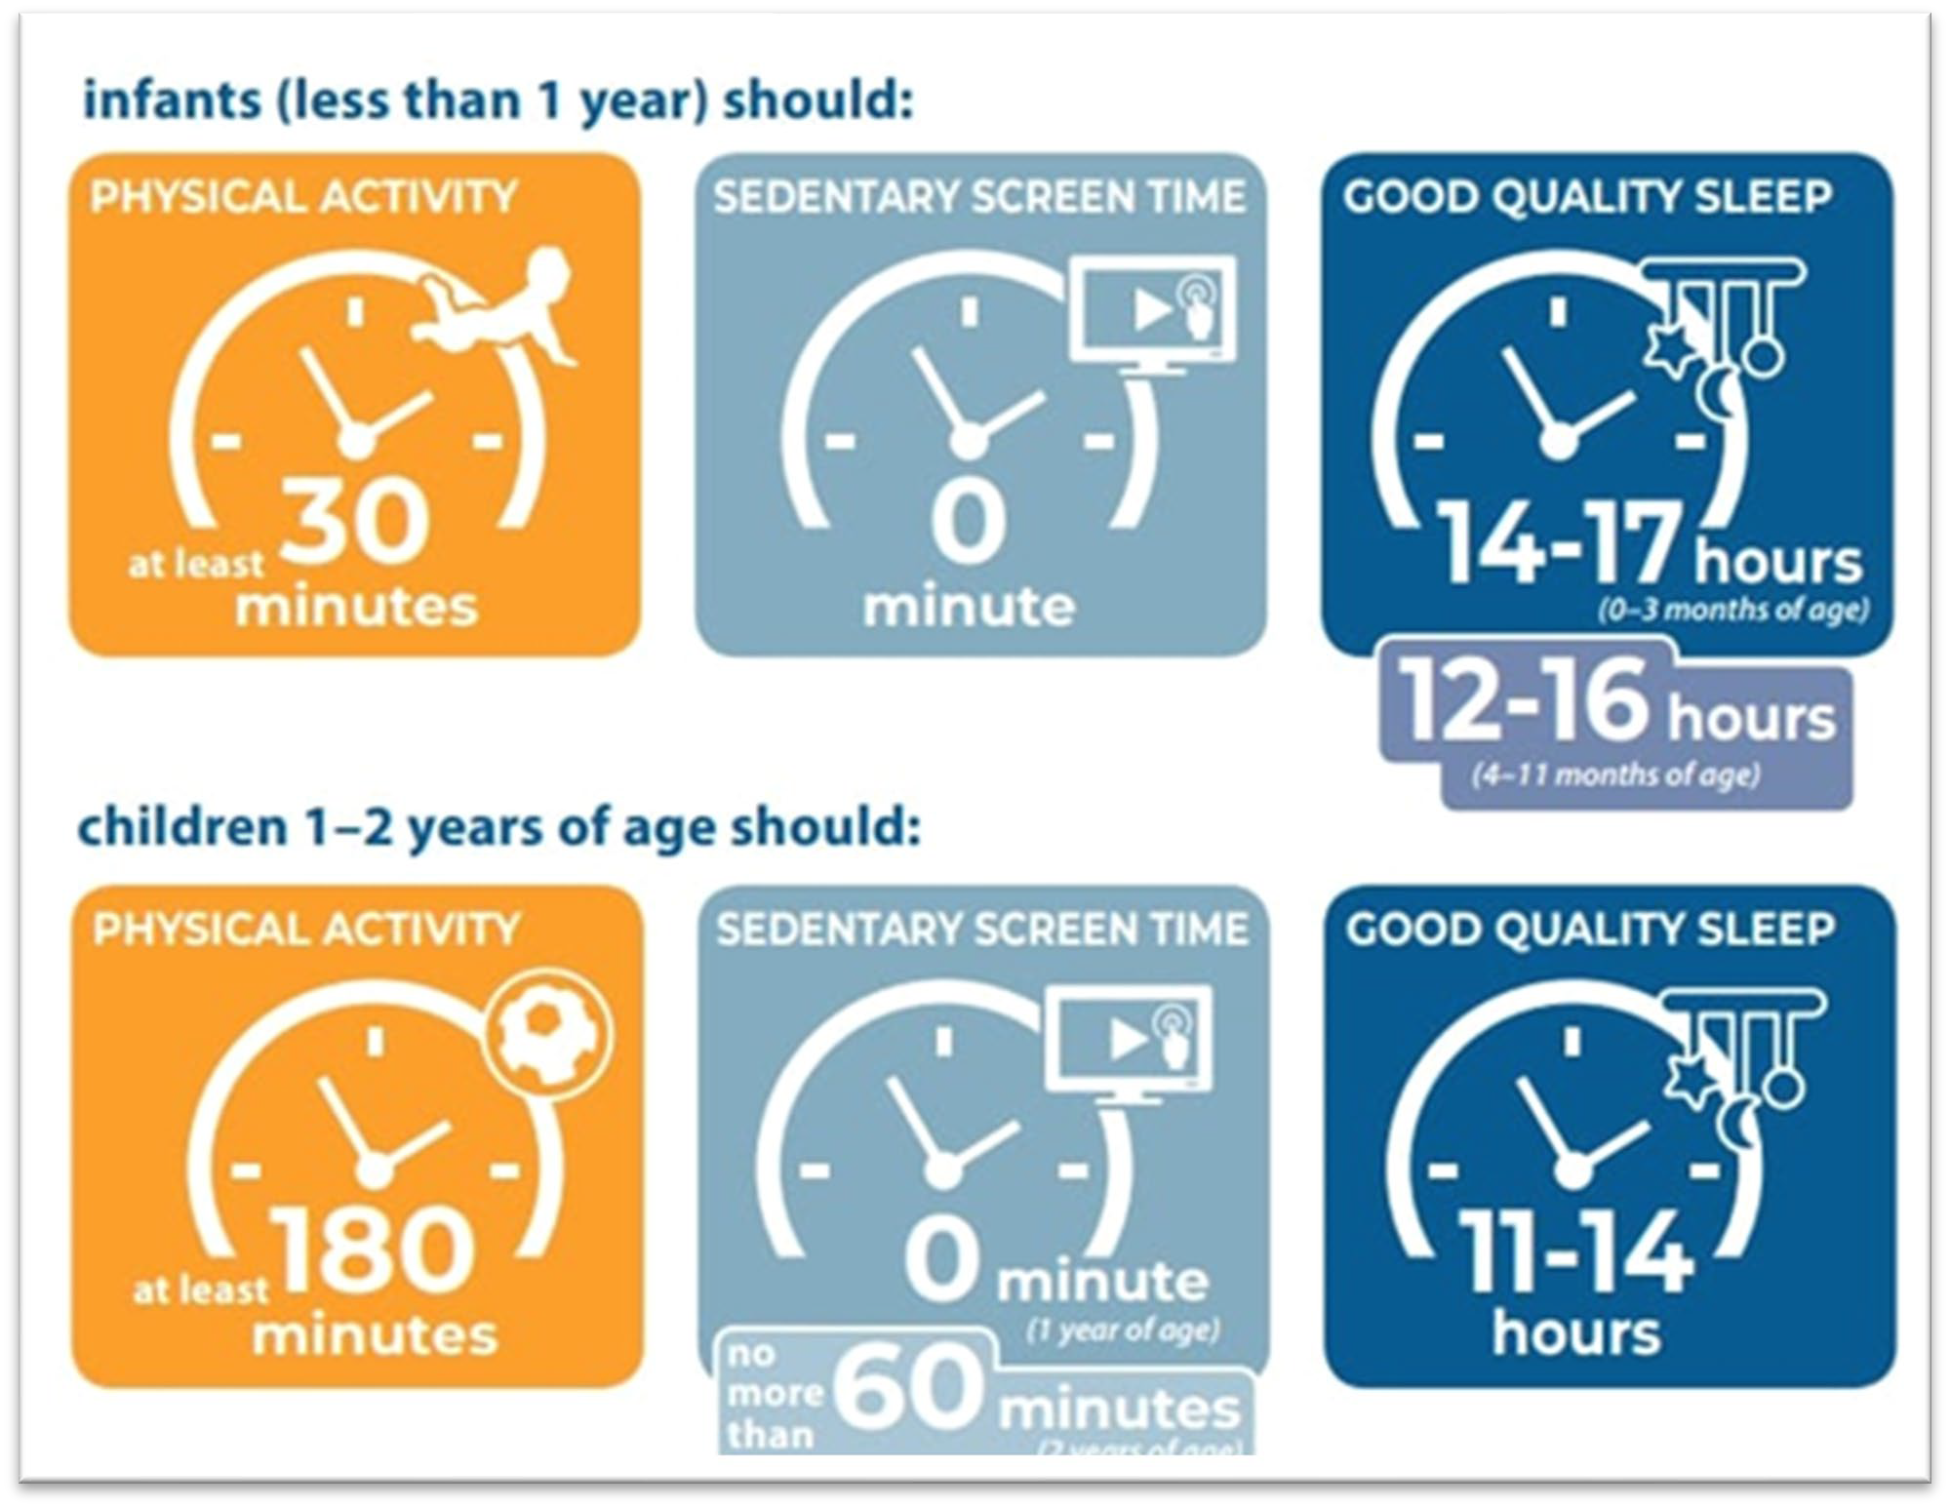
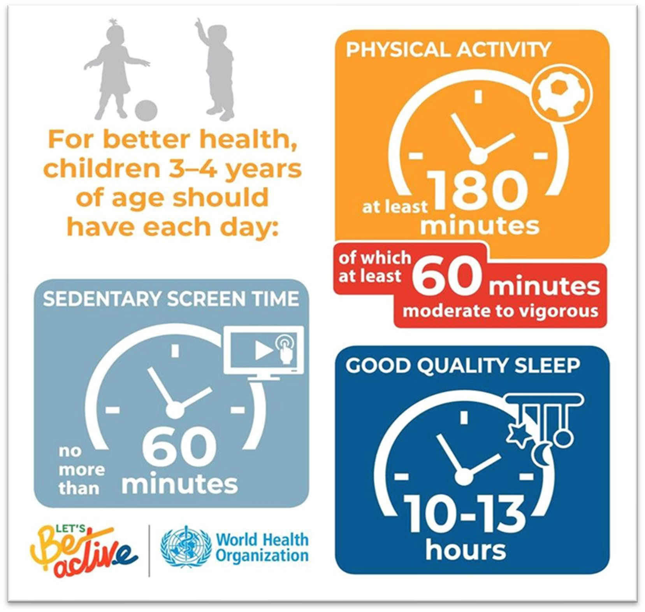
WHO RECOMMENDATIONS FOR PHYSICAL ACTIVITY FOR CHILDREN (0 – 4years)
EduPASS LTT– Luxembourg, January 22nd-26th 2024

Slide 11
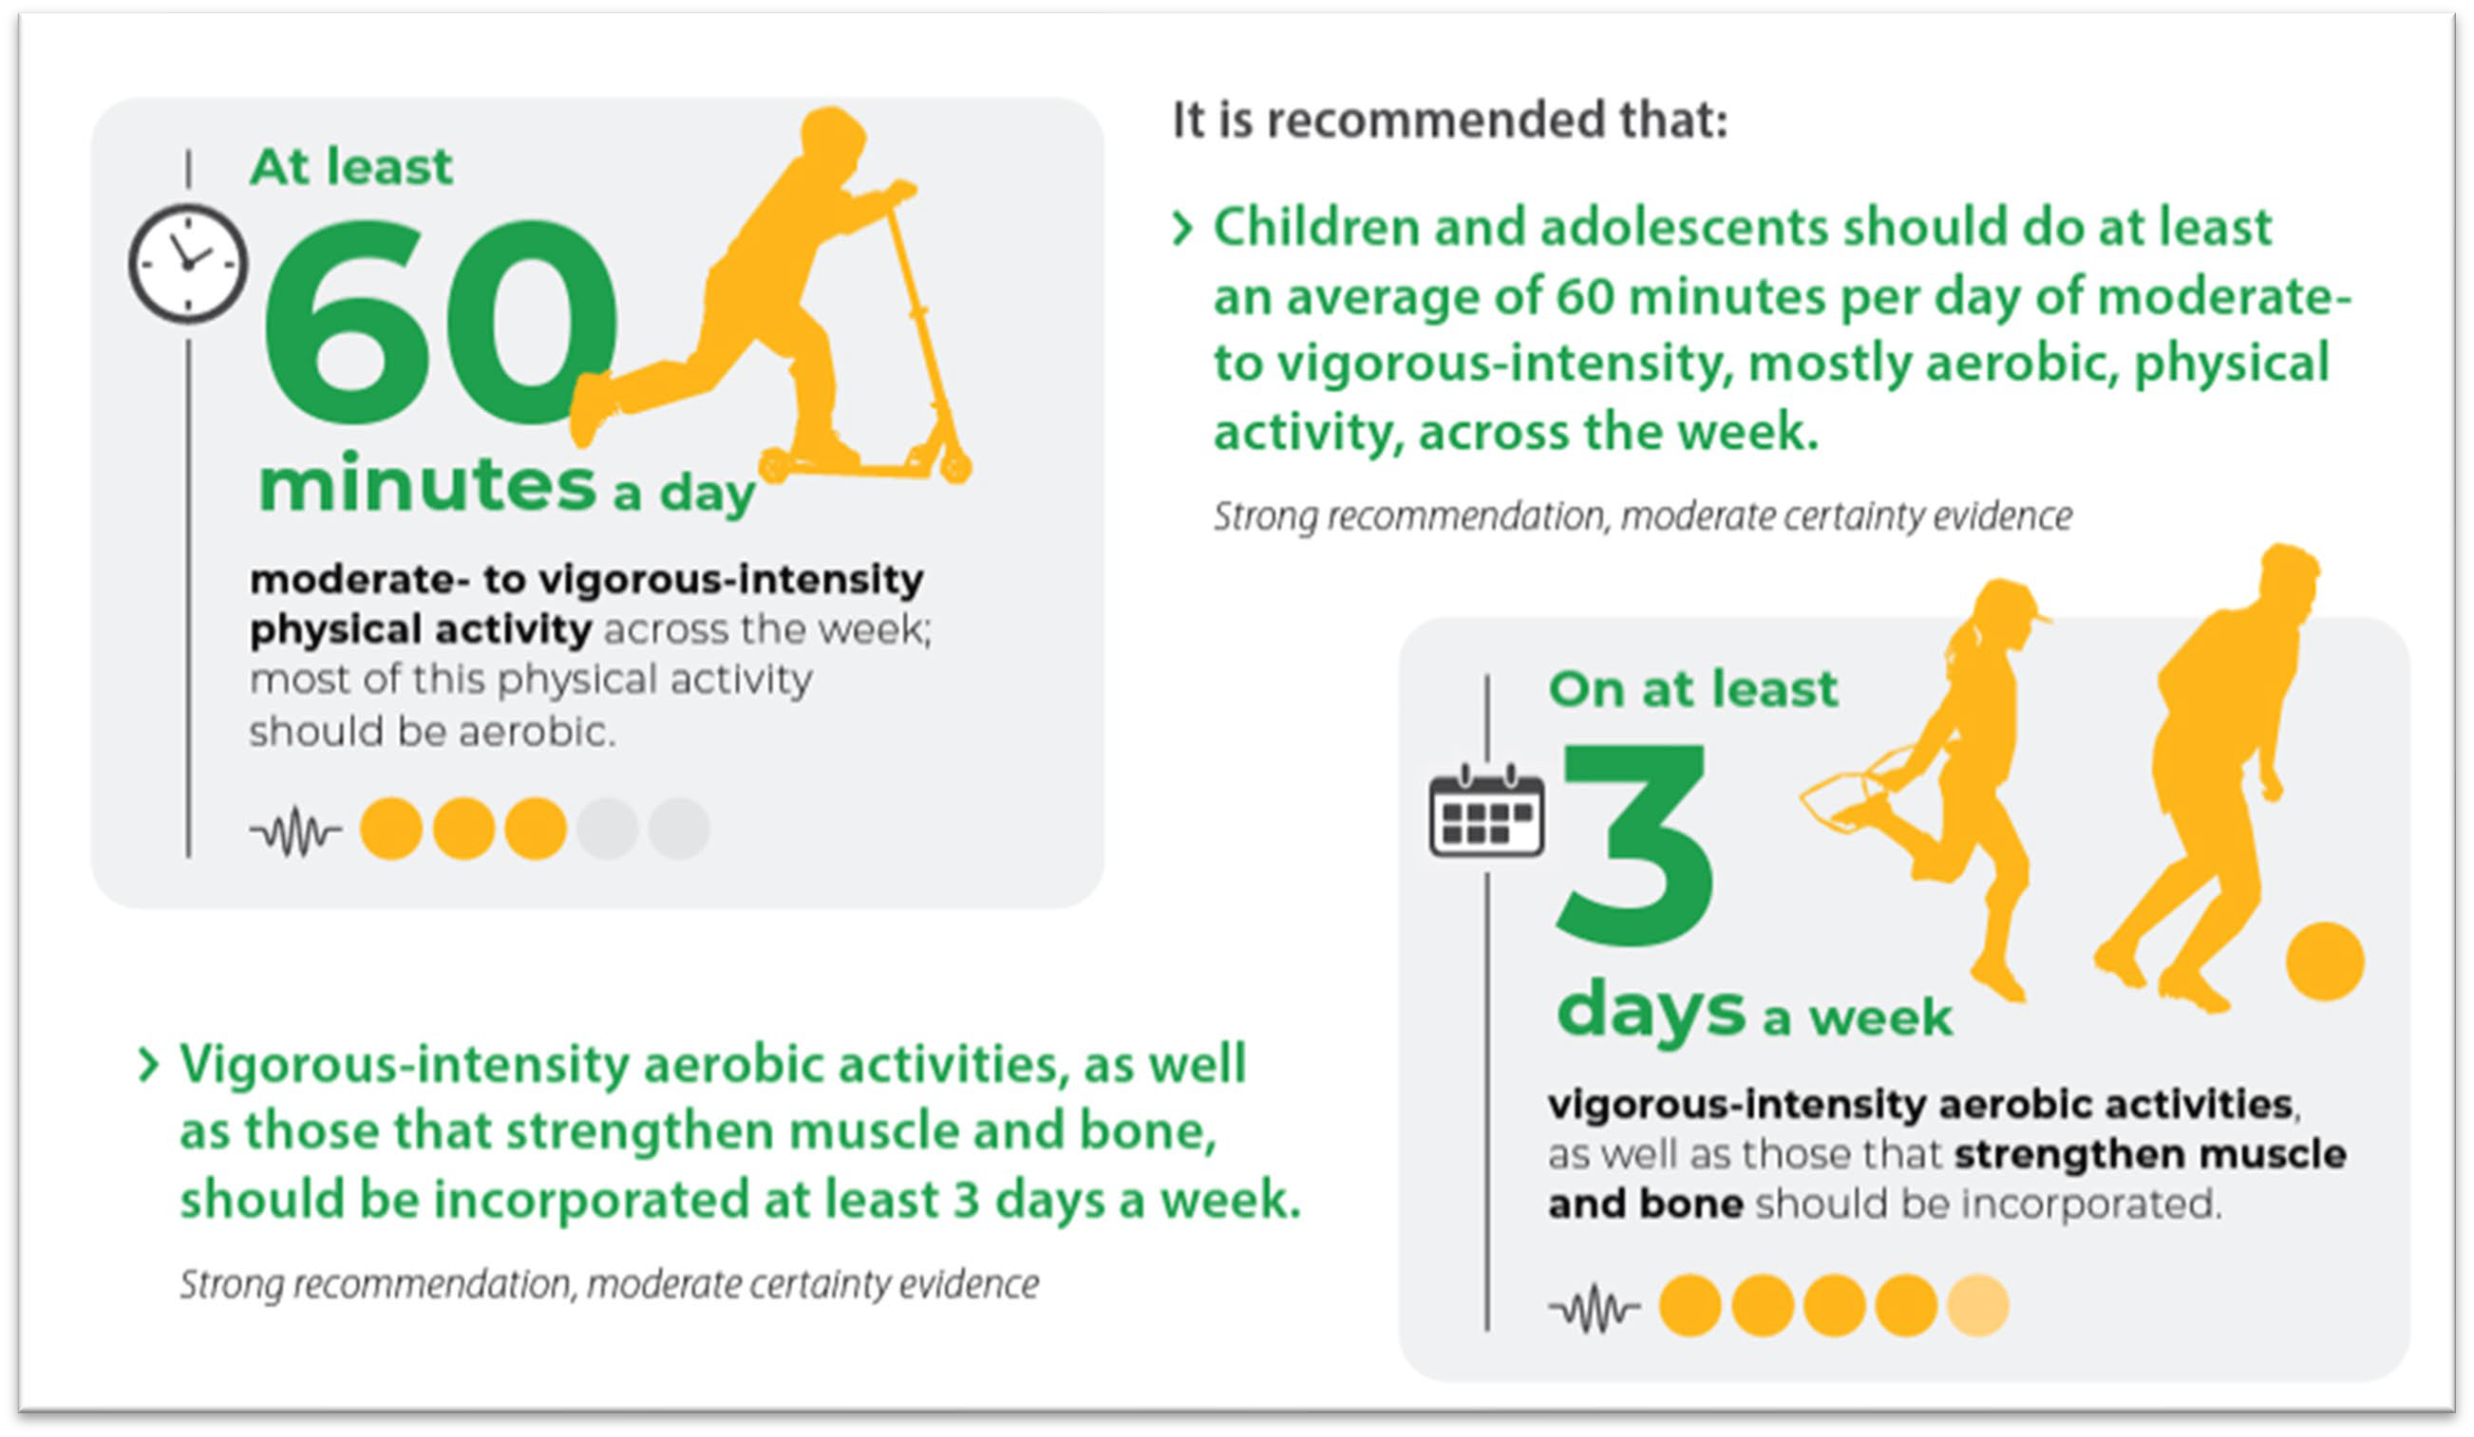
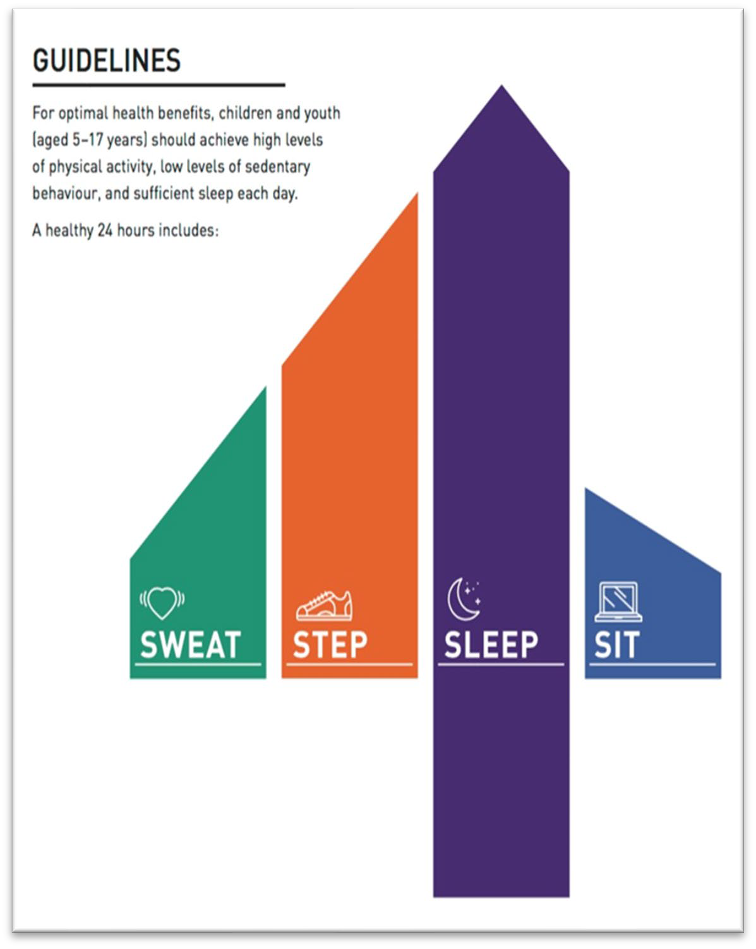
WHO RECOMMENDATIONS FOR PHYSICAL ACTIVITY FOR CHILDREN (>5Y AND ADOLESCENTS)
EduPASS LTT– Luxembourg, January 22nd-26th 2024

Slide 12
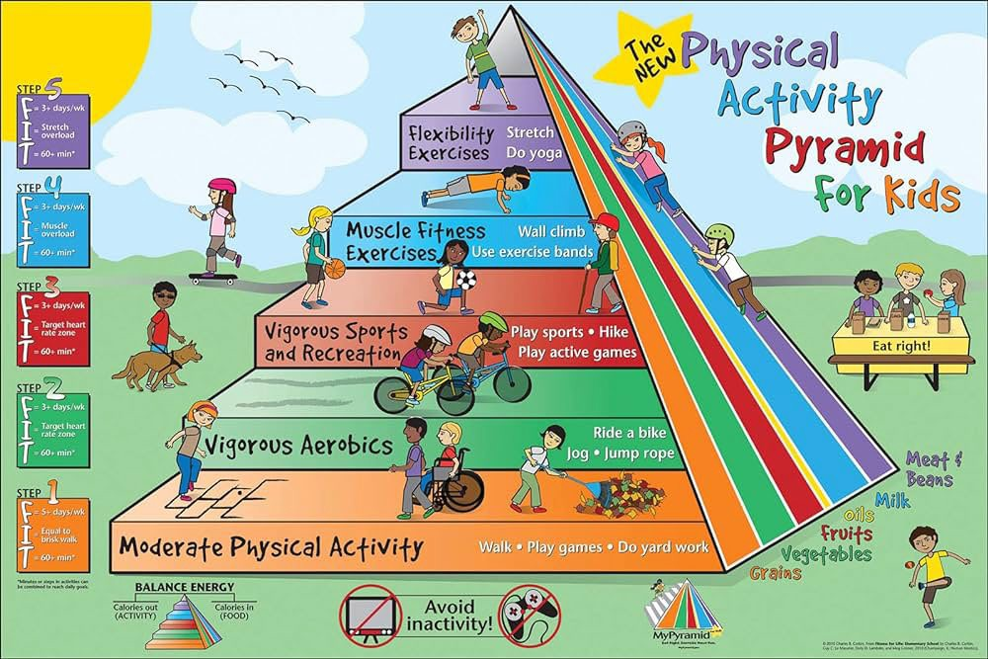
PA pyramid for children

Slide 13
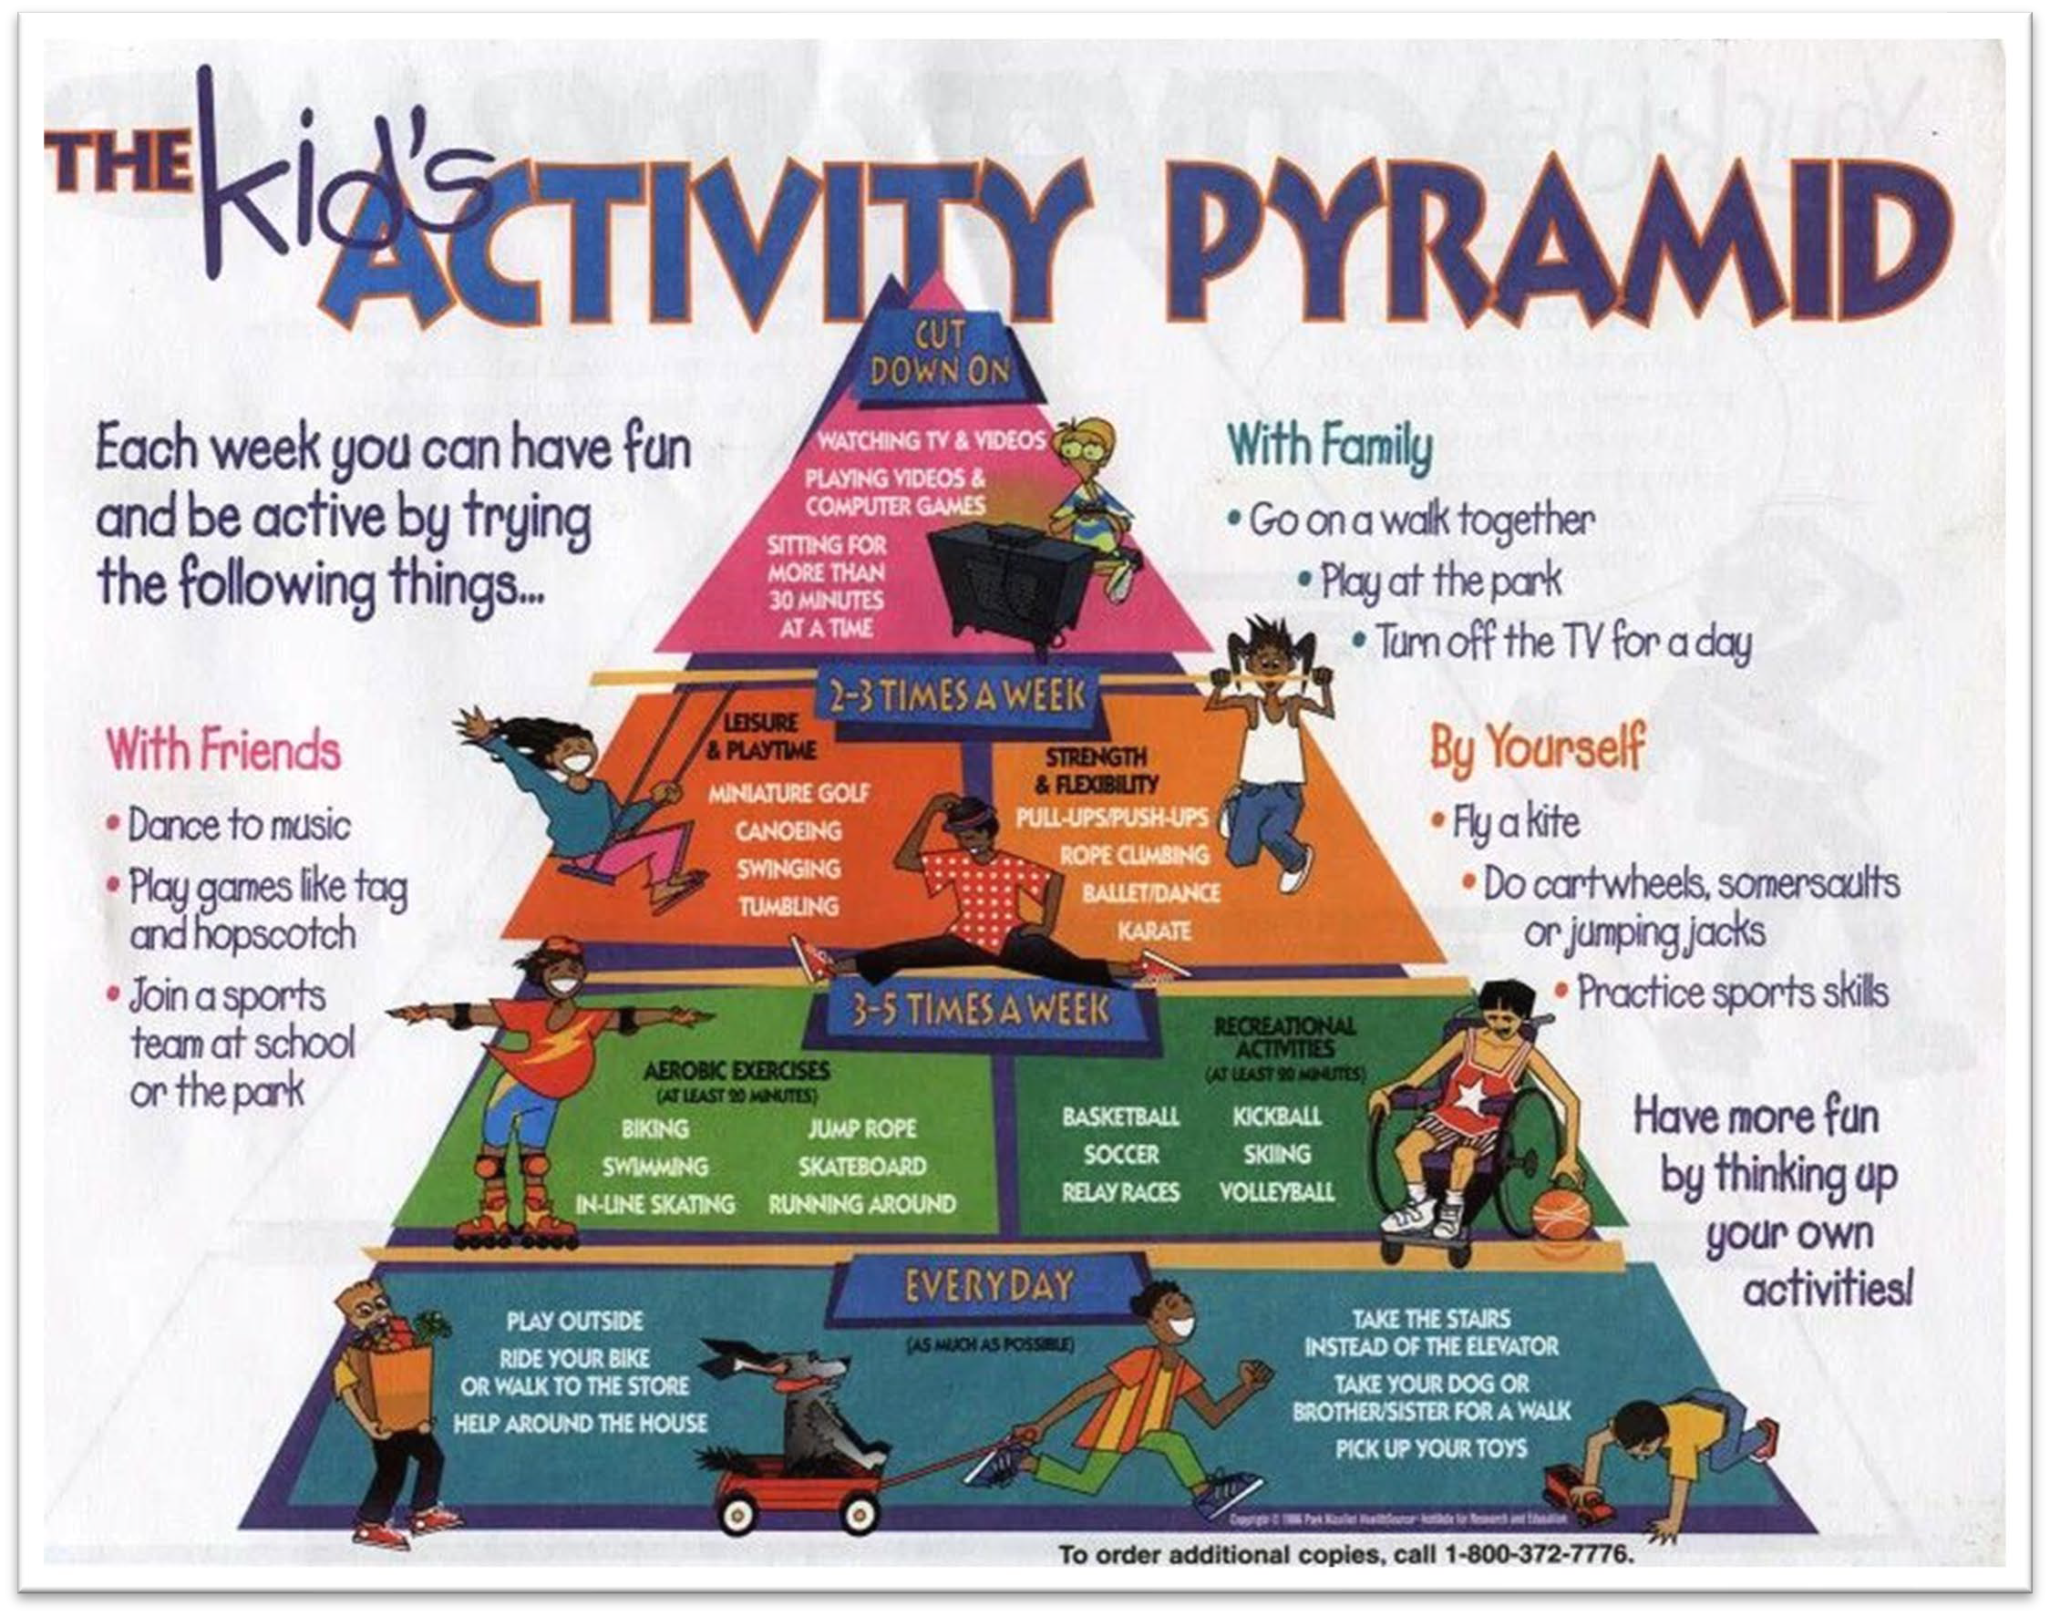
PA pyramid for children

Slide 14
Daily Physical Activity
The 60 Minutes Benchmark – Findings from European Countries
EduPASS TPM#4-5 – Luxembourg January 26th 2024

Slide 15
Overview
Daily PA of European children in relation to the 60 minutes benchmark
The impact of the Covid 19 pandemic on children’s daily PA

Slide 16
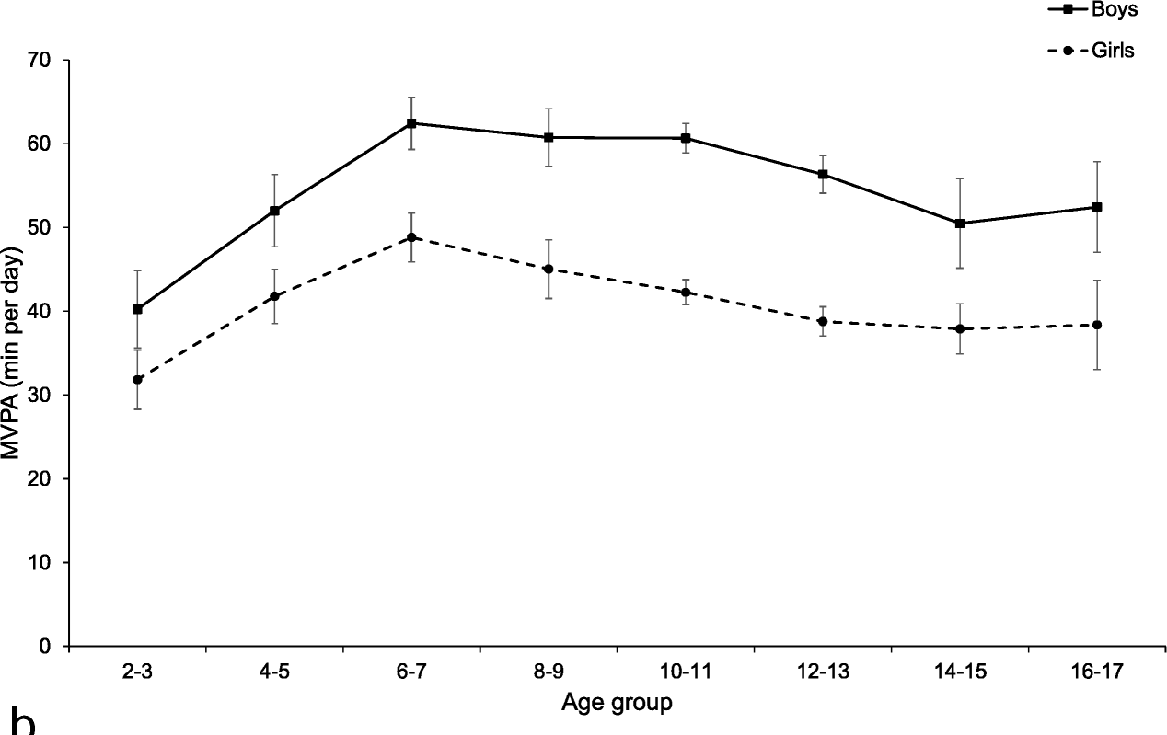
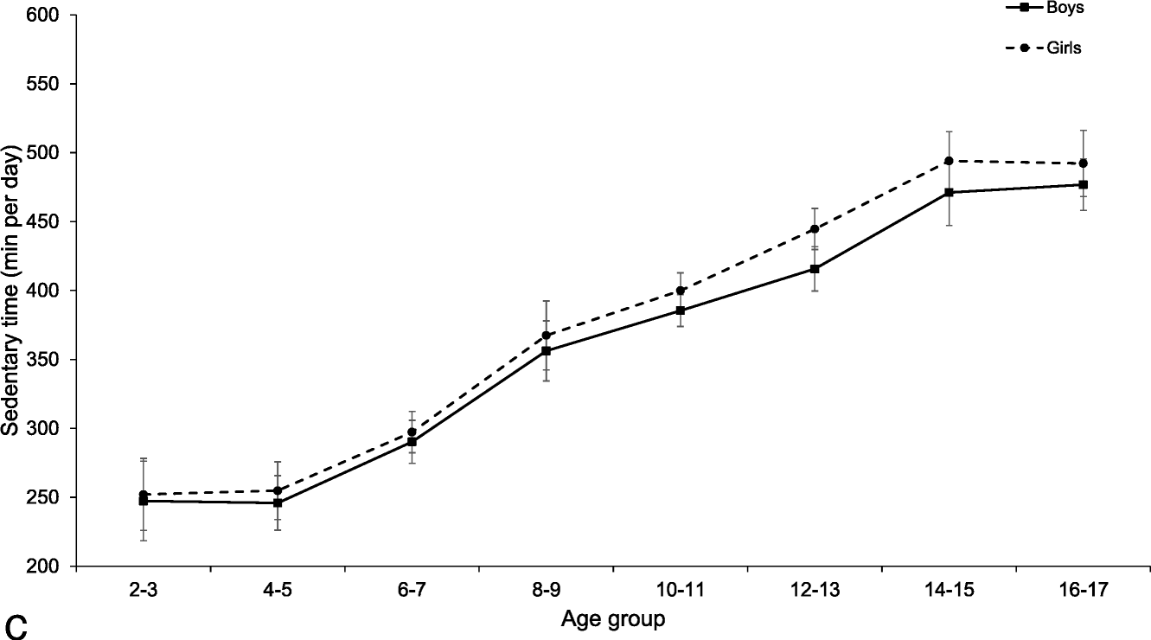
Daily PA of European Children 1
Review of Steene-Johanessen, Hansen, Dalene et al. (2020) Accelerometer data!
60 min. guideline
Fig. 1. Daily moderate to vigorous physical activity by age and sex.
Fig. 2. Daily sedentary time by age and sex.

Slide 17
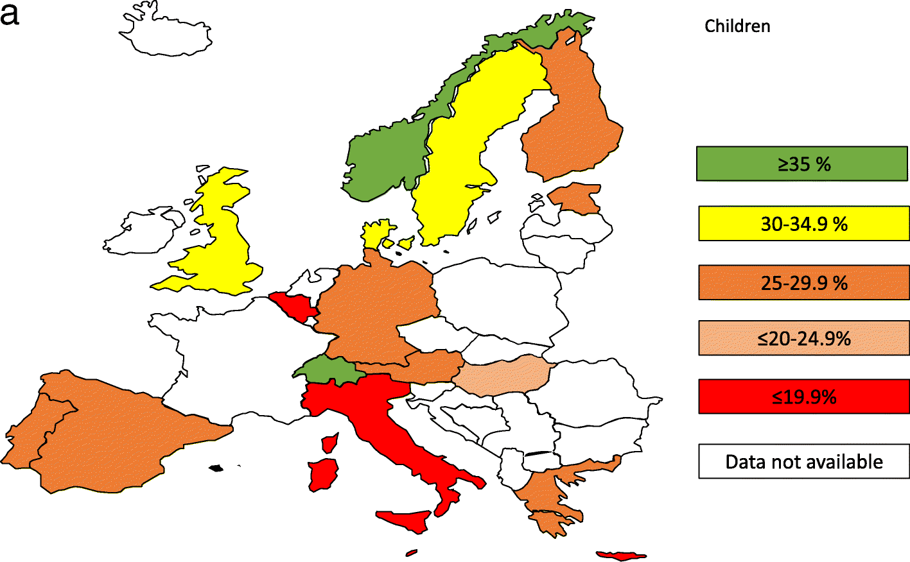
Daily PA of European Children 2
Review of Steene-Johanessen, Hansen, Dalene, et al. (2020) Accelerometer data!
Fig. 3. Prevalence categories of children (2-10 years) achieving the 60 minutes guideline.
Conclusion: "Two third of European children and adolescent are not sufficiently active.“ (p. 38).

Slide 18
Daily PA of European Children 3
Review of Guthold, Stevens, Riley, and Bull (2019) Questionnaire data!
Boys Girls
100
90
80
70
60
50
40
30
20
10
0
Prevalence of insufficient physical activity [%]
Belgium
Czech Republik
Finnland
France
Germany
Greece
Ireland
The Netherlands
Slovenia
Spain
Fig. 4. Prevalence of adolescents not achieving the 60 minutes guideline from 10 European countries (data from Guthold, Stevens, Riley, and Bull, 2019).

Slide 19
Daily PA of European Children 4
Eckelt, Hutmacher, Steffgen, and Bund (2020) Accelerometer and questionnaire data!
90
80
70
60
50
40
30
20
10
0
PA measured by accelerometer
PA measured by questionnaire
90
80
70
60
50
40
30
20
10
0
PA measured by accelerometer
PA measured by questionnaire
Daily moderate to vigorous PA [minutes]
60 min.
60 min.
Overall
Boys
Girls
10-12 years
13-16 years
17-20 years
Fig. 5. Daily moderate to vigorous physical activity by sex.
Fig. 6. Daily moderate to vigorous physical activity by age group.

